Slide 1
What Can We Do to Help People Experiencing Homelessness
SPEAKERS
MODERATOR: Cathy Alderman, Vice President Communications and Public Policy, Colorado Coalition for the Homeless
Kristin Toombs, Director Homeless Initiatives, CO Department of Local Affairs
Chris Connor, Executive Director, Denver’s Road Home
Matt Mollica, Vice President of Housing Placement Services, Colorado Coalition for the Homeless
Ian Kile, Training and Quality Assurance Manager, Volunteers of America
Learn about the spectrum of services available for people experiencing homelessness including emergency options like shelter to long-term housing programs like Rapid Re-Housing. Hear more about what gaps there are in this system in certain communities and how PHAs can access limited resources for those in need.

Slide 2
Kristin Toombs, Director
Office of Homeless Initiatives
Division of Housing
Department of Local Affairs
May 1, 2019

Slide 3
Colorado Division of Housing
Created to improve the access of all Coloradans
to decent, affordable housing
How do we do it?
Funding for operating and rental subsidies
Funding to acquire, rehabilitate and construct affordable housing
Regulatory role as building department
Technical assistance
What have we done?
Funded over 700 PSH PBV units in past 4 years
DOH serves over 35,000 households
Created 3,180 new affordable housing opportunities in past year
Over >80% of vouchers serve people with disabilities

Slide 4
Office of Homeless Initiatives
OHI works with stakeholders to create collaborative approaches to make homelessness rare, brief, and one-time.
Vision: advance solutions that combine affordable housing with accessible services so no one languishes in homelessness.
Mission: work with community partners to create a continuum of efficient and effective solutions that reduce and prevent homelessness and ensure every Coloradan has a safe place to call home.
OHI manages and administers rental assistance programs; creates, funds, and evaluates supportive housing and other homeless solutions; oversees the Fort Lyon Supportive Residential Community; and operates the Office of Homeless Youth Services.
OHI provides technical assistance to implement best practices, including supportive housing, rapid re-housing, housing first, and coordinated referrals and prioritization.

Slide 5
DOH OHI Programs
Rental Assistance Programs:
Continuum of Care (CoC) Supportive Housing
State Housing Vouchers (SHV): Mental Health, Colorado Choice Transitions (CCT), Homeless Solutions Program (HSP)
Housing Choice Vouchers (HCV): Family Unification Program (FUP), VASH
HOPWA (Housing Opportunities for Persons With AIDs)
Project-based for Supportive Housing
Notes:
Our efforts to create more housing.

Slide 6
DOH OHI Programs
Rapid Re-Housing (RRH), Prevention, and Other Programs:
RRH: COR3, Next Step, ESG (Emergency Solutions Grant), Youth
Prevention: HPAP (Homeless Prevention Activities Program), ESG
Shelter, Outreach: ESG
Ft. Lyon Supportive Residential Community
Tenancy Support Services
Host Homes
Capacity Building:
Office of Homeless Youth Services
HMIS (Homeless Management Information System)
Supportive Housing Toolkit & Technical Assistance
Data Sharing Advancements
Notes:
Our efforts to create more housing.

Slide 7
Tenancy Support Services
What are they?
Housing-related activities and services that support a person’s ability to prepare for and transition to housing, and support the person in being a successful tenant in the housing arrangement and thus able to sustain tenancy.
Examples:
Housing Navigation & Counseling
Independent Living Skills
Landlord & Tenant Liaison
Links to Treatment & Care
Links to Vocational & Educational services
Tenant Responsibilities & Rights
Eviction Prevention

Slide 8
Supportive Services Funds in CO
No single sources fully funds services across the continuum of programs.
Medicaid: ex - RAEs programs and contractors
Continuum of Care
Veterans Affairs: case management funded with housing programs (VASH, GPD)
Emergency Solutions Grant
Private Funds
Developer Fees
Cash Flow
Hospitals
Local Gov’t
Child Welfare
Dept. of Education
Justice System: Re-entry, Parole, Probation, OBH programs
Office of Behavioral Health: Newly dedicated SAMSHA funds – RFA TBA!
State Housing Vouchers MH and CCT: Medicaid and OBH services funds
Homeless Programs Solutions: Rapid Re-housing; Housing Navigation; Youth Housing and Justice Involved new RFAs with partial services funding
Aim: Continue to increase resources for tenancy supports directly linked to housing resources.

Slide 9
For more information: https://www.colorado.gov/pacific/dola/division-housing kristin.toombs@state.co.us 303.864.7828

Slide 10
Denver’s Road Home
Chris Connor, Exec

Slide 11
Homelessness in Denver—Point in Time
Notes:
Between 2016 and 2018 the Denver County Point in Time reports:
35.6% increase in unsheltered homelessness (449 to 609)
10.9% decrease in shelter/transitional housing (3182 to 2836)
Still, unsheltered remains a smaller segment of the total homeless population. 15.4% of people identified across the three years reported being unsheltered.

Slide 12
Homelessness in Denver—Permanent Exits
Notes:
Between 2016 and 2018 Denver’s Road Home partners achieved a 33.8% increase in permanent outcomes to housing and reunification.
These are not all “Permanent Supportive Housing” outcomes, but reflect “permanent” exits from homelessness
Largely cultivated through Diversion and Rapid Rehousing
Expressed as proportion of PIT count of all homeless, we’ve moved the needle positively 13.4 percentage points (32.7% to 46.1%) between 2016 and 2018.

Slide 14
New Homeless Response System with Residential Shelter

Slide 15
Effective first engagements
A Rapid Resolution Pilot Program (also known as shelter diversion) in the city’s shelters is connecting first-time shelter guests to a permanent housing solution.
In the pilot’s first year, 255 individuals and families were served, 70 percent of whom successfully stabilized their housing crisis. More than 124 individuals and families returned to permanent housing.
Notes:
Rapid Resolution– Meet people arriving to crisis system for the first time to identify opportunities to resolve needs immediately before they become anonymous to the shelter system.

Slide 16
Coordination with Housing Authority Staff
Denver’s Road Home has appreciated sharing one staff member with the Denver Housing Authority.
The Denver’s Road Home Housing Manager helps align local preference systems and housing developments to homelessness strategies.

Slide 17
Looking forward: Dept. of Housing and Homelessness
With City funds opened to development and preservation of Affordable Housing deeper alignment and coordination is needed. Comprehensive Strategic Planning on homelessness requires integration of Housing Plans with Strategic Plans on shelter, outreach, and other front end systems.
City of Denver will introduce a new Department of Housing and Homelessness this year bringing Denver’s Road Home (currently in Human Services) alongside Division of Housing (currently in Econ. Development)
Notes:
When you’re working together on different islands there is a lot of rowing of boats.

Slide 18
Affordable and Supportive Housing for People Experiencing Homelessness Colorado Coalition for the Homeless
Presentation to CO NAHRO
Matt Mollica
June 28, 2018

Slide 19
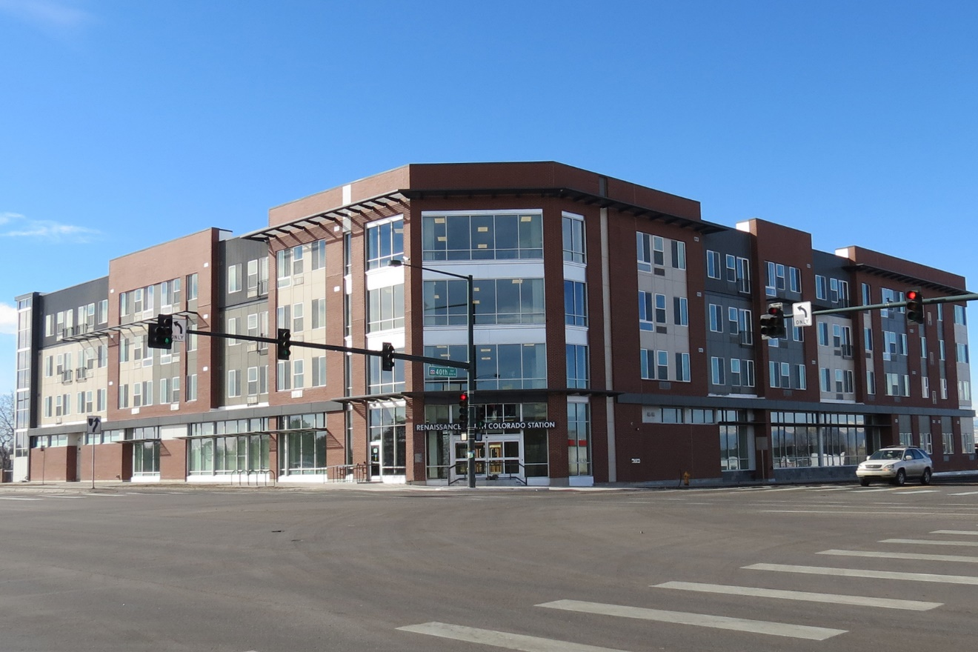
Affordable Housing Including Permanent Supportive Housing
18 properties
4,123 households
1,700 housing vouchers
Combines low-barrier affordable housing, health care, and supportive services for individuals and families
Notes:
Permanent Supportive Housing (PSH)
model that combines low-barrier affordable housing, health care, and supportive services to help individuals and families lead more stable lives.
Housing First Model(HUD):
quickly and successfully connect individuals and families experiencing homelessness to permanent housing without preconditions and barriers to entry, such as sobriety, treatment or service participation requirements. Supportive services are offered to maximize housing stability and prevent returns to homelessness as opposed to addressing predetermined treatment goals prior to permanent housing entry

Slide 20
CCH Housing Assistance Services
Housing Counselor
Housing Navigator
Conducts housing orientations/briefings
Reviews program regulations and expectations
Matches housing stock with tenant preferences
Collaborates with supportive service programs to ensure care coordination for tenant
Conducts annual/biannual HQS inspections
Liaison between landlord, tenant, and supportive service team
Recruits landlords in community to work with CCH housing programs
Educates community landlords regarding service provision and program expectations for both tenant and landlord
Maintains CCH’s waitlists for housing programs
Educates tenants on fair housing rights and tenant responsibilities in unit
Single point of contact for CCH owned units through Renaissance Property Management Corporation (RPMC)

Slide 21
Levels of Care within CCH
Intervention | Description of Services | Subsidy Type
Assertive Community Treatment (ACT) | This level of care refers to services provided to clients capable to living in the community either in support or independent settings, but whose treatment needs require intensive management by a multi disciplinary team. Services, which would be included in this level of care have traditionally been described as partial hospital programs and as assertive community treatment programs. | TBRA and PBRA
High Intensity Treatment Team (HITT) | A team-based approach to the provision of treatment, rehabilitation, recovery, and support services. Therapeutic interventions are strengths-based and focus on promoting symptoms stability, increasing the client's ability to cope and relate to others and enhancing the highest level of functioning in the community. | TBRA and PBRA
Supportive Housing (SHP) | Provides in unit case management and behavioral health services. Clients are independent enough to meet medical needs on their own with some transportation help. Higher case load levels than ACT or HITT teams. | TBRA and PBRA
Housing Case Management | This level of care provides treatment to clients who need ongoing treatment, but who are living either independently or with minimal support in the community, Treatment and service needs do not require intense supervision or very frequent contact. | TBRA and PBRA
Rental Assistance Only | Voucher maintenance and housing counseling services only | TBRA and PBRA

Slide 22
So How Much Does It Cost?
Intervention | Staff/Tenant Ratios | Approx. Annual Cost per Tenant
ACT Services | 1:10 | $17,000
HITT Services | 1:15 | $13,000
Supportive Housing | 1:25 | $8,500
Housing Case Management | 1:75 | $1,352
Rental Assistance Only | 1:130 | $406
*Does not include Rental Assistance, Utility Costs, or Security Deposits

Slide 23
CCH Partnering with PHAs
Denver Housing Authority
Colorado Division of Housing
Denver Social Impact Bond
Lowry PSH Project (FSS)
Blue Spruce Townhomes (FSS)
CCH Residential Services Dept SHP Programs
Uptown Lofts
Riverfront Lofts
Stout Street Lofts
Denver Social Impact Bond
Both TBRA and PBRA
Recovery Housing at North Colorado Station
State Housing Vouchers
PSH Bonus/Youth Bonus/Metro 1 (CoC funds)
CCH Residential Services and FSS Depts SHP Programs
Uptown Lofts
Stout Street Lofts
West End Flats

Slide 24
Rapid Rehousing
An effective approach to permanent housing.

Slide 25
Rapid Rehousing Overview
A time-limited, service-intensive housing intervention that provides case management and temporary financial assistance to secure and/or maintain permanent, stable housing.

Slide 26
Case management
Housing First
Individualized Service Plans
Participant-Driven
Landlord Engagement and Support
Community Education

Slide 27
Case management, continued…
Progressive Engagement
Employment
Legal Assistance
Public Benefits
Access to physical healthcare
Access to mental healthcare

Slide 28
Temporary Financial Assistance
Progressive Engagement
Security Deposit
Rental Assistance
Utility Assistance
Transportation
General Housing Stability

Slide 29
The Flexibility of Rapid Rehousing
Adaptable to meet higher-need populations
Nationally recognized standards
Increased financial assistance
Extended lengths of stay
Focus on employment and public benefits
Integration of behavioral healthcare

Slide 30
Benefits
Low Barrier to Entry
Rapid Placement
55% w/in 45 days
78% w/in 90 days
Higher Retention
12% higher than conditional housing
Cost Effective
Adaptable
Community Focused

Slide 31
Challenges
Fidelity to Standards
Housing Market
Landlord Partnerships
Local Resources
Part of a Spectrum of Interventions
Community Reliant

Slide 32
Resources
National Alliance to End Homelessness
endhomelessness.org
United States Interagency Council on Homelessness
www.usich.gov
Urban Institute
www.urban.org
U.S. Department of Veteran Affairs - SSVF
www.va.gov/homeless/ssvf/

