Slide 1
Pathways Home Colorado
Dedicated to the hope that future generations will not experience homelessness
Effective policies Engaged political leadership
Prioritized resources Collaborative partnerships

Slide 2
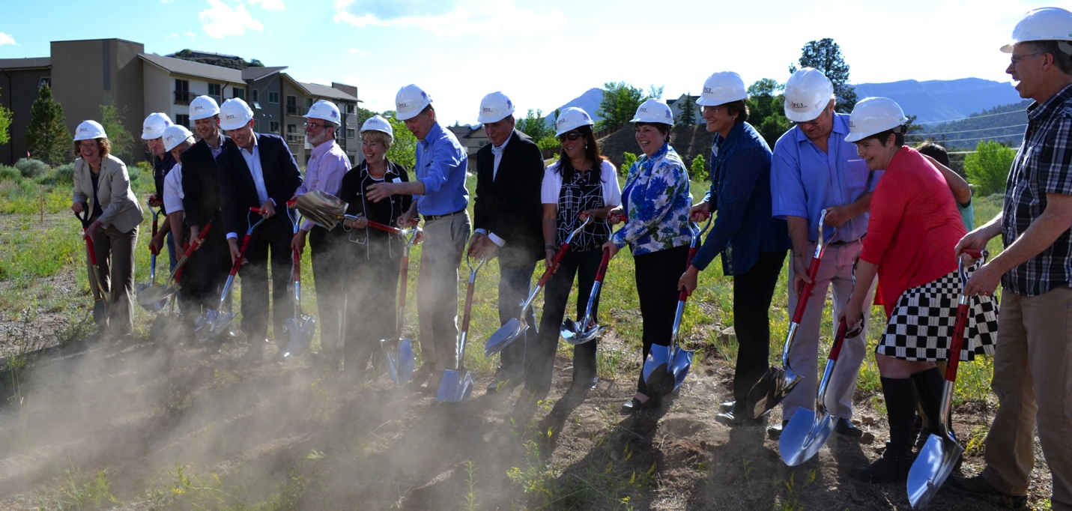
Interagency Collaboration is best practice and can take our efforts to scale
Expanded positions in Governor’s Office made possible through generous funding from local foundation community.
Statewide approach
Works across state agencies to implement outcome-based policies and programs that prevent and end homelessness in Colorado.
Directs Pathways Home implementation

Slide 3
Homelessness in the Centennial State
HUD’s annual Point-In-Time survey provides a snapshot of the number of persons experiencing homelessness in Colorado. In January of 2014 Colorado counted 10,028 homeless persons.
Notes:
Source: www.hudexchange.info/resource/reportmanagement/published/CoC_PopSub_State_CO_2014.pdf
Every year at the end of January volunteers from across the country survey individuals, families, and unaccompanied youth staying in emergency shelters, transitional housing projects and those who are considered ‘unsheltered.’
January 26 – 27, 2014 Colorado counted 10,028 total homeless persons.
We know this is an undercount. A number of different factors from weather to volunteer turnout can affect this snapshot. However, it does provide valuable information on shifting demographics.

Slide 4
181 Colorado School Districts reported 23,293 Homeless Youth 2012 – 2013
Notes:
Source: https://fusiontables.googleusercontent.com/fusiontables/embedviz?viz=CARD&q=select+*+from+11RU4FaUNUFpmhN8oU-LuXWW_oCaJHqc7BhHDECTP+order+by+col1+asc&tmplt=3&cpr=3

Slide 5
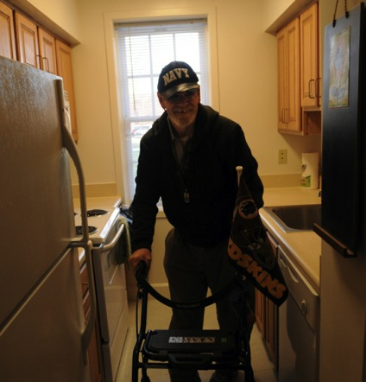
Introduction to Supportive Housing
Supportive Housing - A more humane solution to ending homelessness for families and individuals struggling with addiction, mental health and/or other disabilities who lack the social support, resources or ability to sustain and maintain housing without supportive services and subsidized housing.
Notes:
Zoe

Slide 6
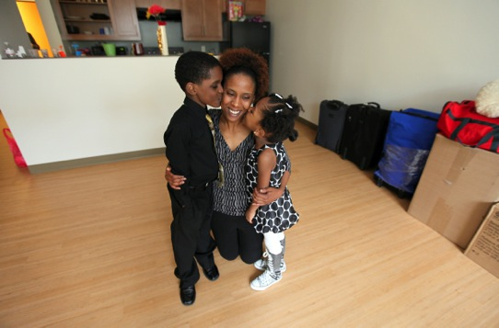
Combining affordable housing with access to support services like case management, employment training, and mental health treatment, supportive housing is a nationally recognized best practice which gives vulnerable individuals and families the opportunity to live stable, autonomous, and dignified lives.
Notes:
Zoe

Slide 7
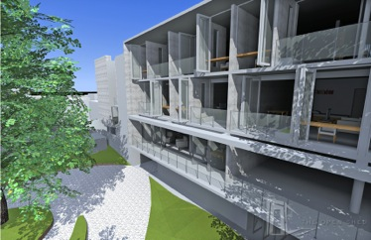
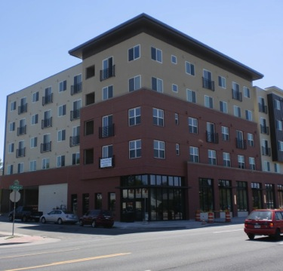
Housing
Permanent: Not time limited; not transitional
Affordable: Tenants pay no more than 30% of their income for rent
Independent as possible: Resident holds lease with normal rights and responsibilities
Notes:
Zoe

Slide 8
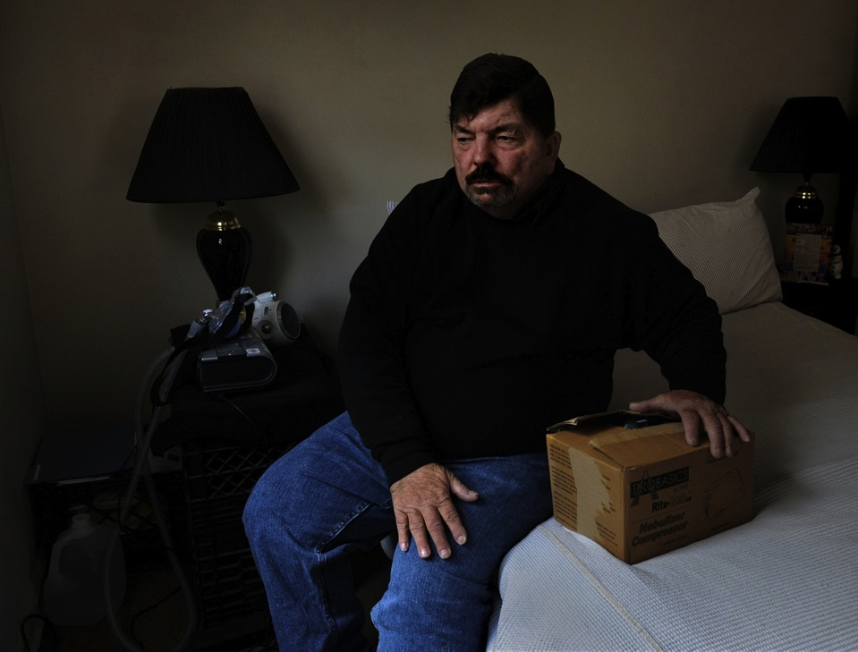
Services
Targeted: Based on populations served
Flexible: Responsive to residents’ needs
Voluntary: Participation is not a condition of residency
Independent: Focus is on housing stability
Notes:
Zoe
Goal is to keep people Housed and maintain the therapeutic relationship between the service provider and client

Slide 9
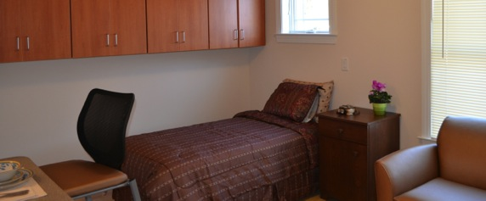
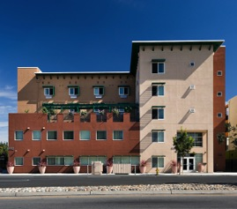
Populations Served
Families
Unaccompanied adults (singles)
Reintegrating from corrections
Veterans
Dual Diagnosed
Mentally Ill
Youth/Young adults aging out of foster care
Chronically Addicted
Chronically medically vulnerable or fragile
Notes:
Zoe
-domestic violence survivors

Slide 10
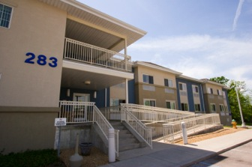
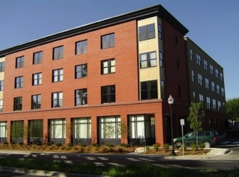
Types of Supportive Housing
Single site: buildings developed / rehabilitated
Scattered Site: rent-subsidized apartments
Mixed-income buildings
Master-leased buildings or units
Notes:
Zoe

Slide 11
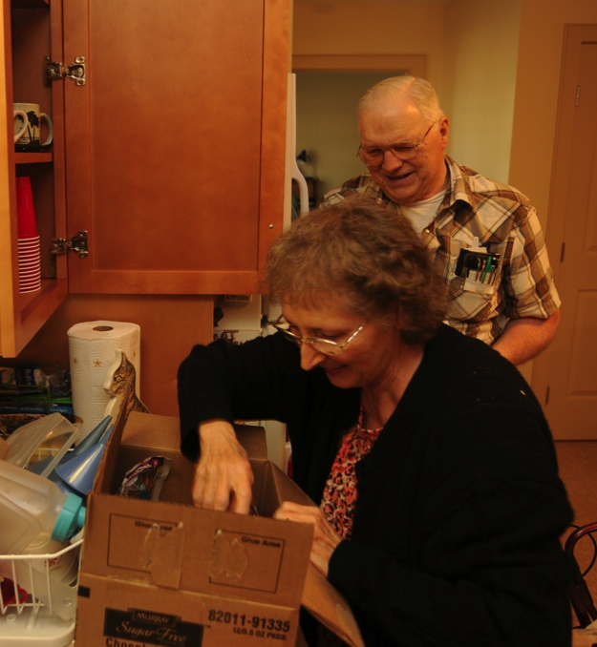
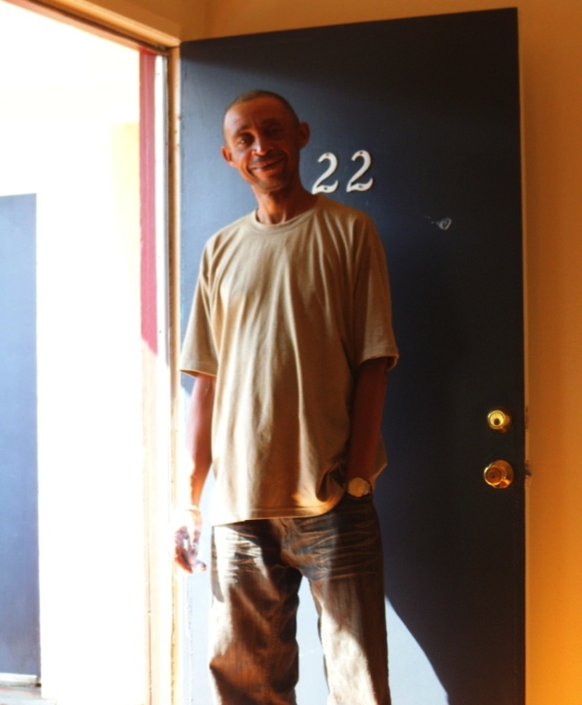
State Strategies
Increase Permanent Supportive Housing (PSH) Statewide
Change PSH housing funding process at CHFA and the Division of Housing
Increase capacity through Pathways Permanent Supportive Housing Toolkit Process
Complete a Medicaid Crosswalk to increase access to Medicaid for PSH services
Increase state funded vouchers

Slide 12
Financing Supportive Housing
Traditional Affordable Housing
Supportive Housing
Capital
Operating
Capital
Operating
Services
The most difficult and →
least stable to finance as
residents have complex needs
Notes:
Jenn
Single Purpose: 100% of units for tenants who have special needs or are formerly homeless, at or below about 30% AMI with coordinated supportive services.
Integrated Housing: A mix of supportive housing units with affordable or market rate units in one development.
Affordable Housing: 100% of units for tenants typically at or below 60% AMI and no coordinated supportive services.
In affordable housing often a resident service coordinator providers some referral or general services.

Slide 13
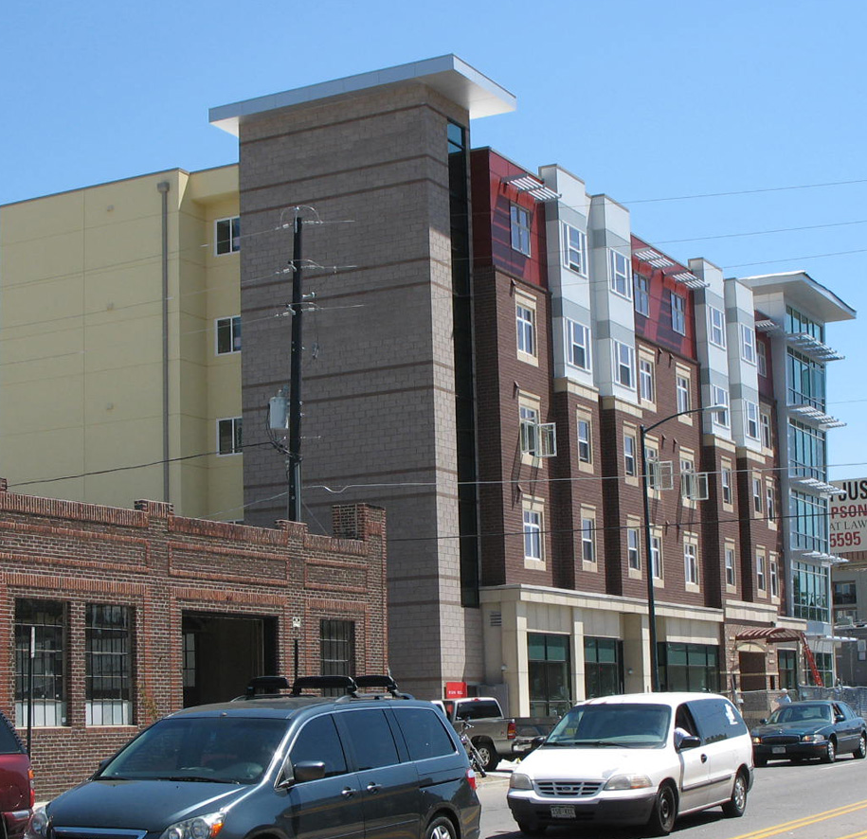
Affordable Care Act: An Opportunity
Expansion states now include homeless single adults
5% of Medicaid beneficiaries account for 50% of program costs
Additional resources in ACA provided to find new approaches to cost containment
Time is now as federal government pays majority over the next few years

Slide 14
State of Colorado and ACA
We know we are not utilizing Medicaid dollars in the most cost effective way with our most vulnerable populations
Bringing in expertise to understand our state specific Medicaid and BHO systems are critical to addressing homelessness

Slide 15
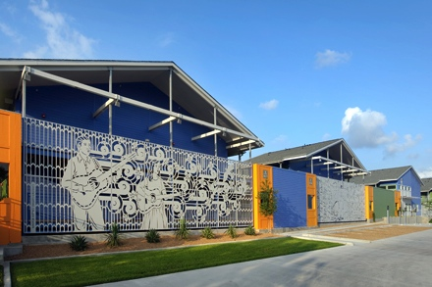
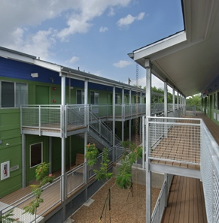
CSH advances solutions that use housing as a platform for services to improve the lives of the most vulnerable, maximizing public resources and building healthy communities.
Notes:
Peggy
CSH - A national non-profit intermediary with teams that are focused on specific states as well as those that are focused nationally. Our national Government affairs and innovations team works to identify and test tools like social impact financing that help communities working to meet the housing needs of their most vulnerable citizens.
CSH has:
Project-specific Financing and expertise to help create supportive housing.
Capacity Building to strengthen and expand the supportive housing industry.
Public Policy Reform to build an efficient system for producing and financing supportive housing.

Slide 16
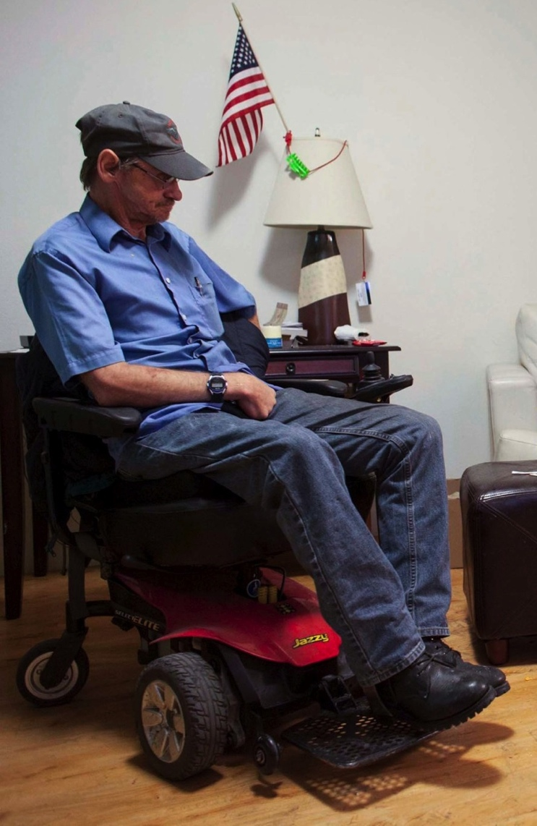
For this population the lack of housing itself dictates health outcomes
Denver study found 50% of tenants improved health status and 43% had improved Mental Health
Seattle study found 30% reduction in alcohol use among chronic alcohol users in Supportive Housing
Chicago study found 55% survival rate for people living with aids in supportive housing compared with 35% of control group, and lower viral loads among housed group
Notes:
Jenn

Slide 17
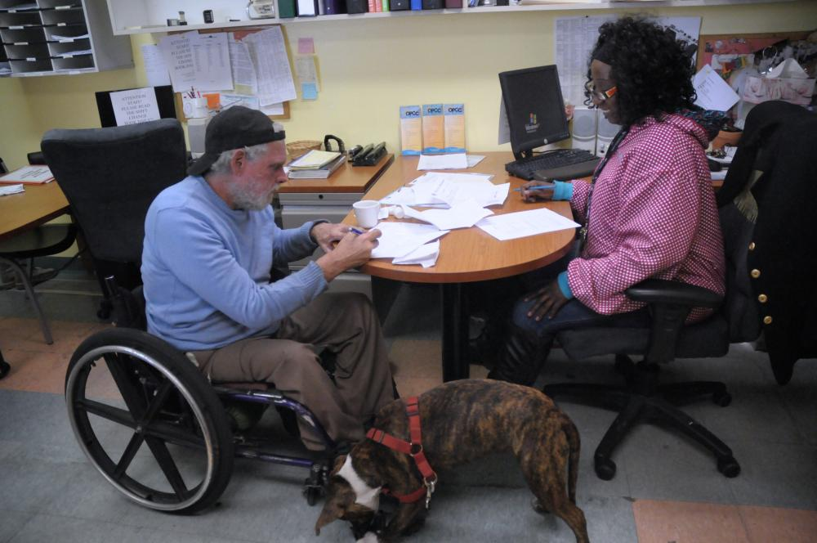
CSH’s Frequent Users of Health Systems Initiative found that prior to housing residents of supportive housing had ER and hospital inpatient costs over $58,000. Two years after housing, residents incurred only $19,000.
ACCESSING MEDICAID FOR SERVICES ATTACHED TO HOUSING ALSO SAVES COSTS
Chicago, IL:
PSH saved almost $25,000
Portland, ME:
Medicaid costs were reduced by almost $6,000
* All $$ amounts are per person, per year
Notes:
Peggy

Slide 18
Colorado’s Medicaid Crosswalk
What is a crosswalk?
Analysis of Permanent Supportive Housing services covered in current Medicaid plan
Clarifies differences by subpopulations
Opportunity for stakeholder input
Identifies what can be billed now, may encourage new billers
Identifies Gaps/Opportunities
Notes:
Peggy

Slide 19
Colorado Business Case
What’s a business case?
Medicaid cost savings
potential
Process
Need State information on high cost and housing need
Compare to current cost of PSH (engage stakeholders)
Provides financial motivation for policy changes
Notes:
Peggy

Slide 20
Draft Colorado Medicaid Crosswalk and Business Case
Updated by Jenn Lopez for NAHRO Conference with feedback from Peggy Bailey
Director of Health Systems Integration
May 2015

Slide 21
Review Purpose
Target supportive housing to appropriate populations
Grow capacity for permanent supportive housing– multiple reasons
End chronic homelessness
Reduce Institutionalization (jail, prison, nursing facility, mental health, etc)
Control Medicaid cost for most expensive
Improve health outcomes
Improve Services financing
Stretch current resources farther
Make case for increased housing resources
National supportive housing cost studies show as much as a 61% decrease in costs
Identify opportunities in CO to achieve similar results

Slide 22
MEDICAID 101
Medicaid: a public health insurance that pays essential medical and medically-related services for people with low-incomes. The state and federal government jointly fund Medicaid.
The State Medicaid Plan: an agreement between the state and federal government that determines what services are covered and how each entity pays. The federal agency that oversees state plans is CMS (Centers for Medicaid and Medicare).
Waivers and Amendments: States and CMS can agree to provide optional benefits and states can apply for waivers or plan amendments. Most are done under a federal statute called Home and Community Based Services (HCBS).

Slide 23
MEDICAID 101 Cont.
States can pay providers directly for services or they can contract with managed care organizations (MCO’s) to negotiate contracts with providers. In some cases MCO’s provide services directly.
The state and/or MCO’s decide licensing requirements and staff qualifications that determine what agencies can bill Medicaid for services.
Colorado is an expansion state which means that virtually all people with extremely low-incomes qualify for Medicaid benefits (versus a limited definition prior to ACA).
Colorado also has several waivers which gives the state the authority to offer extra or alternative services through Medicaid to people who meet a specified level of need as long as the state can show that providing such services will produce cost savings.

Slide 24
MCO’s
Regional Care Coordination Organizations (RCCO) strive to coordinate all service delivery and pay for care coordination.
Behavioral Health Organizations (BHO) pay specifically for behavioral health services (BHO).
The state negotiates contracts with MCO’s to manage services and pays them to do so on a per-member-per-month (PMPM) basis.
BHO’s use state funds to pay direct service providers to deliver services.
BHO’s have some discretion in how they pay for services and for which services they will considerable billable under their contract.

Slide 25
Medicaid Business Case
Determines if there is a Return on Investment (ROI) potential for Medicaid financing supportive housing services
Developing the Business Case:
CSH collects state information on high cost users and housing status
Compares current Medicaid costs to existing costs of services in permanent supportive housing (services only)
If a business case does exist to cover PSH services it provides financial analysis to support policy changes leading to supportive services coverage or better access to funding from Medicaid

Slide 26
Medicaid spending on persons experiencing homelessness
HCPF provided cost by decile groups
Top 10% of population that is experiencing homelessness spent $74 million (while homeless)
Average $1,666 per person, per month
Accounts for 46% of total spending for the population (both homeless and non-homeless spans)
Next 10% spent $19 million

Slide 27
Data for Top Decile
3,700 People = $97,604,416 in Spending

Slide 28
Cost of Supportive Housing Services
Provider costs from survey
Average $609 per person, per month ($500 low, $718 high)
Estimates base on current spending, not exact costs
CSH estimate Medicaid benefit would cost $450 per person, per month
Other state and local sources needed for non-Medicaid portion
Could be more or less depending on population target
Targeting 3,700 top spenders could yield $1.5 million in savings
Based on conservative assumptions
Due to services cost estimates process
Issues raised when comparing homeless vs non-homeless spans

Slide 29
Services Crosswalk
HCPF staff
Compared Supportive Housing Services chart with Medicaid authorities
State Plan
HCBS waivers
Behavioral Health
CSH staff
Interviewed and Surveyed 13 agencies (Denver and West Slope)
Both Medicaid and non-Medicaid billers

Slide 30
Crosswalk Findings
There are ways to currently bill for Supporting Housing Services
BHO contracting – provides most comprehensive coverage
EBD and CMHS Home and Community-Based Services Waivers (other HCBS waivers could also be used, these serve larger percentage of the population)
Services not covered and requires other state funding resources
Tenant Move-In/Orientation
Tenant Rights
Legal Assistance
Emergency Financial Assistance
Furnishings
Conflict Resolution/Mediation
Credit Counseling
Substance Use Group Counseling (AA/NA/CA)
Sober Recreation
Education – job training
Job Development
Parental Services (child care, parenting classes, domestic violence assistance, family reunification)

Slide 31
More Findings
Little difference between services provided by non-Medicaid billing entities and Medicaid billing entities.
Medicaid Gaps
People Experiencing Homelessness Without a Behavioral Health Diagnosis or Disability
Limited Provider Billing
Provider Understanding of Medicaid Coverage Vs. Non-Coverage
Significant misunderstandings exist b/t providers and Medicaid Program (includes, state, BHOs, RCCOs, etc)

Slide 32
Recommendations for State
Integrate supportive housing services into the State Medicaid delivery system within the Accountable Care Collaborative (ACC). RCCOs and BHOs should be informed of the housing services available for Medicaid clients and partner with the community based agencies providing housing and supporting housing services in their regions.
Use Toolkit training model to expand trainings to:
inform RCCOs and BHOs of housing services available to Medicaid clients.
educate housing and supportive housing service providers about the role of the RCCO’s and the BHO’s and how to partner with them to assist their clients in achieving housing stability

