Slide 1

TOP TEN HOME MODIFICATIONS

Slide 2
1.How to Complete a Home Mod Assessment
2. Top Ten Home Modifications
3.Advocating for Home Modifications
4. Funding for Home Modifications

Slide 3
The term ‘home modifications’ encompasses a broad range of alterations made to one’s home in order to create a more usable and comfortable environment in which to carry out daily activities.

Slide 4

Client Based Home Modification Assessments
Individual needs vary greatly, so it is important to design an assessment process which will result in individualized modifications
What do you need?

Slide 5
One Size does not fit all
Federal accessibility design requirements are meant to meet the needs of the general public and rarely address individual needs
Checklists can be helpful when used in a face-to-face, room-to-room evaluation
Long distance evaluations do not work
Someone completing a needs assessment from his/her office will probably not address individual needs

Slide 6
Solutions will be individual because each person with a disability is an individual
People facing a similar obstacle may require a different solution due to their specific needs

Slide 7

TOP TEN HOME MODICIFCATIONS
Simple to Complex
Furniture
Portable Assistive Devices
Installed Assistive Devices
Surfaces
Cabinets and Storage
Assistance with Hygiene
Accessible Routes
Structural Changes
Environmental Controls
Appliances

Slide 8
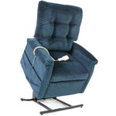
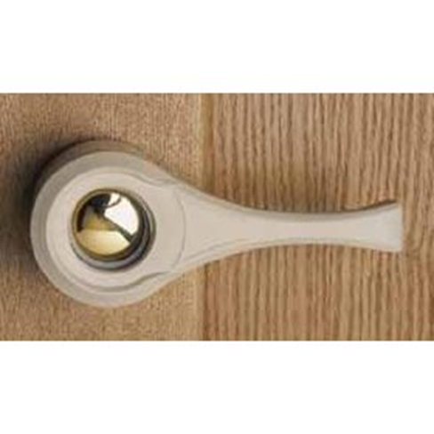
FURNITURE
Power Lift Chair, sturdy armrests, back support, seat or bed height, fabric color, rounded corners on tables, arrangement of furniture & equipment, properly supported bookcases &TVs
PORTABLE DEVICES
Door knob extenders, night lights, bed rails, toilet seat extenders, shower chair, suction cup grab bars

Slide 9
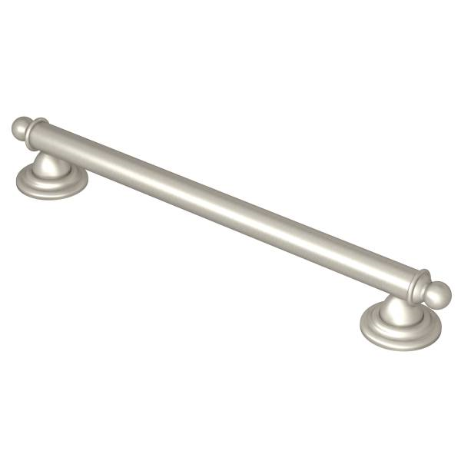
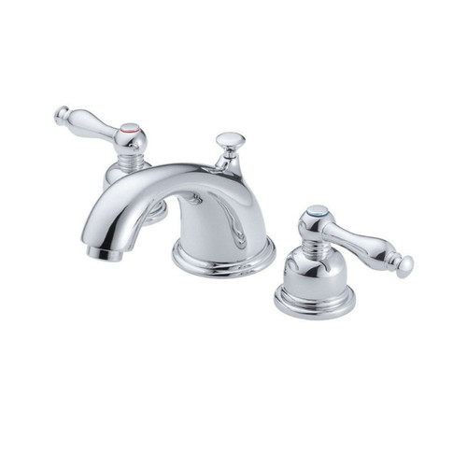
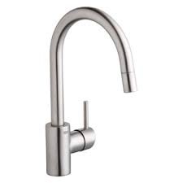
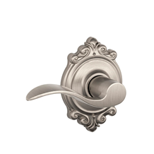
INSTALLED ASSITIVE DEVICES
Grab bars, single & dual lever faucets, clear swing hinges, single lever door handles, motion activated sink faucets, auto door openers

Slide 10
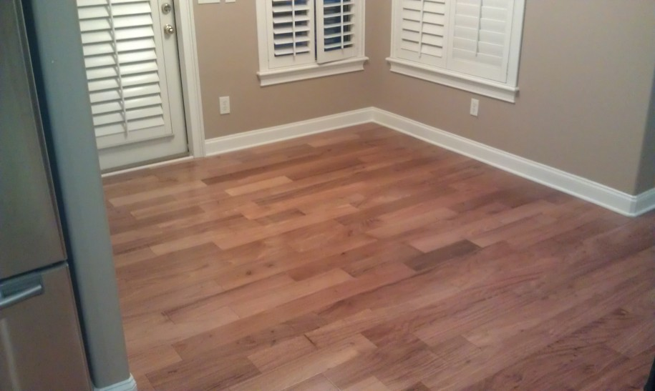
SURFACES (walls & floors)
Color/Texture/Pattern
“Non-Skid”
Durability
Maintenance
Other things to think about
Electric wheelchairs
Transition strips between different surfaces
High traffic areas
Use of space
Wall Protectors

Slide 11
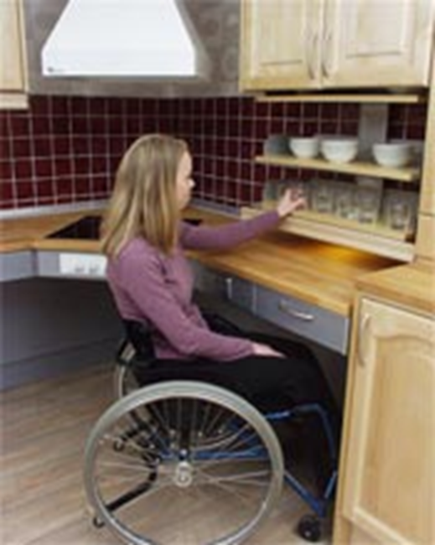
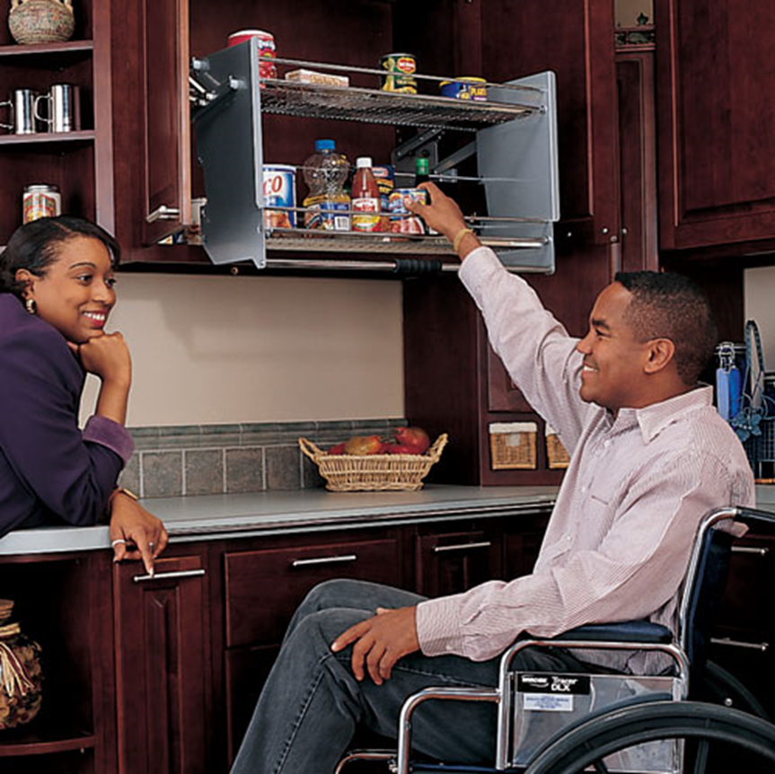
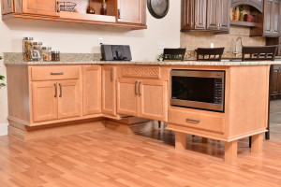
CABINETS and STORAGE
Toe kick
Lower counters
Knee space
Pull down/Pull out shelving

Slide 12
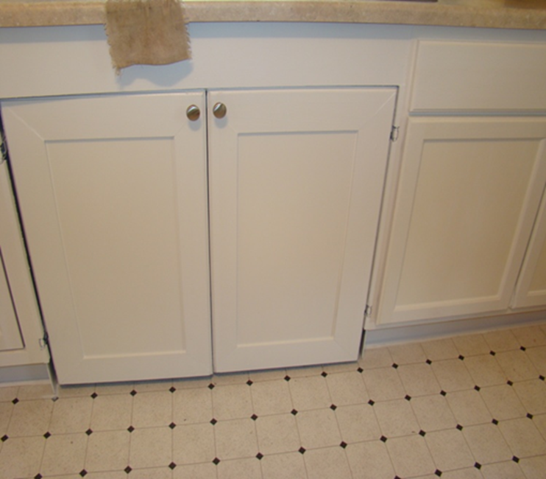
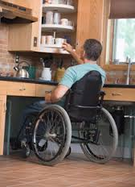
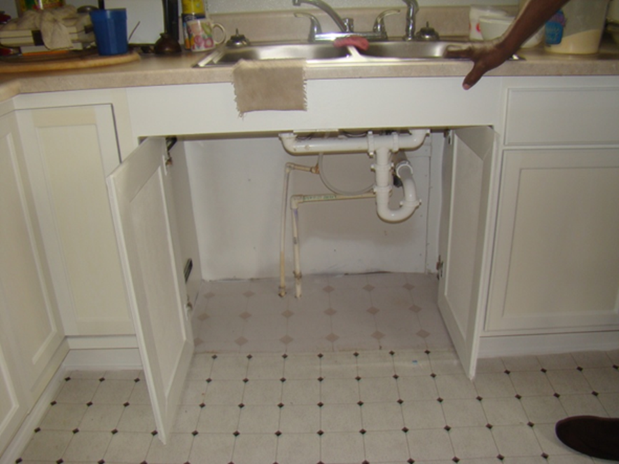
Carousel
Shelving
EZ Pocket Doors

Slide 13
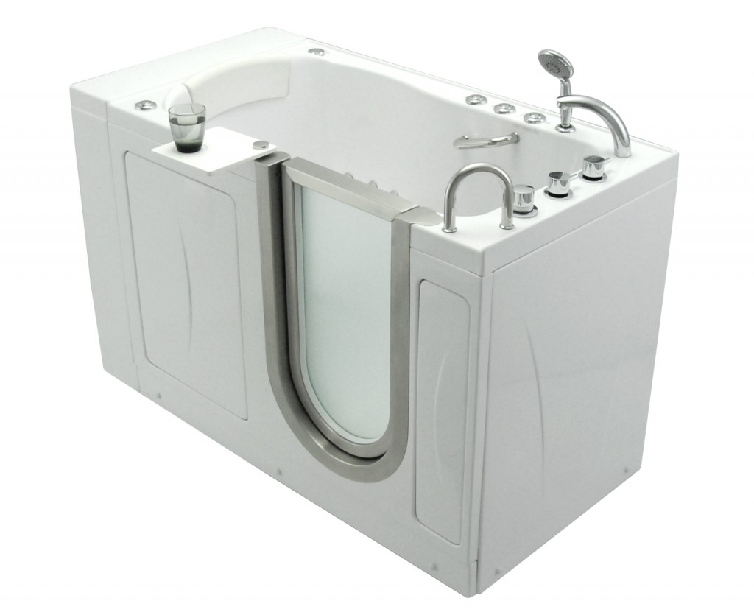
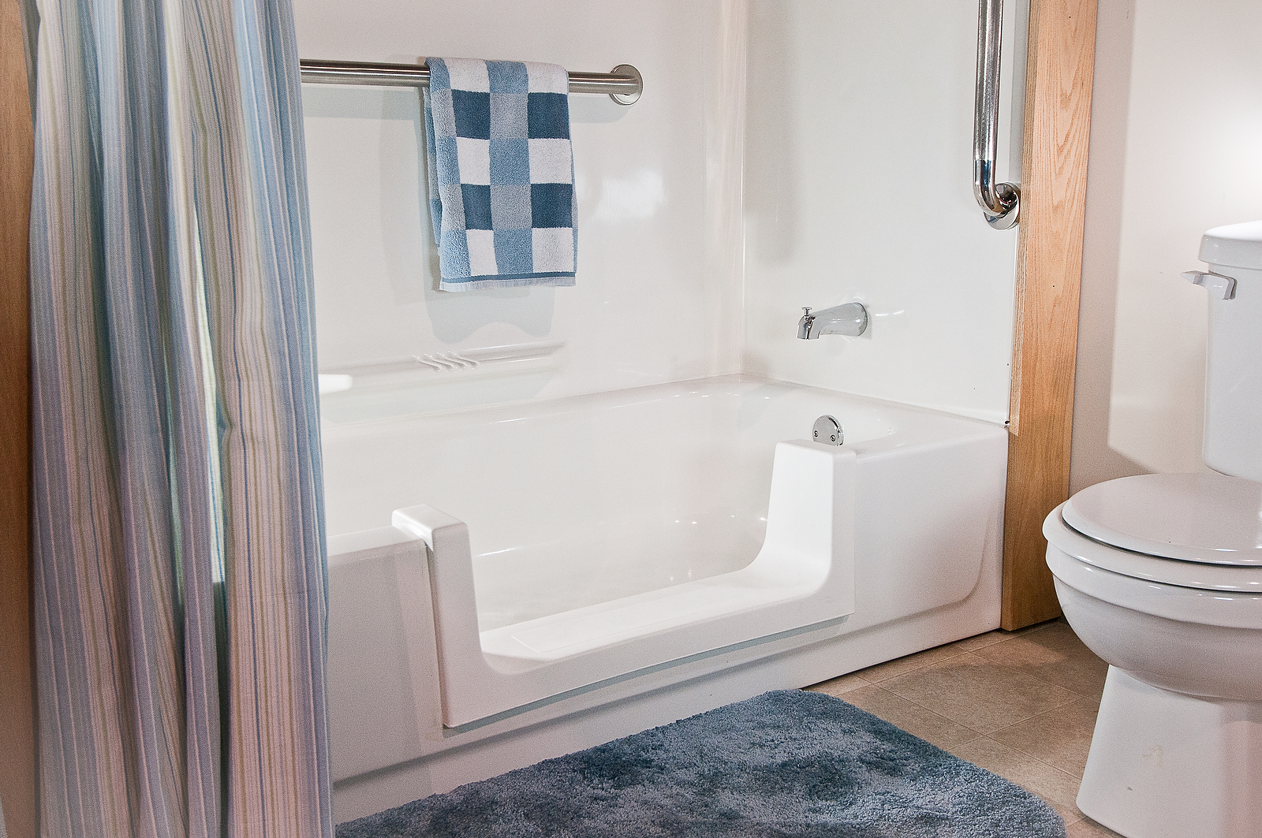
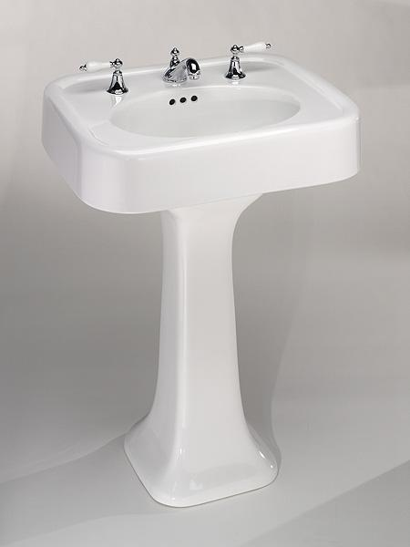
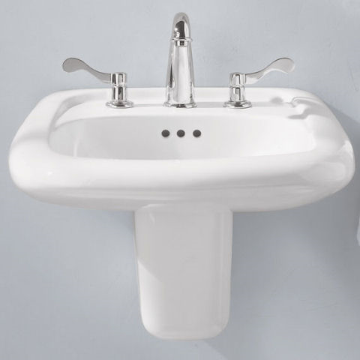
ASSISTANCE with HYGIENE
Cut out tub
Walk-in tub
Roll in shower/Walk-in shower
Wall mounted shower seat
Comfort height toilet
Accessible sink

Slide 14
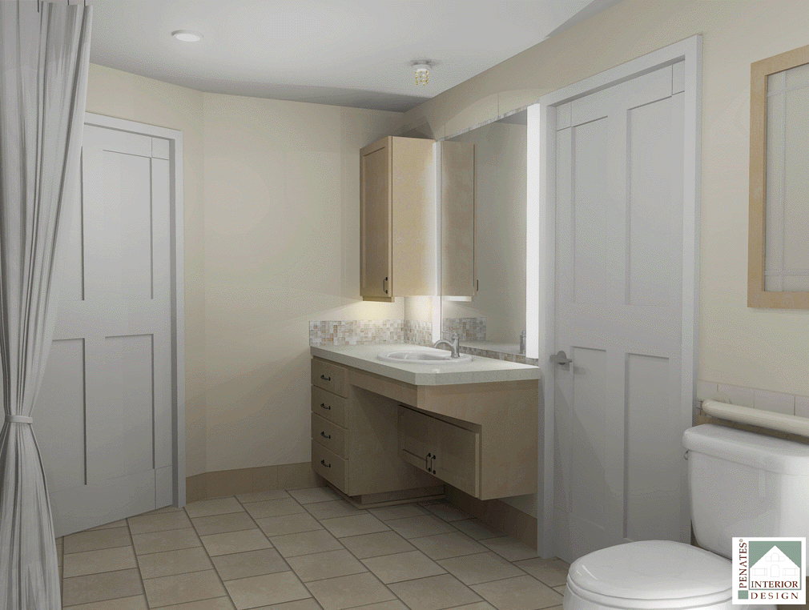
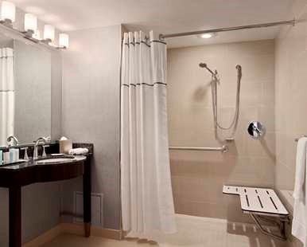
Aesthetics and Function
Access to plumbing has been incorporated into the design of the vanity

Slide 15
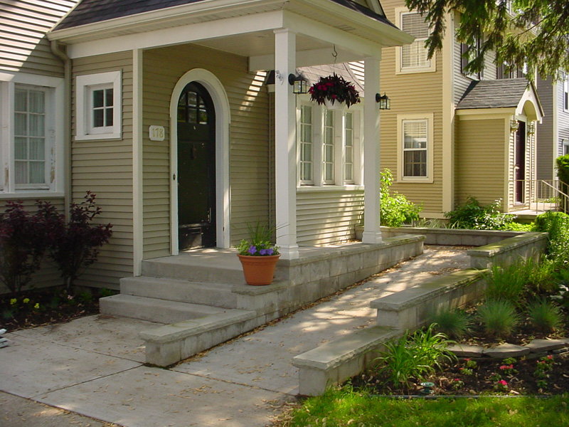
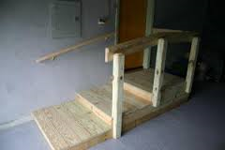
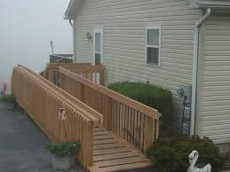
ACCESSIBLE ROUTES
Ramps – wood, concrete, modular, threshold
Stair Glide
Wheelchair Lift
Easy Steps

Slide 16
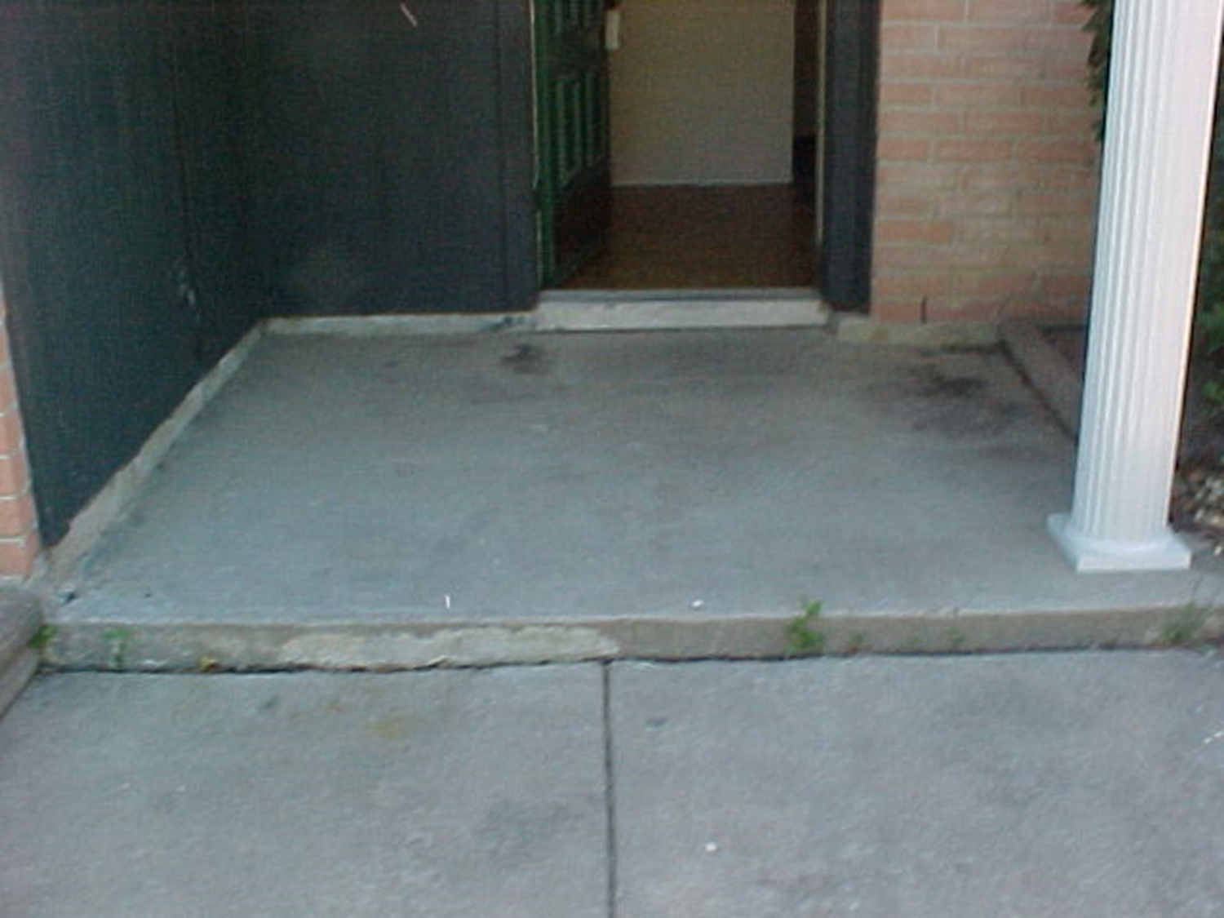
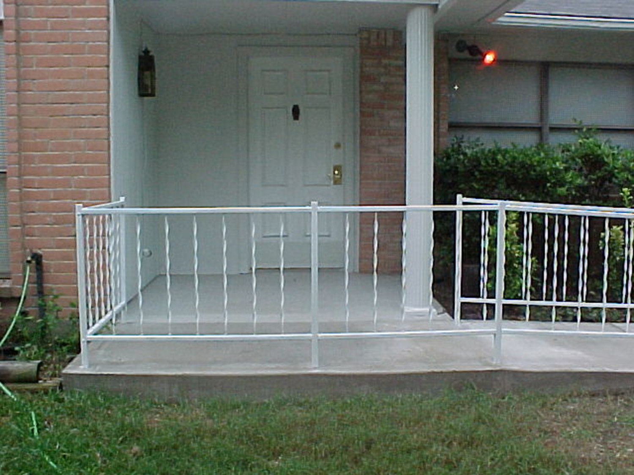
BEFORE AFTER

Slide 17
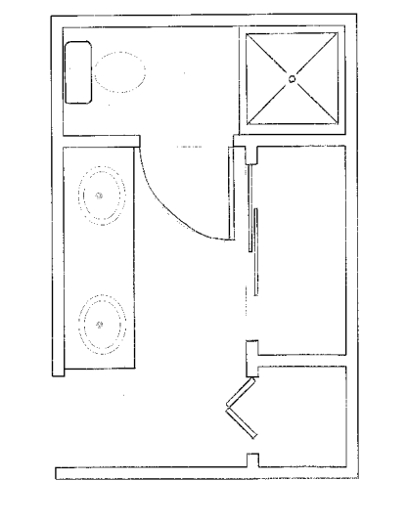
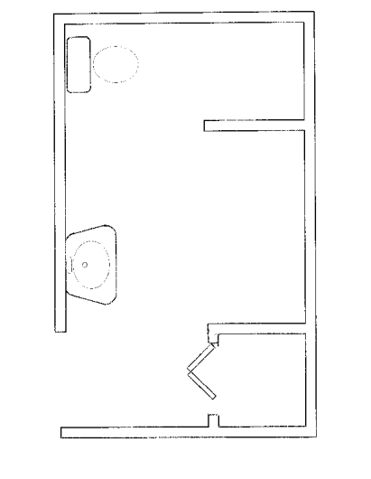
STRUCTURAL CHANGES
BUILT IN SHELVING
SHOWER
SHELF
CLOSET
SHOWER
STORAGE
CASE OPENING
STORAGE
BEFORE
AFTER

Slide 18
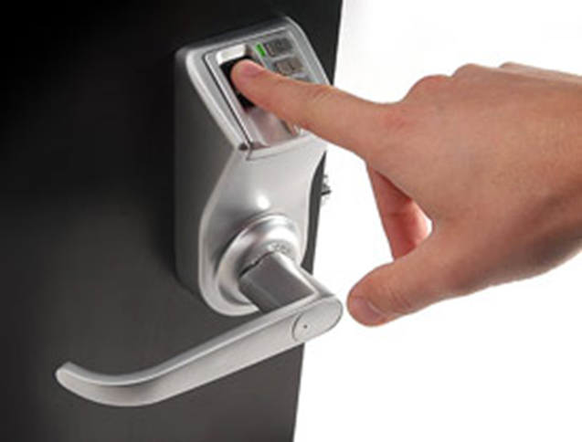
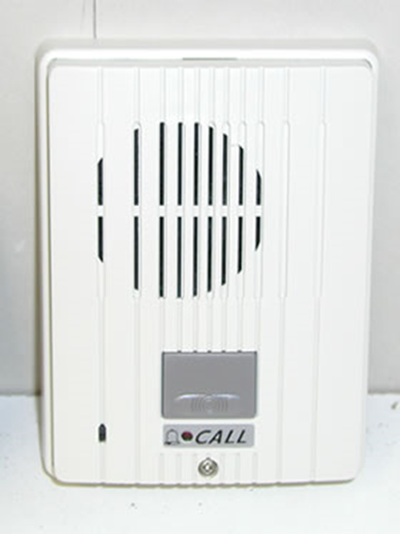
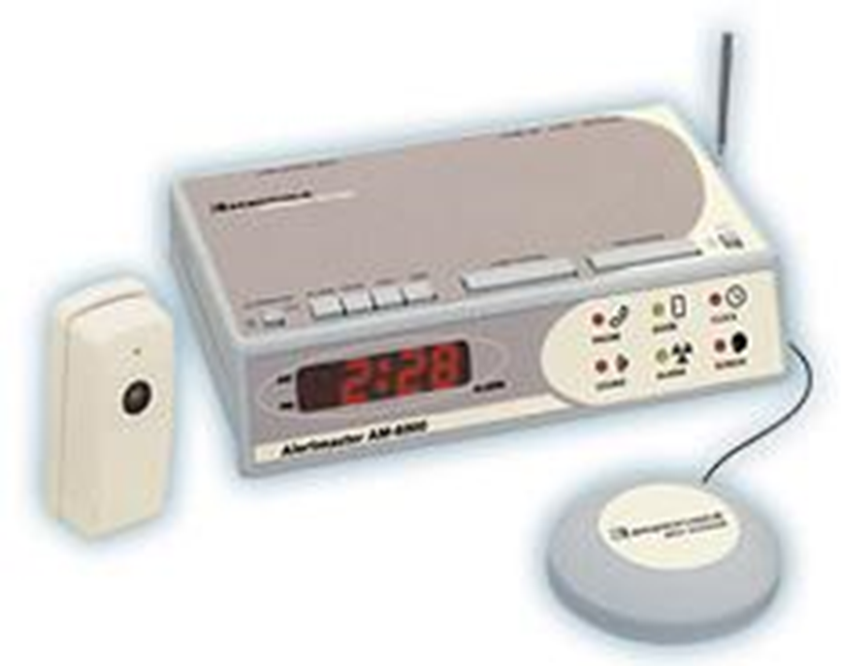
ENVIRONMENTAL CONTROLS
Alarms
Thermostat
Lighting
Light Switches/Electrical Outlets
Assistive Technology

Slide 19
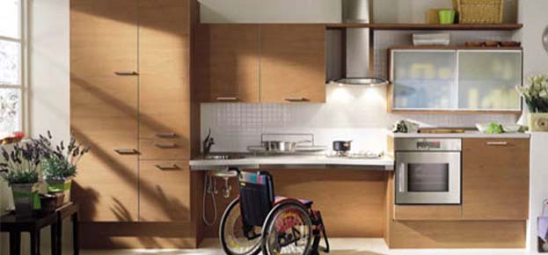
APPLIANCES
Built in Ovens Cook Tops Side by Side Refrigerators
Installation Height of Dish Washers
Front Loading Washer & Dryers

Slide 20

ADVOCATING FOR HOME MODIFICATIONS
Can I get a ramp?

Slide 21


The Fair Housing Act
  Establishes design and construction requirements for multifamily housing of four or more units built for first occupancy after March 13, 1991 (privately funded)
  Landlords/Owners cannot refuse to make reasonable accommodations when such accommodations may be necessary to afford a person with a disability equal opportunity to use and enjoy a dwelling
  Landlords/Owners are not required to pay for the modifications but can request that the tenant restore the unit to it’s original condition

Slide 22

Section 504 of the Rehabilitation Act of 1973
Access requirements apply to new construction of federally subsidized multi-family housing having 5 or more units constructed after July 11, 1988
A percentage of units must be made readily accessible and not merely adaptable for people with disabilities
Request for reasonable accommodations cannot be refused and are completed at the owner’s/landlord’s expense

Slide 23

Americans with Disabilities Act
Civil rights law guaranteeing equal opportunity for individuals with disabilities in employment, state and local government services, public accommodations, transportation and telecommunications
In multi-family housing, the leasing office would be covered under the ADA, as it would be a place of public accommodation. The individual units and common areas would be covered under the Fair Housing Act and/or Section 504

Slide 24
FUNDING for HOME MODIFICATIONS
City and County Housing Departments
Non-Profit Organizations
Volunteers
Medicaid Home Modification Program

Slide 25
What is the Medicaid Home Modification Program?
  A benefit for people who are clients of Medicaid, with a waiver to receive “Home and Community Based Services”
  Goal = prevent institutionalization by improving accessibility of their home
  Available statewide through local & regional “Single Entry Point” (SEP) case management agencies, found here: https://www.colorado.gov/pacific/hcpf/single-entry-point-agencies

Slide 26
Steps to Medicaid Home Modification
  Client requests modification from their local SEP
  Case Manager completes referral and schedules evaluation by an Occupational or Physical Therapist
  Case Manager gets bids from contractors who are enrolled as home modification “providers”
  Once bid approved, Case Manager notifies the chosen contractor & the work may proceed.
  Provider/contractor submits pay requests to HCPF.

Slide 27
How can we Improve Medicaid Home Modification?
  Complaints – doing inspections & following up on resolution
  Stakeholder meetings
  New standard forms
    Improve communication between clients, SEPs & contractors
    Ensure that the home modification work matches the bid, the OT/PT evaluation, and clients’ expectations
    Speed up the approval process
  Planning for Inspections
  Contractor/provider outreach – updating areas served
  Training on process, what is allowed, etc.

Slide 28
How can we Improve Medicaid Home Modification?
  Whatever we can cook up next…
  What are your ideas?

Slide 29
  Ann E. Watts, Home Modification Program Manager
  Home Modification Unit
  303-864-7820
  ann.watts@state.co.us
  Naomi S. Hubert, Housing Rehabilitation and Accessibility Specialist
  Hom Modification Unit
  303-864-7825
  naomi.hubert@state.co.us
  Department of Local Affairs/Division of Housing
  1313 Sherman, #320
  Denver, CO 80203

