Slide 1




HOW
WORDS MATTER
Colorado NAHRO
Messaging Framework
From your friends at Toolbox Creative
Notes:
Introductions:
Dawn Putney and Tom Campbell
CoNAHRO hired our company, Toolbox Creative last year to develop messaging and imagery to help organizations like yours communicate with your audiences. We interviewed several officials around the state and developed the messaging and images for your new toolkit.

Slide 2
THE BRAND
BRANDING AS A CORE
ORGANIZATIONAL STRATEGY
  Strong positioning builds a bridge between program strategy and communications.
  Effectively articulate your mission
  Supporters and the community more cohesively understand why what you do matters
Notes:
A lot of people will talk about branding as an organizational strategy. You’ll even here us talk about it, nonstop if we can trap you in a corner and get you to listen.
However, the real magic is in positioning as part of building that brand. That’s what we’re focusing on today. How you position your brand is the glue that makes it all stick.

Slide 3

THE BRAND
IDEA = IncreasED capacity
  Integrity is keeping it real
  Democracy sets your brand free
  Ethics = staying true to your values
  Affinity = a collaborative force
Notes:
Brand integrity, is about keeping it real.
It’s ensuring your internal identity matches.
Establishing brand integrity helps ensure the brand process will succeed.
Brand democracy is setting your brand free.
Your brand needs to be fed, nurtured and set free into the world. With a solid mission, strong messaging and effective brand identity in place, brand democracy can amplify your brand voice, and your mission, exponentially.
Brand ethics is staying true to your values and culture and goes beyond being an ethical organization:
It’s ensuring your brand message and image always reflect your core values. When every representative of an nonprofit clearly understands their brand ethics, they become powerful and effective brand advocates.
Brand affinity is being a collaborative force in your sector. Brand affinity is being a baker, not an eater. It’s recognizing that a rising tide lifts all boats.
For smaller nonprofts, brand affinity makes partnering with large nonptofits less intimidating. For larger NPOs, it positions them as a partner of choice, rather than a threatening, dominant force in your sector.

Slide 4

THE BRAND
Floating all ships
  Convey a unified message without eclipsing members’ brand and message
Notes:
Nonprofit coalitions face a significant positioning challenge. The mission and brand of each coalition member needs to both stand alone and work toward the greater good.
The coalition brand needs to convey the unified message without eclipsing the members’ brands.
When the IDEA principles are applied to coalition brand development, members think of themselves as a flotilla of ships, all rising with the tide

Slide 5
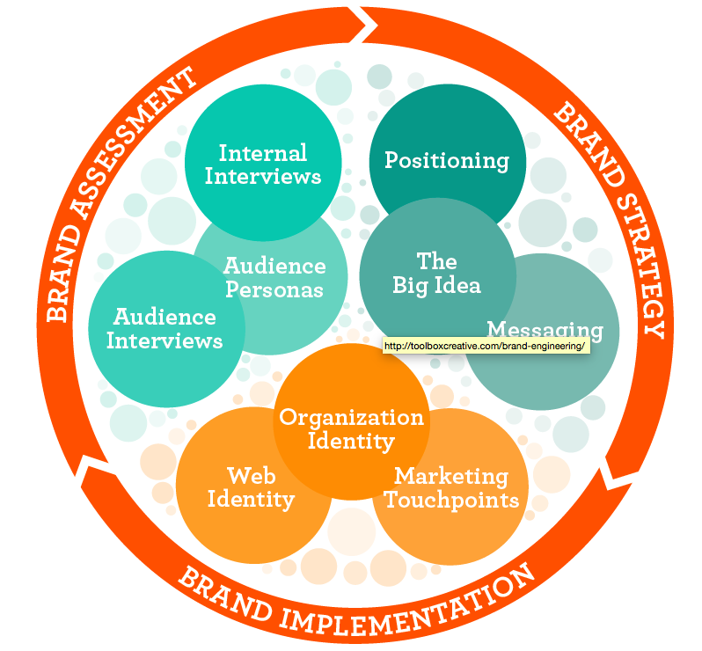
THE METHOD
Assessment
strategy
implement
  www.toolboxcreative.com/idea-worth-sharing/
Notes:
Our NAHRO marketing team was Betsey Martens, Boulder and Julie Brewen and Kim Iwanski from Fort Collins.
Internal and audience interviews
Messaging, Positioning, The Big Idea
Campaign Identity, Marketign Touchpoints, Toolkit

Slide 6
THE METHOD
Mindjam
IntervieWS
Notes:
We talked to a wide variety of housing professionals throughout the state.
We interviewed:
Jody Kole, Grand Junction HA
Jill Klosterman, Eagle County Government
Tami Fischer, Metro West Housing Solutions
Ted Ortiviz, Pueblo Housing Authority
David Martens,, Colorado NAHRO staff
Kimball Crangle, Gorman and Company
Ute Jantz, Delta Housing Authority
We asked interviewees a series of questions related to CO NAHRO and it’s proposed brand messaging and positioning campaign.

Slide 7
THE METHOD
findings
  Areas of improvement:
  PR tools to get the word out and garner support
  Increased statewide advocacy
  Serving everyone — one size does not fit all
Notes:
Some of the areas of improvement, as requested by your peers and colleagues

Slide 8
THE METHOD
Outreach efforts
  Tactics that worked:
  Solid DATA — easy to understand and consistent messages
  Economic impact messages
  Articles from NAHRO or CHFA to housing and county commissioners
  Powerpoints — with before and after photos
  Backing up personal stories with results
Notes:
In our interviews we listened to outreach efforts that work throughout the state

Slide 9
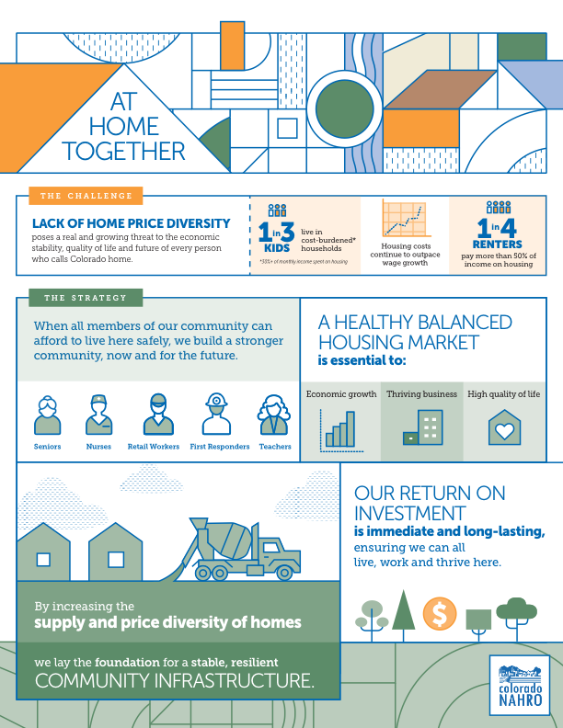
THE METHOD
Internal
toolkit
Notes:
This is an INTERNAL toolkit, designed to work equally well in two directions – for those who support housing professionals, it is giving them tools and language to be the most affective advocates they can be.
Those who are unfamiliar with our work may be inclined to be opposed to the efforts of housing professionals, this messaging platform provides talking points, to build points of concensus and educate, and sway.
Very specific, audience-focused tools for NAHRO members when they are having conversations with important people within their jurisdiction.

Slide 10
THE FRAMEWORK
WHEN WE CHANGE THE WORDS,
WE CHANGE THE MESSAGE
  Without a messaging strategy that helps the public imagine or see housing differently, new data or research does little to support our cause
  Data and evidence should be used to enhance a more effective overall message
Notes:
Credit Frameworks Institute’s Reframing Affordable Housing findings from Peer Discourse Sessions
Data and research cannot be the only message
Data can be used to support our message but it should not BE the message.
Build it into the story and frame it well.
Other findings in our interviews:
• Us vs. Them – people don’t understand because they have their hands full living their own lives.
• NIMBY: Most agree that affordable housing is an important thing, but when it comes to building a community that is for the extremely low income, nobody wants in their backyard. There is a general lack of understanding of who residents are, how they live, and whether or not they contribute to the community.
• We see it time and again – neighbors come out with pitchforks when we are first talking about building a new community, but in the end everything is just fine.
• Uninformed: Government often understand our mission, but neighbors typically don’t/ The support of the general public is VERY important for to be able to carry out our mission. They know they want affordable housing, ut they don’t knwow hat public housing, Section 8 or LIHTC is. They just need to know we deliver quality and long-term sustainability.

Slide 11
  Building strong communities
  Attainable housing is a shared public concern and we can work together as a community to increase the supply and price diversity of homes
Notes:
Our process:
Worked with CoNAHRO marketing team and interviewed several HA’s around the state.
We heard the differences from the needs of all your organizations across the state, from Rural communities to the Front Range and urban areas.
Presented our findings to the CoNAHRO board, and got concensus on the overall message. The final product – At Home Together.
The stealth position we are taking is that you can’t talk about a healthy financial economy without talking about a healthy social economy.
We are talking about the community as a whole and how the community is reliant on economic and home price diversity.

Slide 12
Notes:
Audiences
Messaging goals

Slide 13

THE FRAMEWORK
TOGETHER AT HOME LANGUAGE
  Homes, not units
  Stable homes
  Housing stability
  Housing that is affordable
  Home price diversity
  Families with lower incomes vs. low-income families
  Communities, not projects. Neighborhoods are places where you live.
Notes:
When we are talking about the issue overall we talk about economic development.
When we are talking about what we do we are using warm, familiar words, not institutional words.
For example, home is better than housing.
Units are cold, mathematical things. Homes are where you raise your kids and have plants and pets.
Housing is a govt program, home is where you live.
Do NOT use the word Project. Ever.
Avoiding labeling people or families as low-income. Flip it from low-income people to people with lower incomes.

Slide 14

  Affordable housing can feel like a large unfixable problem along with world hunger and poverty.
Notes:
This is a common struggle with all the nonprofit work we've done. People can get behind the problem and understand it's a challenge, but it can quickly become overwhelming and people back out.
It gets back to positioning.

Slide 15
THE FRAMEWORK
HELP PEOPLE SEE IT DIFFERENTLY
  Economic impact
  Emphasize price diversity in homes, communities for all ages and supporting an essential workforce
Notes:
Early decisions to lean heavily to the economic impact side of the tone-o-meter
It’s not coincidental that we are using words that are typically used in financial and economic development and the economy.

Slide 16
THE FRAMEWORK
TELL THE STORY OF US NOT THEM
  Tell the larger story
  We are all impacted AND we all benefit
  Help people understand their stake in overall success
Notes:
A range of housing options available to residents
Essential workers can live in your community
Supporting an essential workforce
Housing issues appear in the paper when it’s about housing, and that’s it. Housing really affects education, ability to go to work, our kids, our health, but the message tends to be only about housing. Work with our colleagues when there are housing implications to other issues.

Slide 17

THE FRAMEWORK
TALK ABOUT WHAT WORKS,
NOT WHAT’S
BROKEN
  Show how new housing policies have worked
Notes:
Don't try to show people how the system is broken; instead show them how it can be fixed.

Slide 18
THE FRAMEWORK
Talk about cause and effect
  The ability to afford a home provides the foundation for Americans to reach their full potential
  Access to neighborhoods of opportunity can
  reduce stress, increase access to amenities
  and lead to important health benefits
Notes:
High housing prices leads to more renters. More renters drive up the cost of rent.
Rents increase but wages don’t keep up. The gist: Fix problems with the housing market.
When people understand the cause and effect, as people’s inability to solve their own problems, we need to change that. Get the explanatory change into the conversation. Methaphors are key. People need to understand quickly what is causing these issues.

Slide 19
THE FRAMEWORK
CONNECT WITH OTHER ISSUES
Notes:
Housing intersects with almost every other social issue – education, health, employment, and public safety. When housing is expensive, it makes it hard to afford to go to the doctor, to pay for healthy activities, or eat well, all of which affect our health.
Kids learn better when they have a stable home – when they are healthy, have food to eat and a safe place to sleep at night.

Slide 20
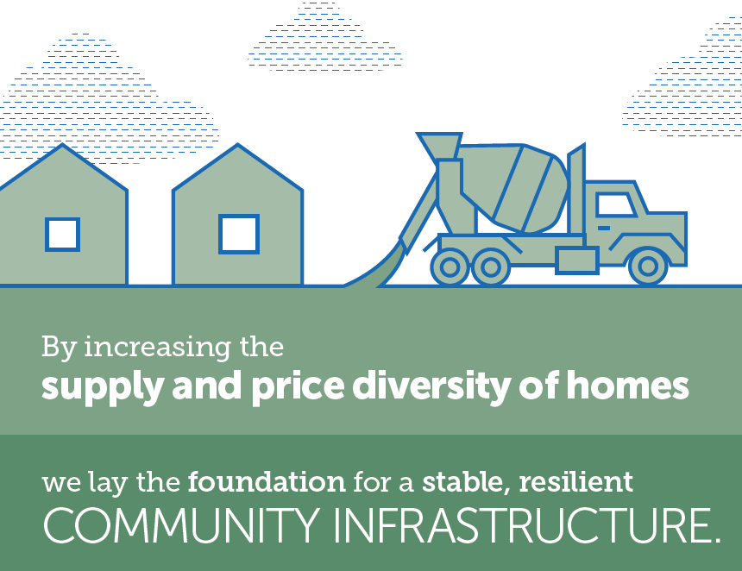
THE FRAMEWORK
TALK ABOUT housing AS
infrastructure
  Like roads and bridges, affordable housing is a long-term asset that helps communities and families thrive
Notes:
Housing as infrastructure means that it is as important as roads, public transportation, utilities.
The basic economy of a society depends on people having a place to live.
. Without access to affordable housing, investments in transportation and infrastructure will fall short of creating vibrant communities. Increasing the supply of affordable housing— especially in areas connected to good schools, well-paying jobs, healthcare, and transportation—helps families climb the economic ladder and leads to greater community development.

Slide 21
THE FRAMEWORK
Pivot: redirect
the message
  Instead of refuting people’s beliefs about the issue, redirect the topic to your message
  Ready-to-go redirects
Notes:
This is a common tool for political candidates. This is the practice of moving the message back to your core theme and message.

Slide 22
THE FRAMEWORK
Talking points:
the grid
Notes:
This is a conversation starter, FOR yoor supporters, for those who are NEUTRAL and even points for those who are AGAINST.
You can add to it and expand it as you deem necessary.

Slide 23
THE FRAMEWORK
cO NAHRO: THE EXPERTS
  Housing officials are the most responsible stewards of allocated federal funding
  You are positioned to address an unmet need and complement what for-profit developers are doing

