Slide 1
Department of Local Affairs Division of Housing
Jen Stepleton
Housing Development Specialist
Division of Housing

Slide 2
COLORADO DIVISION OF HOUSING
The Division of Housing (DOH) was created by statute in 1970 to improve the access of all Coloradans to decent, affordable housing. Working with the State Housing Board, DOH:
Provides state and federal funding to private housing developers, housing authorities, and local governments to increase the inventory of affordable housing.
Provides federal and state funded rental assistance statewide through local housing authorities and non-profit service organizations.
Certifies all factory/manufactured structures built in or shipped to CO and approves multifamily construction in counties with no construction codes.

Slide 3
Grant & Loan Programs
Community Development Block Grant (CDBG)
Home Investment Partnerships Program (HOME)
National Housing Trust Fund (HTF)
Neighborhood Stabilization Program (NSP)
Colorado Housing Investment Fund (CHIF)
Homeless Solutions Program (HSP)
Housing Development Grant Funds (HDG)
Housing Development Loan Fund (HDLF)
DOH assists developers and local governments in creating more affordable housing through gap funding for acquisition, rehabilitation and new construction projects.

Slide 4
Rental Assistance Programs
Housing Choice Vouchers (HCV)
Veterans Affairs Supportive Housing (VASH)
Family Unification Program (FUP)
Family Self Sufficiency Program (FSS)
Housing Opportunities for Persons with AIDS (HOPWA)
CoC Permanent Supportive Housing (PSH)
State Housing Vouchers (SHV)
Mental Health (MH)
CO Choice Transitions (CCT)
Homeless Solutions Program (HSP)
Section 811
HOME TBRA Program
DOH works with community partners to serve populations with barriers to housing stability throughout the State.

Slide 5
Home Ownership Programs
Single-Family Owner-Occupied Rehabilitation Program (SFOO Rehab)
Self-Help Rehabilitation Program
Down Payment Assistance Program (DPA)
Mortgage Assistance Program
DOH also works with community partners throughout the State to provide homeownership assistance through the Revolving Loan Fund Program.
Notes:
Cheryl
Federal Funds: Community Development Block Grant (CDBG), Emergency Solutions Grant (ESG), Home Investment Partnerships Program (HOME), National Housing Trust Fund (HTF), Neighborhood Stabilization Program (NSP)
State Funds: Colorado Housing Investment Fund (CHIF), Homeless Solutions Program (HSP), Housing Development Loan Fund (HDLF), Housing Development Grant Funds (HDG)
Grant and loan programs are competitive. Funding is based on timing, availability and department priorities.

Slide 6
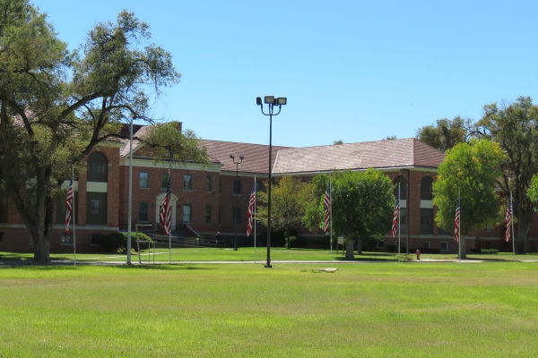
Additional Programs
Homeless Prevention Activities Program (HPAP)
Emergency Solutions Grant (ESG)
Fort Lyon Supportive Residential Community
Office of Homeless Youth Services (OHYS)
Home Modification
Housing & Technology Standards
In addition to grants, loans, and rental assistance, DOH supports communities through a variety other initiatives and programs.
Notes:
Cheryl
Federal Funds: Community Development Block Grant (CDBG), Emergency Solutions Grant (ESG), Home Investment Partnerships Program (HOME), National Housing Trust Fund (HTF), Neighborhood Stabilization Program (NSP)
State Funds: Colorado Housing Investment Fund (CHIF), Homeless Solutions Program (HSP), Housing Development Loan Fund (HDLF), Housing Development Grant Funds (HDG)
Grant and loan programs are competitive. Funding is based on timing, availability and department priorities.

Slide 7
Developer Team Regional Assignments

Slide 8
Asset Manager Regional Assignments

Slide 9
Thank you!
Jennifer Stepleton
Jennifer.Stepleton@state.co.us
970-640-7576

