Slide 1


NAHRO 2014
Successful Senior Housing

Slide 2
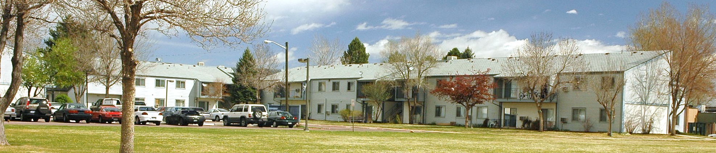
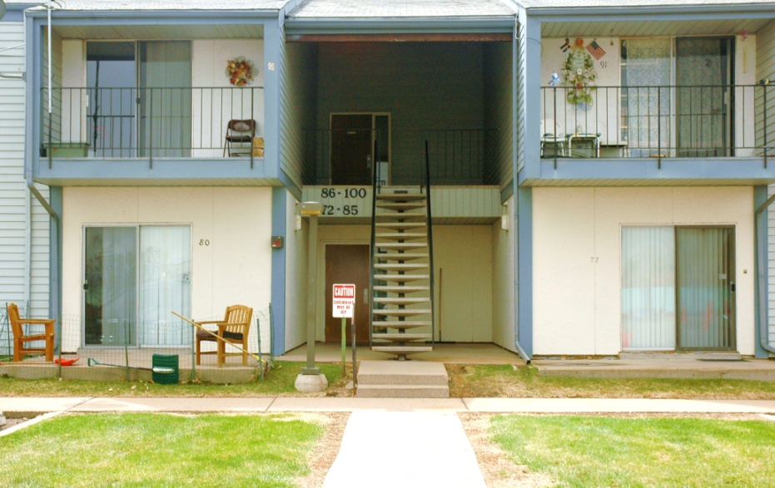
What we started with
Buckingham Gardens: 40 year old public housing for seniors/disabled
Functionally obsolete:
  No elevators: 2-story, exterior stairs
  Mostly exterior entries
  No central air-conditioning
  No h/c accessibility
  No secured access system
  No amenities

Slide 3
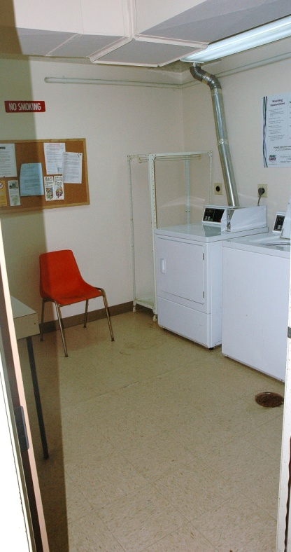
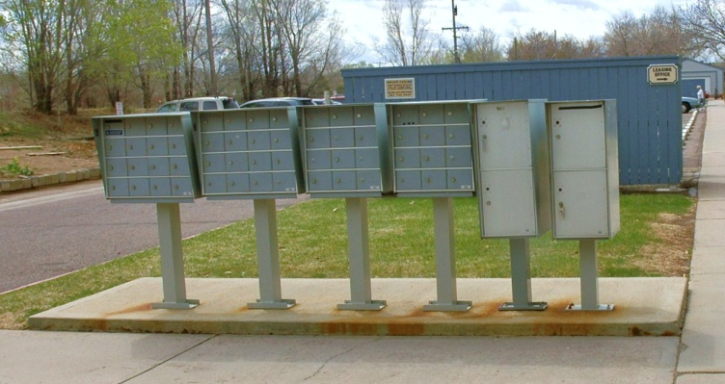
What we started with
Economically obsolete:
  HUD’s operating costs ≠ enough to maintain old property
  Resident rental payments average $189/mo.
  AHA ‘feeding’ property for on-going maintenance
Physically obsolete:
  Trees rooting through sewer lines
  All electric baseboard heat – EXPENSIVE!
  Doorways too narrow for wheelchair access
  Exterior mailboxes, exterior trash containers

Slide 4
“Challenges”
Mismatched Approvals:
  LIHTC and HUD Demo-Dispo both submitted on 7/1/2010
    CHFA approval in 7 weeks, on 8/15/10
    HUD approval in ~8 months, on 2/25/11
Need to clear site for construction:
  Needed Demo-Dispo approval from HUD, but 7 month lag
    HUD also had to approve transfer of PH land to LLLP
  Needed vouchers for tenants in townhomes (± 3 mos for HUD)
  Had to relocate tenants in townhomes (Section 18 vs. URA)
    Started relocation in March, all residents moved by mid-May.
  ACM abatement prior to demolition, done in June
  By then we were in closing -- frustration
    Title Regs: can’t change anything on site that might cause lienable event

Slide 5
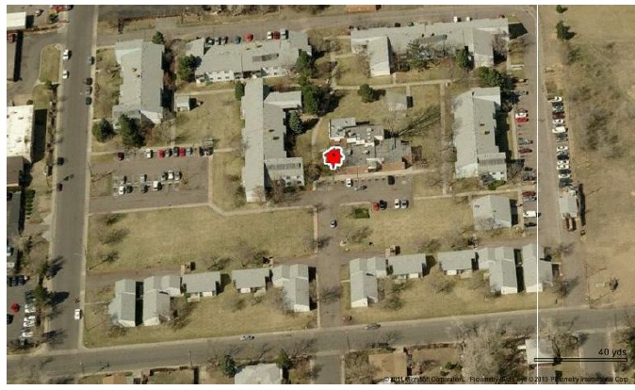
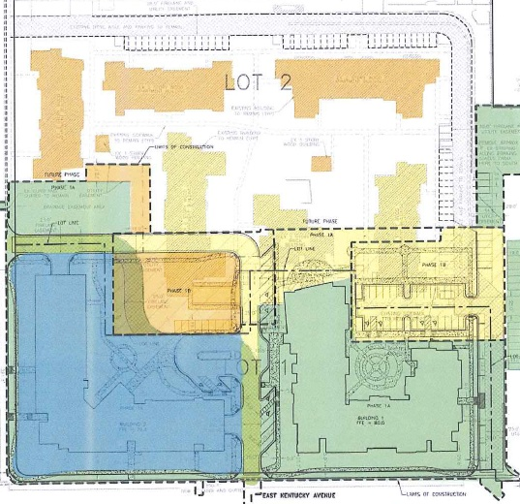
Existing Conditions
10 townhomes + AHA offices in the way

Slide 6
Challenges of Existing Conditions during Construction
  Existing tenants had to stay in place
    No suitable location for all residents nearby
  AHA Offices in place
    Visitors, staff, clients needed access
  Replacing aging infrastructure
    Utilities not in locations listed on original plans
      Several water and power outages during construction
  Unauthorized visitors to construction site
    Hard to manage when residents and office in place

Slide 7

Sources & Uses
≈ $243,545/unit for 55 units
Including all common area rooms/ offices/ amenities / costs
Low permanent debt = Positive Cash Flow Owner equity of 20% is nearly unprecedented in LIHTC.

Slide 8
Shameless Promotion Ensues….

Slide 9
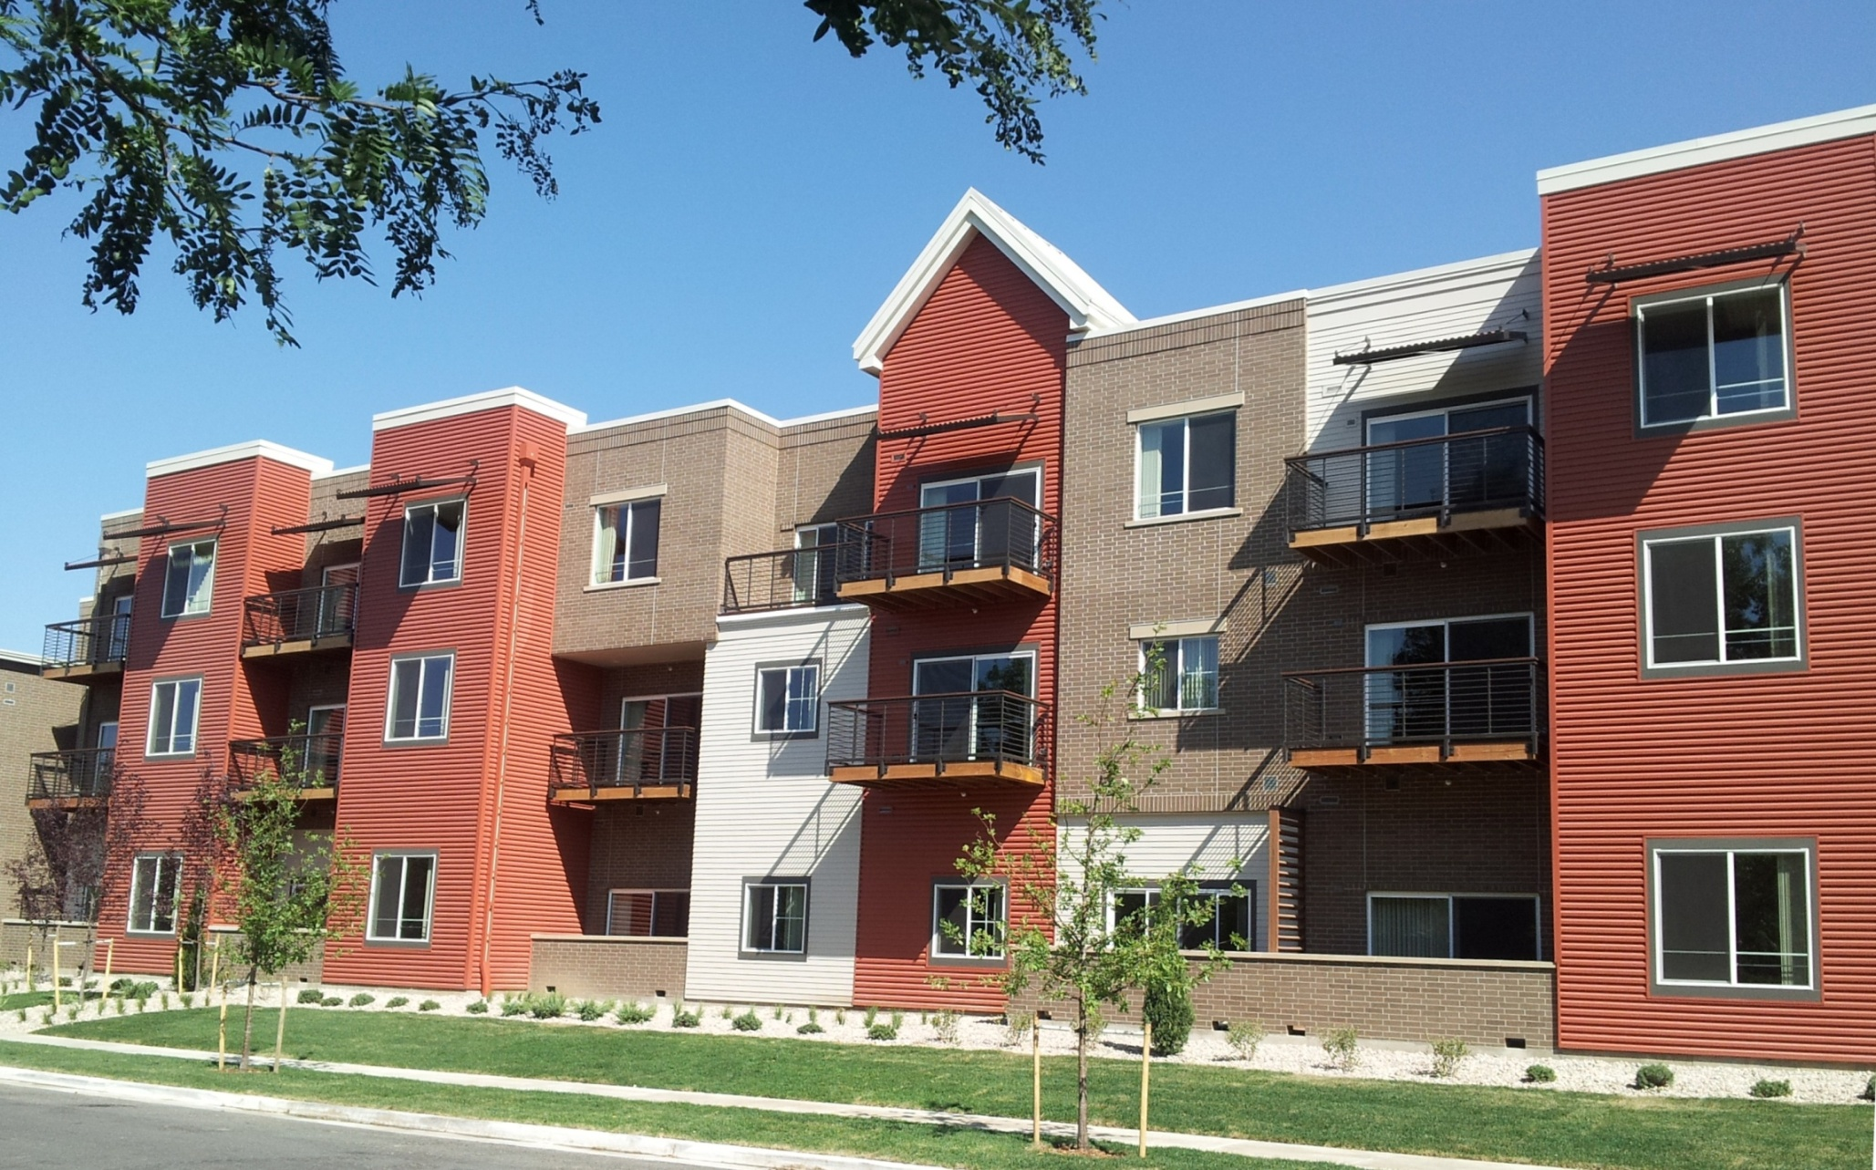
Long-term Asset:
55 units for very-low income seniors and disabled, with maintenance-free brick and metal siding, and five styles of one- and two-bedroom units.

Slide 10
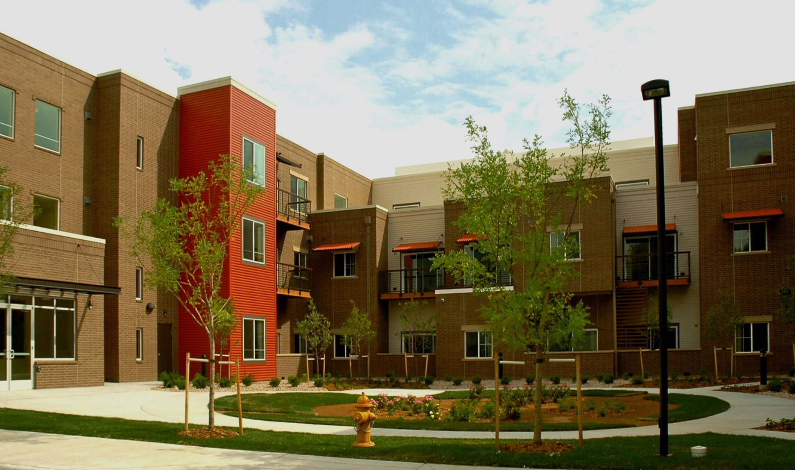
Daylight: Private balconies, large windows, and natural lighting in corridors enhance spaces

Slide 11
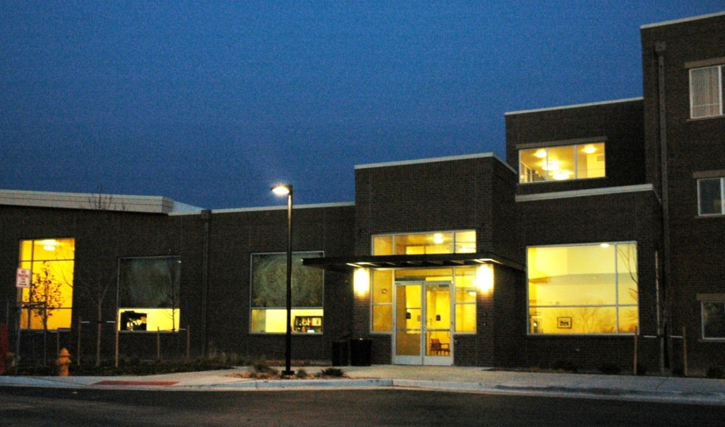
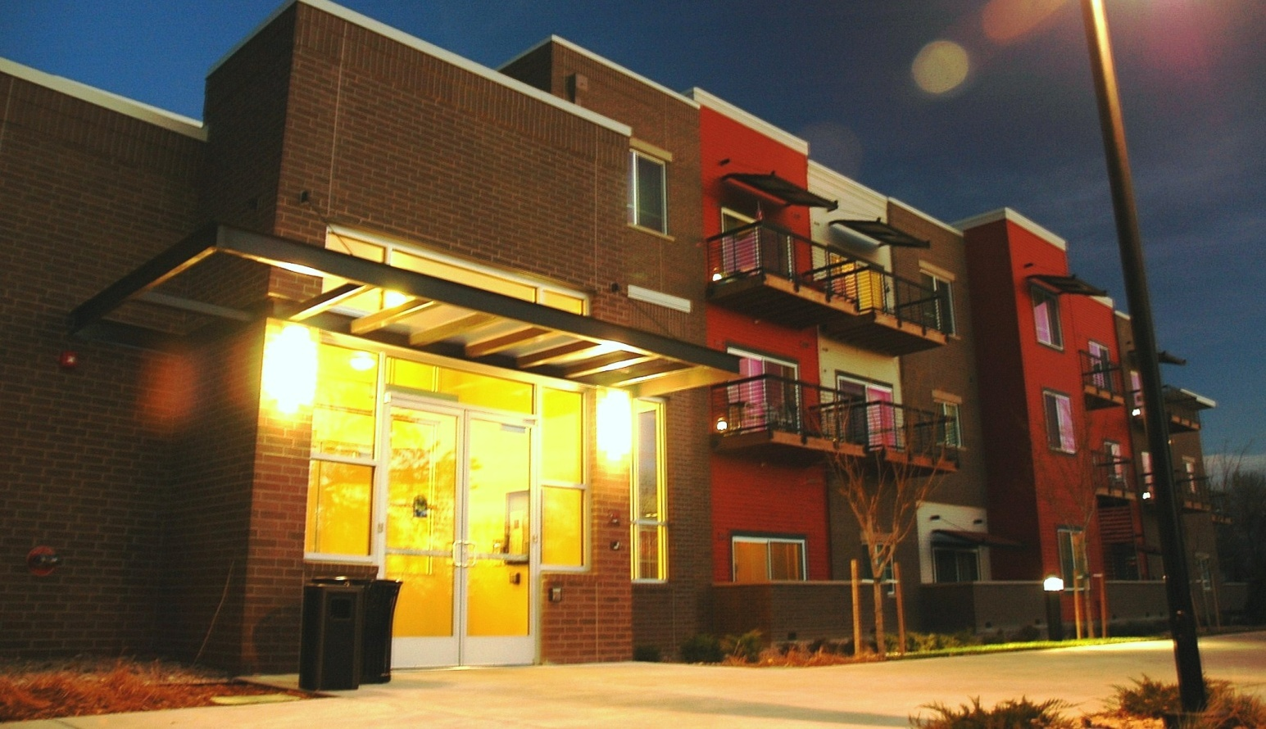
Access and Safety:
Key-fob entryways, exterior cameras, and brightly lit exteriors provide security to a vulnerable population.
“Snow-melt” sidewalks provide secure footing around perimeter of building.

Slide 12
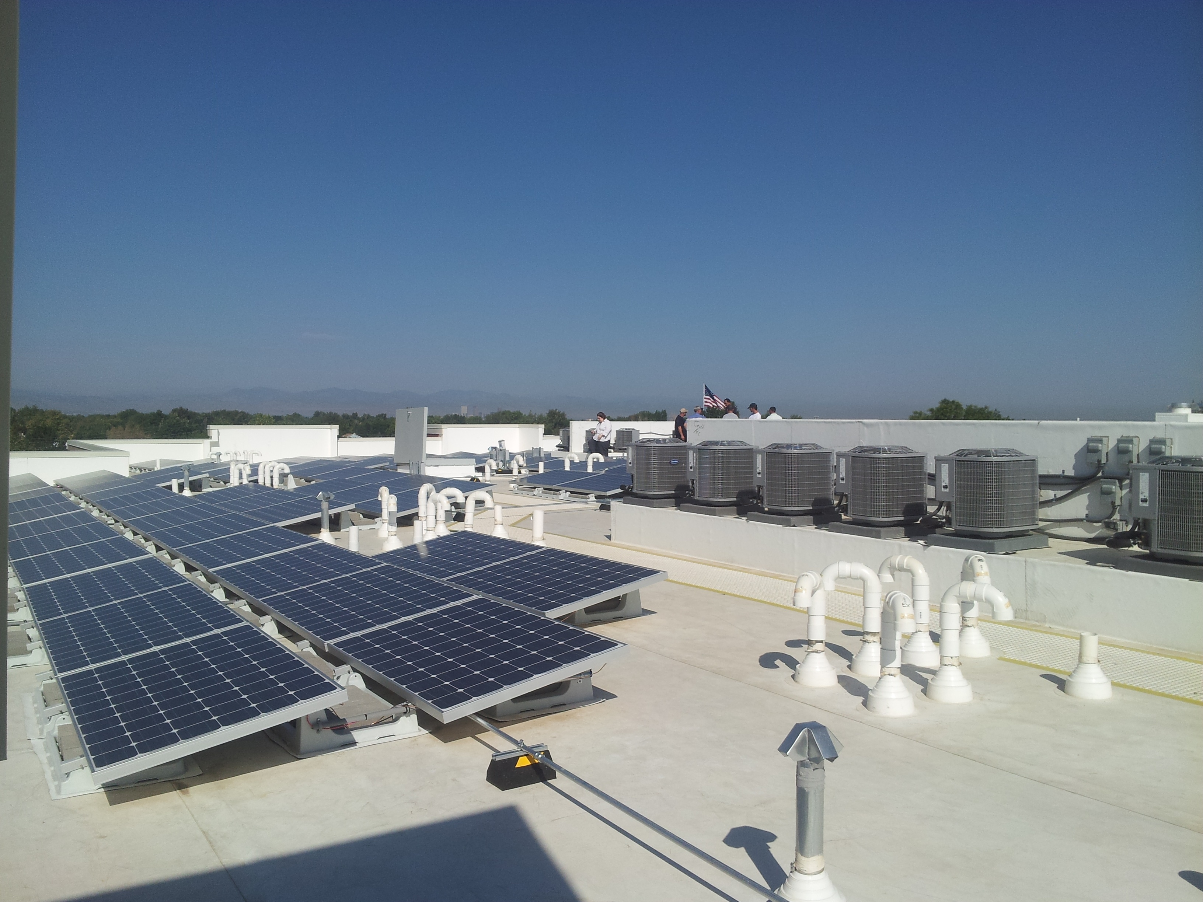
Sustainable:
Reduced energy consumption with 245 photo-voltaic panels, increased insulation, low-flow faucets, and Energy Star rated appliances and lighting, exceeding Green Build requirements.
Since October 2012 completion, the PV panels have generated over 133 Megawatts of electricity, saving the property over $18,100 in electrical costs.

Slide 13
H/C Accessible Community Gardens
Outdoor picnic area
Density AND Space:
21 units/acre, with reduced parking requirements, and room for community gardens, landscaped courtyards, and open space.
The site is located adjacent Westerly Creek Trail, and to 57-acre Expo Park with small rec center, tennis courts, playground, and disc golf course.
Community Rooms, Offices, Maintenance, Hair Salon
Interior Courtyard, landscaped
Trash chutes + recycling area

Slide 14
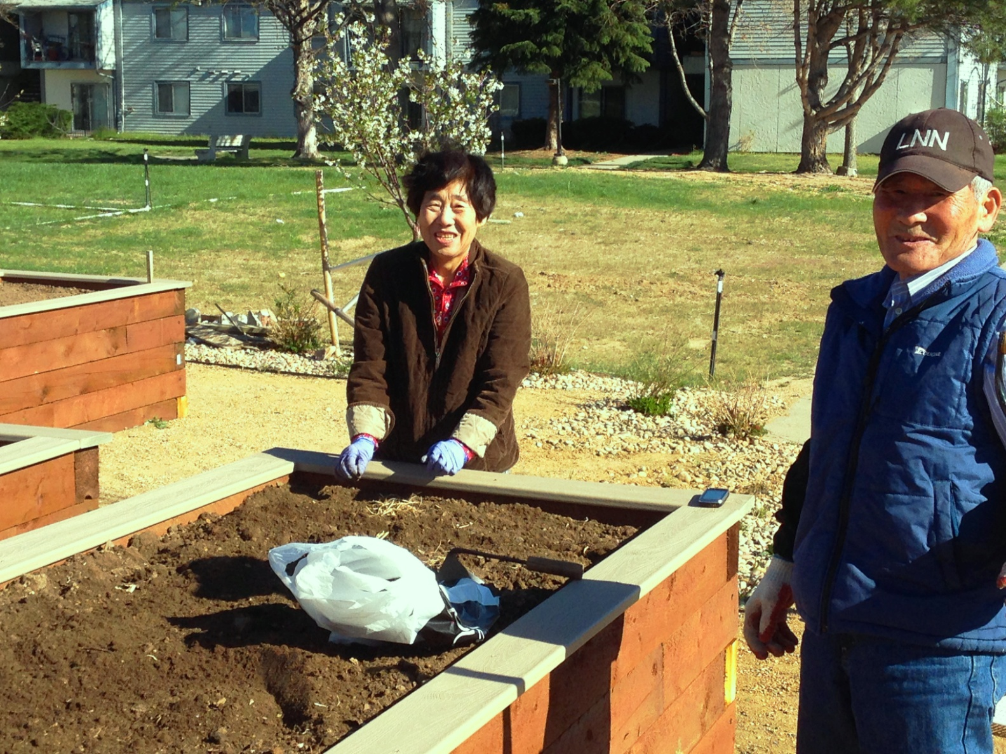

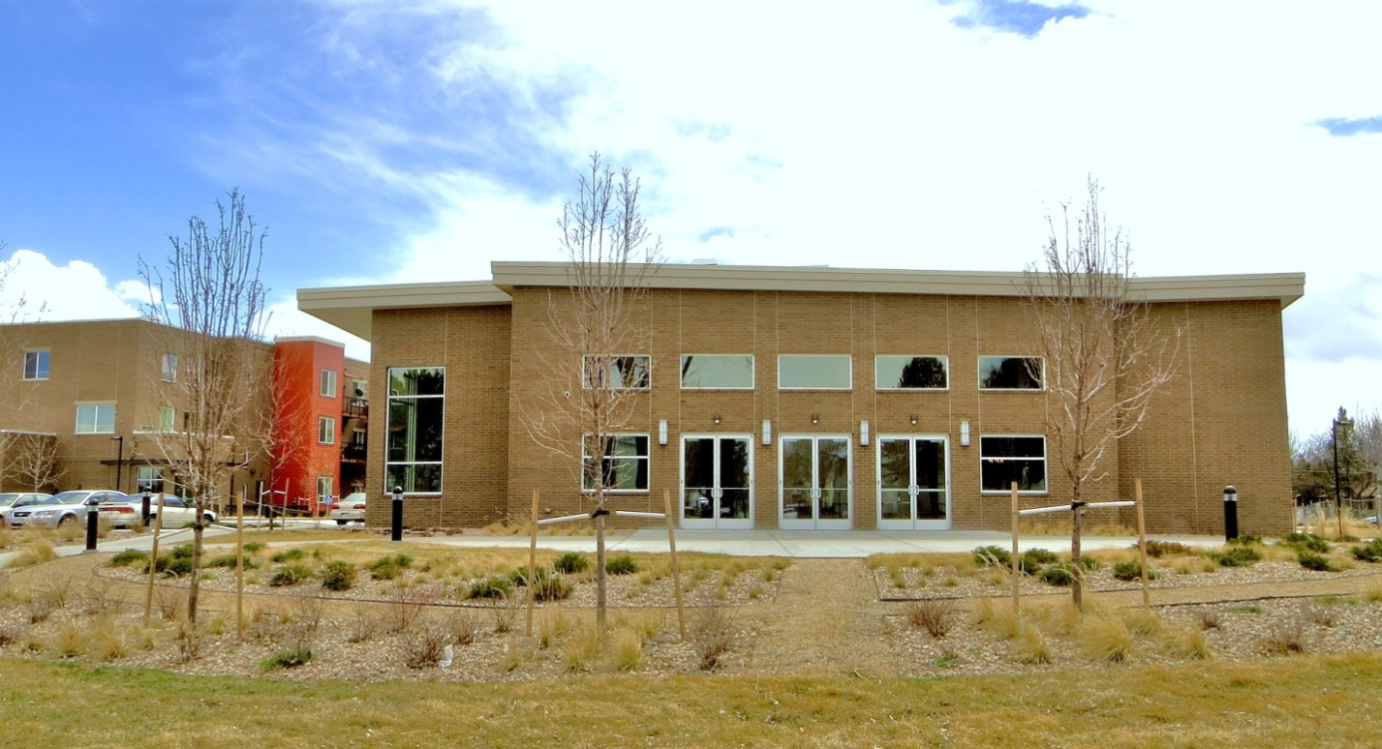

Respectful:
The amenity-rich building blends in scale, materials, and design to the adjoining neighborhood
Looking toward Rainbow Room
Gardeners at raised beds

Slide 15
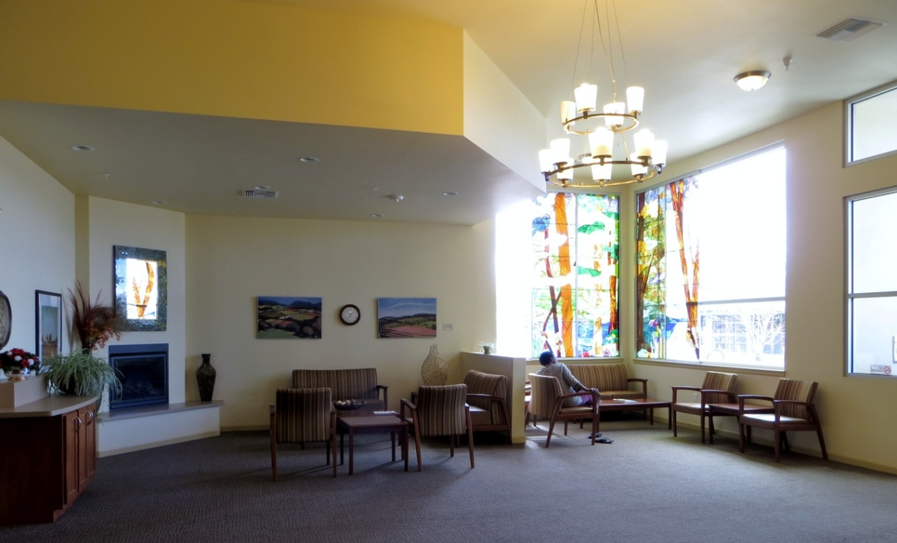
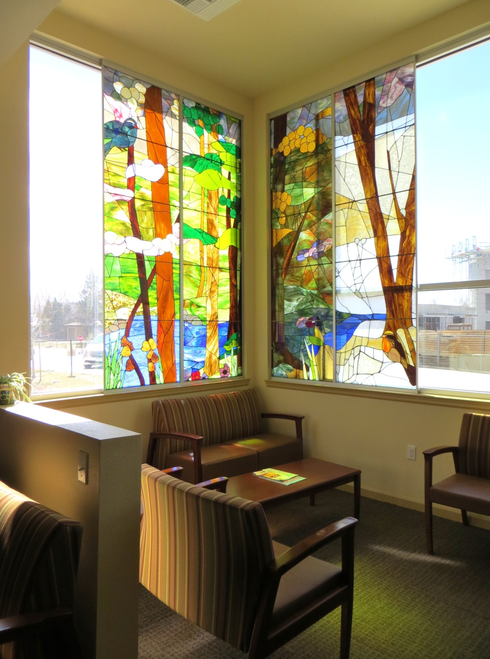
Creating Community
Comfortable areas with warm colors for large gatherings or intimate chats.
Custom Stained Glass in main lobby, depicting the Four Seasons. Each Season is 2 ½’ wide X 10’ tall.

Slide 16
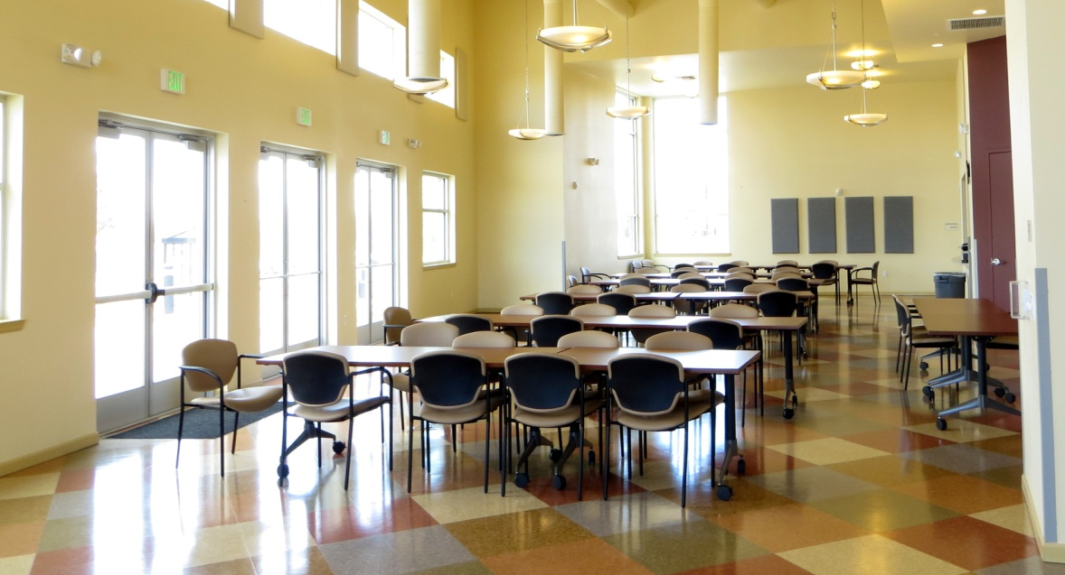
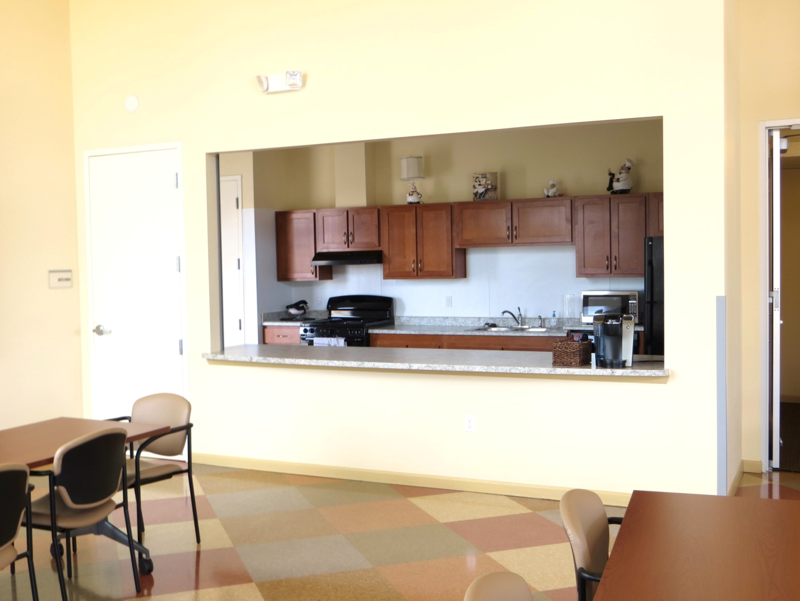
Gatherings big and small
“Rainbow Room”
Seats up to 130 at tables
With community kitchen

Slide 17
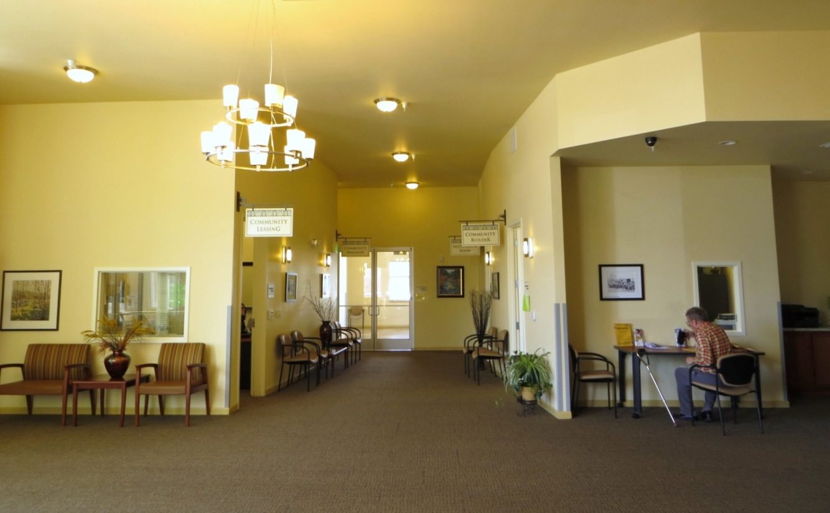
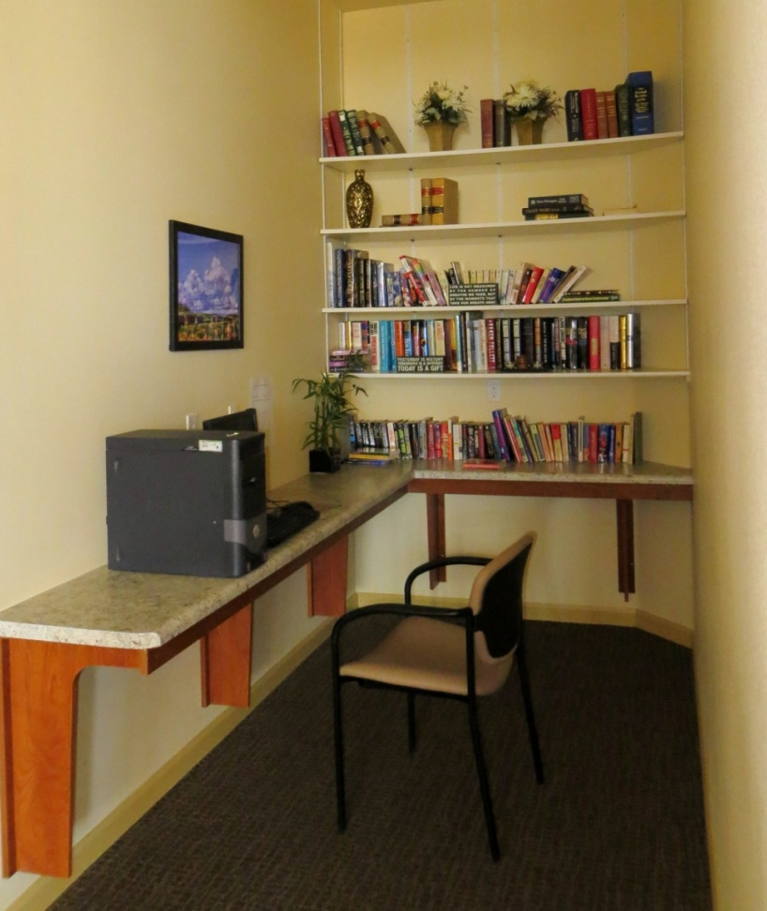
Public and Private Spaces
Lobby looking toward Community Room
Book Nook / Computer Station

Slide 18
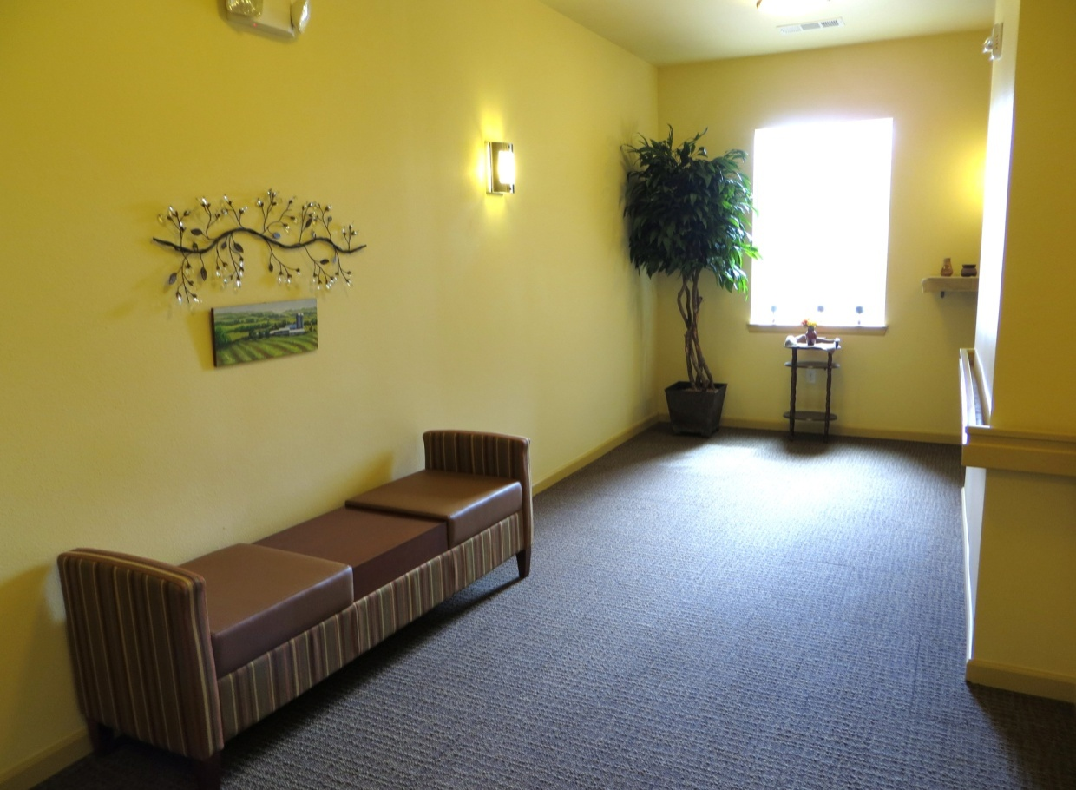
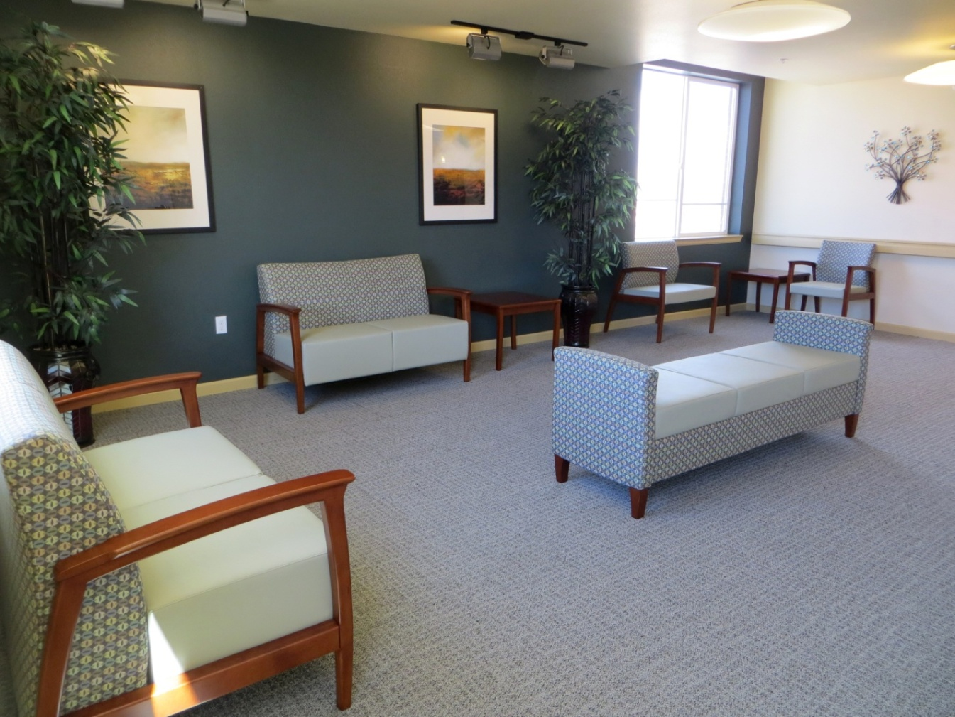
Aging in Place
Each floor has its unique color scheme as a memory device. The first floors colors are warm burgundy and gold.
Third floor seating area. The third floors colors are cool gray and light green.

Slide 19
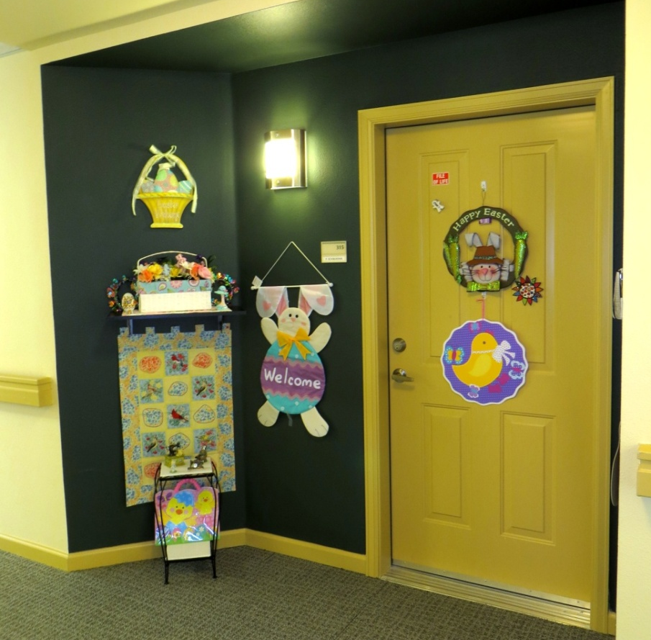
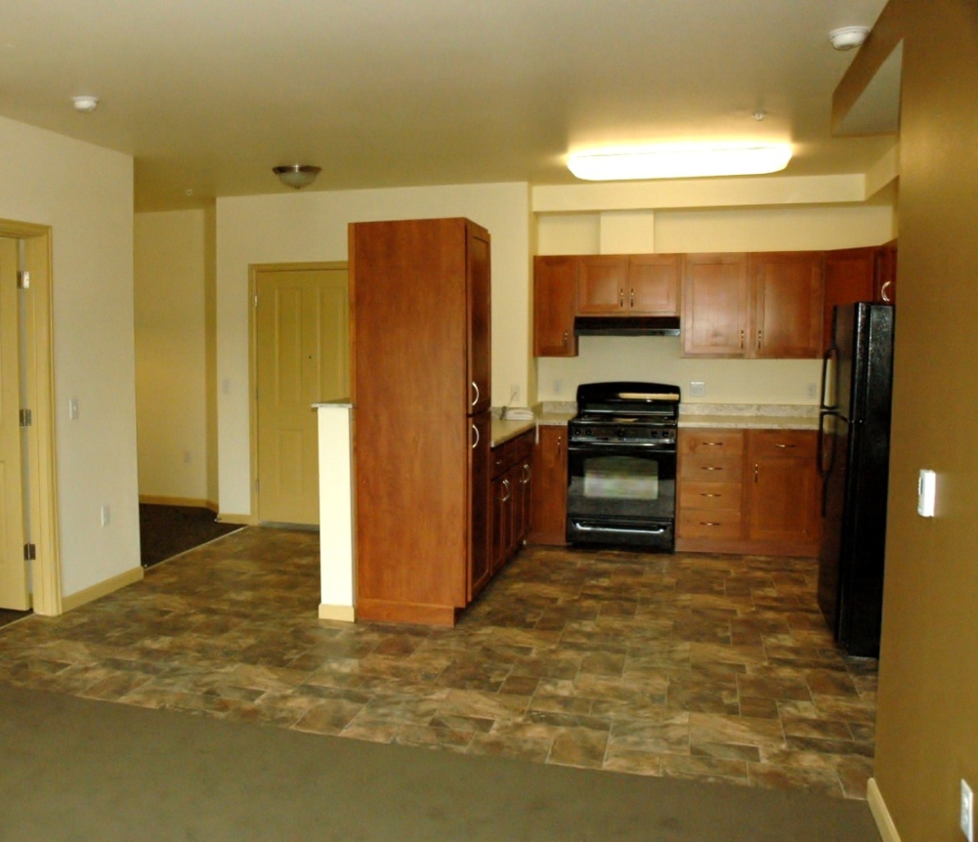
Comfy:
Residents have an inset doorway, with ‘porch’ light, and shelf area to personalize
Utilitarian:
Kitchens contain cherry-wood finished cabinets, large upright pantries, black Energy-Star appliances, and ‘Lazy-Susans’ in each corner cabinet, flooring that looks like ceramic tile, and ‘granite’ Formica.

Slide 20
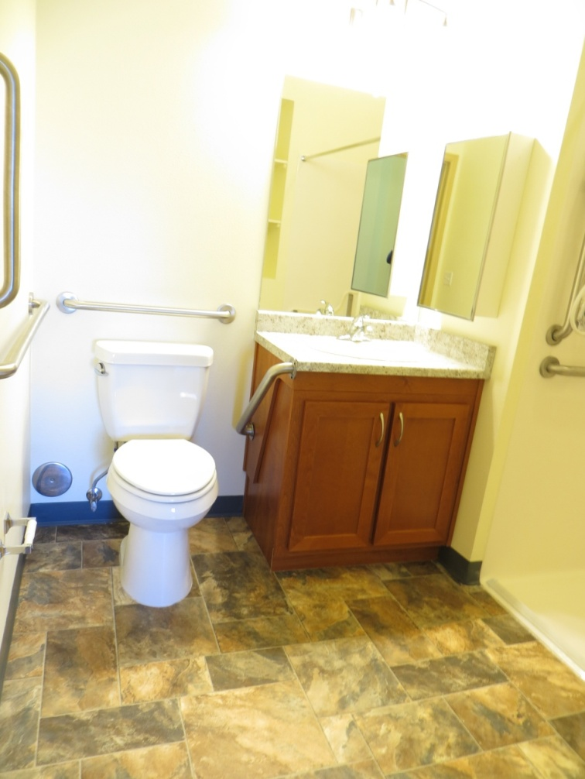
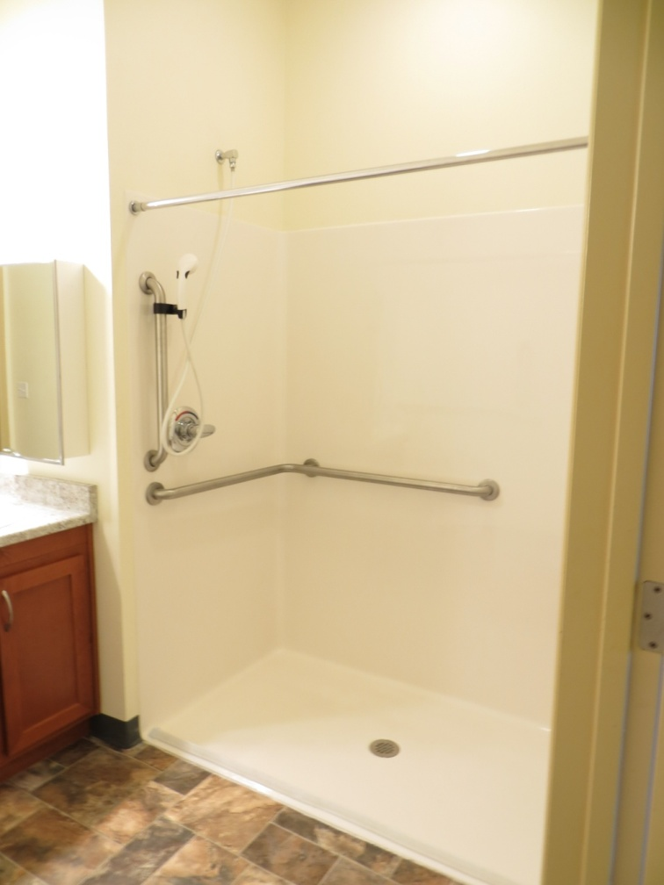
Accessible: Bathrooms have large turning radii, grab-bars, roll-in showers, with low-flow toilets and showerheads. Bathroom cabinet can be easily removed, leaving just the countertop.

Slide 21
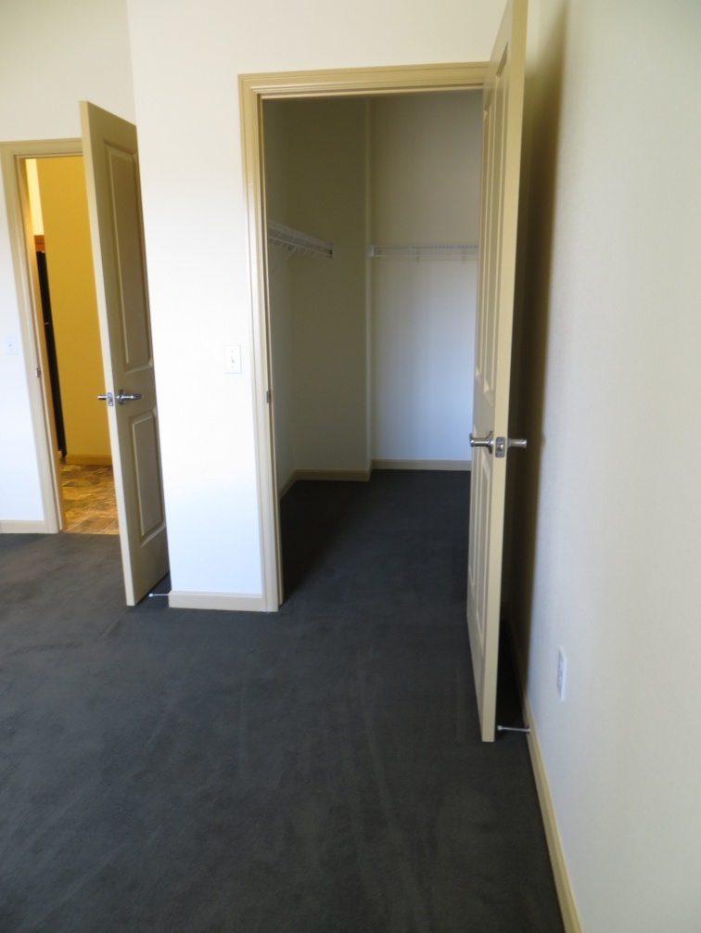
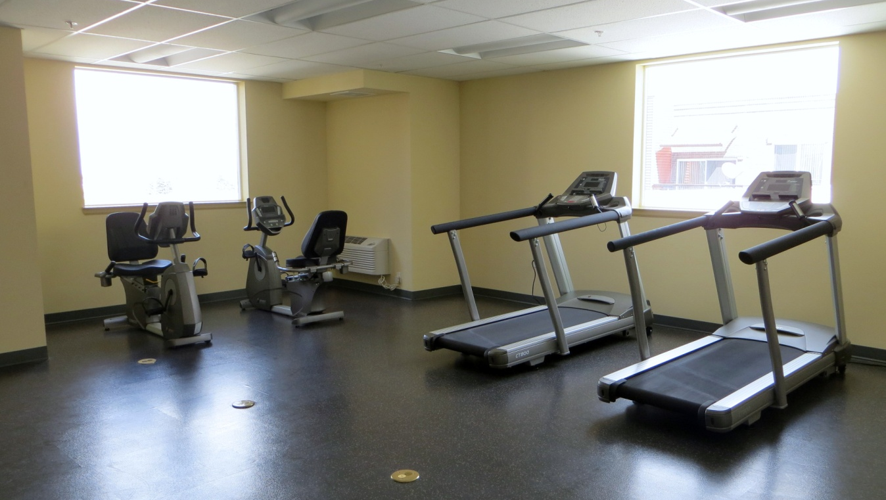
Considerate of next generation of residents
Most bedrooms have large, walk-in closets
Large exercise room on top floor

Slide 22
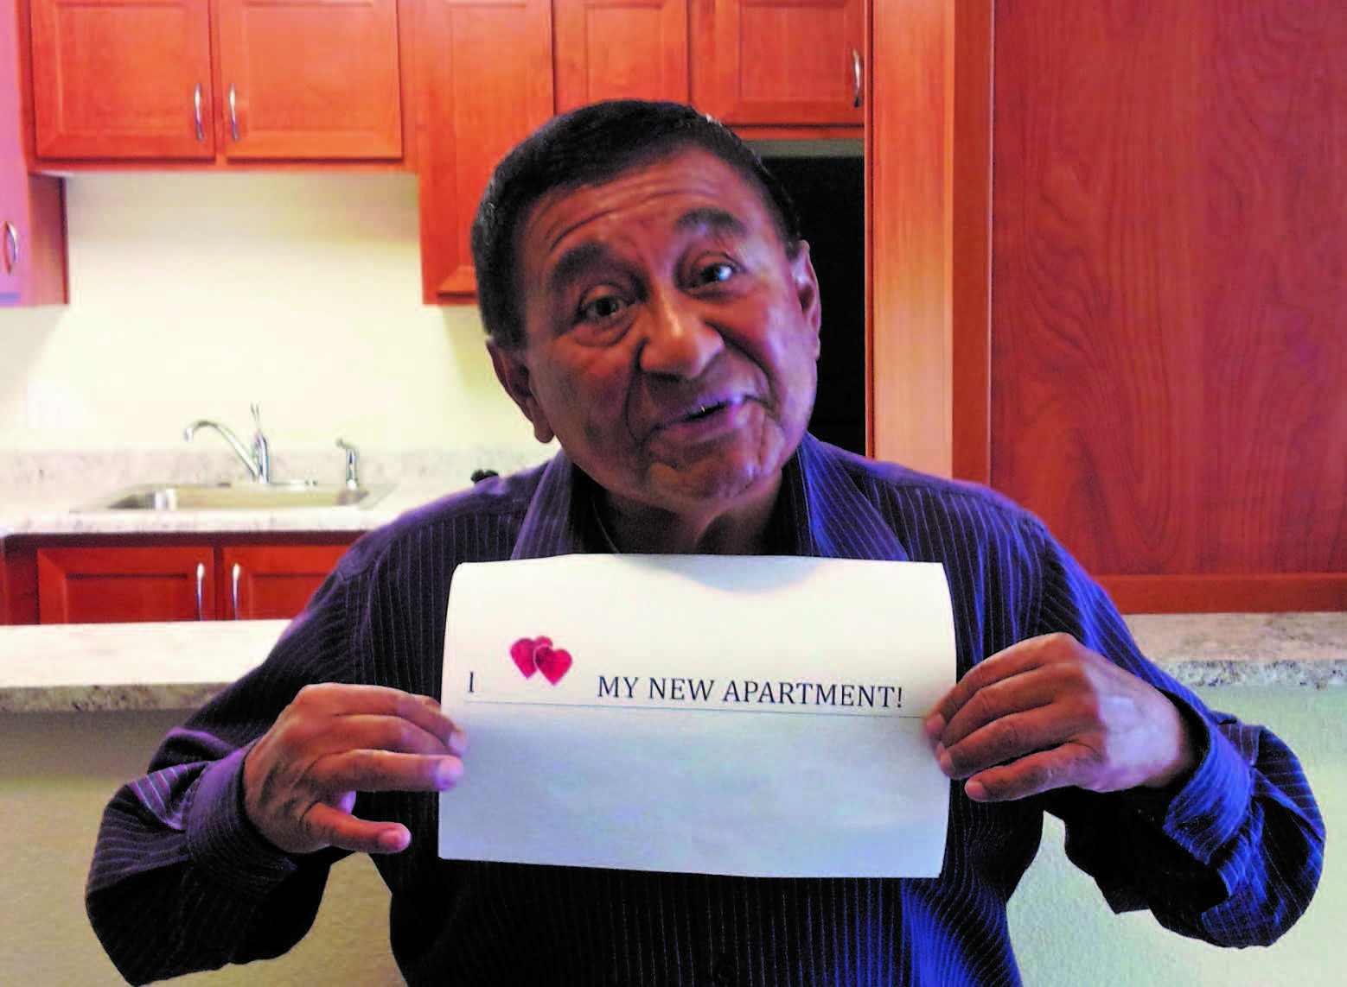
What’s not to love??

Slide 23
Some lessons learned on design/functionality
What I’d Do Again
Community Room -----→
Snow-Melt Sidewalks--→
Community Garden---→
Exercise Room -------- →
Lots of Windows ----- →
“Granite” formica----- →
Low pile carpeting----- →
Phone access system--- →
Lots of outlets --------- →
Reduced Parking ------ →
Dishwashers ----------- →
2-BR units ------------- →
Resident Involvement-→
What I Learned from it
But not a Cavernous Room!
But more of them!
With Raised Beds (done later)
Smaller, not over another unit
Solar cell shades on S & W sides
Rolled edges on countertops
Only in bedrooms
Retro! Intercom, not cell phones
Higher off of floor
Assigned parking
It’s not for this generation
Pros/Cons of Aging in Place
You can’t please ‘em all

Slide 24
Other Lessons Learned
Surprise! Things take longer and cost more.
A good surveyor/utility locator is invaluable.
Get “REAL” references on Lender, Equity Investor, GC
    Don’t just call the references they list, call your NAHRO colleagues or others
      Ask about Lender: how smooth or painful was their conversion to permanent loan?
      Ask about Equity: not just the upfront pricing, what is their compliance like?
      Ask about General Contractor: how do they respond to warranty requests?
    You’re married to them for many years
Constr. Super and Project Mgr WAY more important than the GC.
    A good construction superintendent can make a ‘bad’ GC good;
    a bad construction superintendant can make the best GC look ‘bad’.
    GCs don’t self perform
    Need experience with local government (permitting, inspections, water)
    They need to be firm with their subcontractors
The “little things” that are time vampires
    Utility, telecom, cable, satellite, water, sewer
Need relationship with Title Company
    Get them involved earlier than you think
Hire a Relocation Specialist when doing relocation!
    Get them involved earlier than you think.
    Relocation rules constantly evolving, and complete and thorough files are critical!

Slide 25
Questions?
Thank You!
Elizabeth Gundlach Neufeld
Deputy Executive Director, Property Operations and Development
egneufeld@aurorahousing.org
(720) 251-2075 direct

