Slide 2
Agenda
Why we exist
History & Achievements
Triple bottom line impacts
Programs/Services
Discussion & Questions

Slide 3
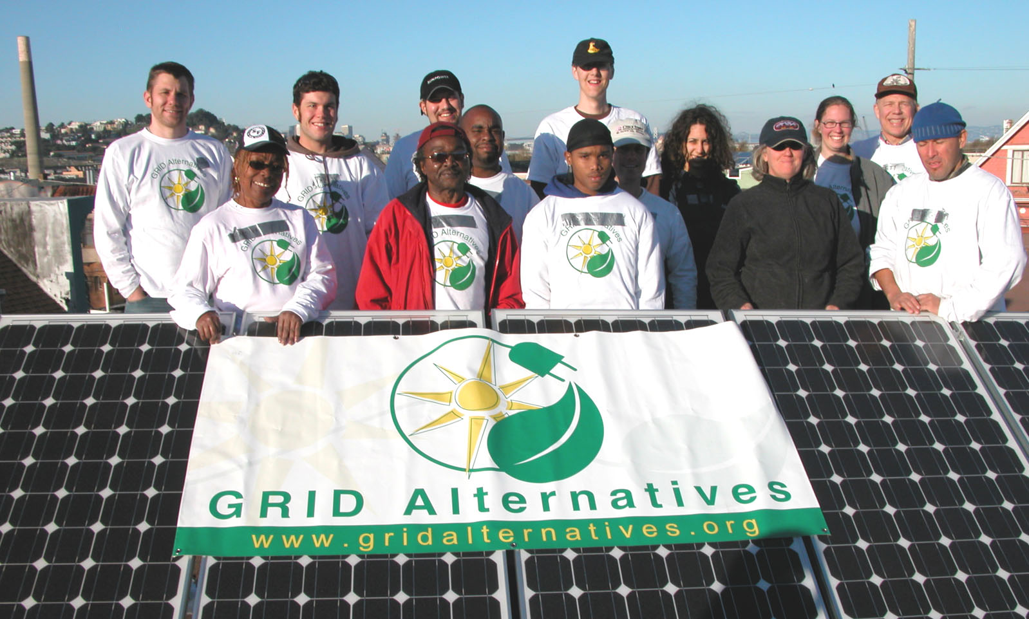
Our Vision
Vision: A successful transition to clean renewable energy that includes everyone
Mission: To make renewable energy technology and job training accessible to underserved communities
A successful transition to clean, renewable energy that includes everyone.

Slide 4
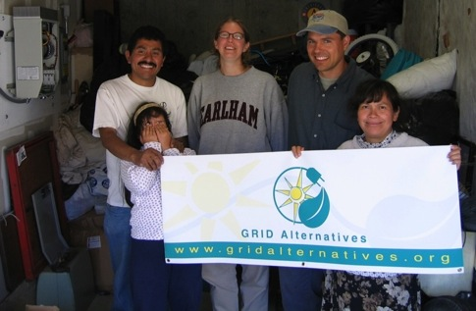
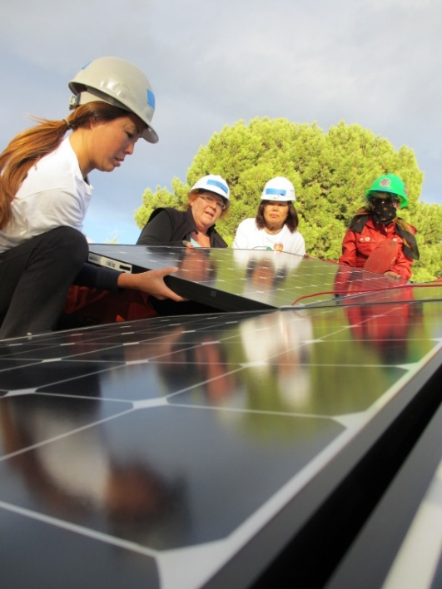
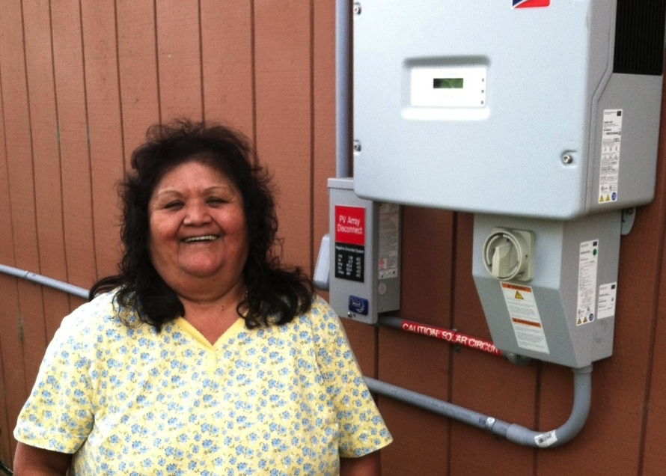
History
First Installation in 2004
National Expansion: Colorado, California, NY Tri-State and Mid Atlantic region
Tribal Solar Initiative
International Program
White House “Champion of Change” Award

Slide 5
Who we partner with
Homeowners
Solar industry
Affordable housing agencies and developers
Municipalities
Corporate sponsors
Job training organizations
Foundations
Community volunteers

Slide 6
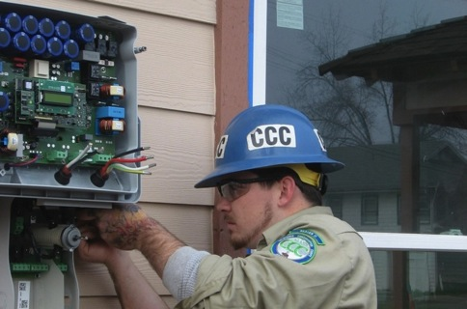
People: Long-term savings for working families struggling to keep up with basic expenses Planet: Reduced greenhouse gas emissions, while showing how pro-solar policies can benefit all of our communities. Employment: Real-world, hands-on training and experience to help workers access jobs in the rapidly growing solar industry
Our “Triple Bottom Line”

Slide 7
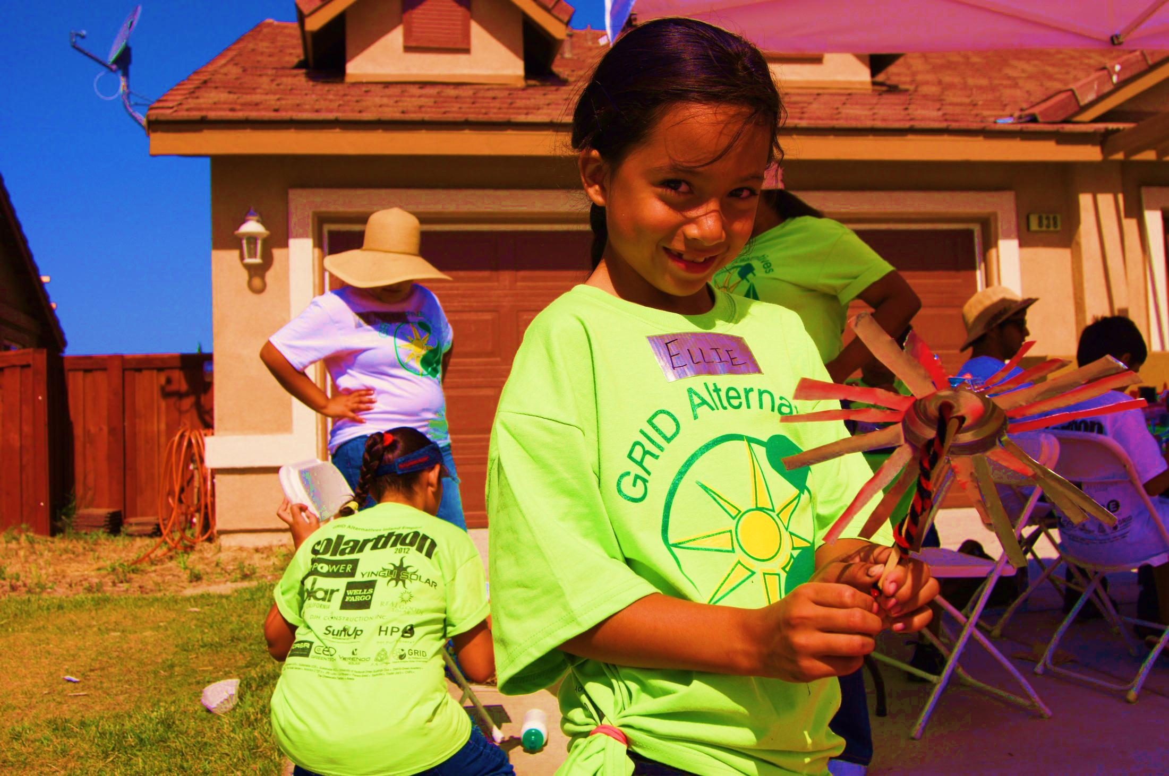
People
People
Over $130 million in savings
5,200 systems installed

Slide 8
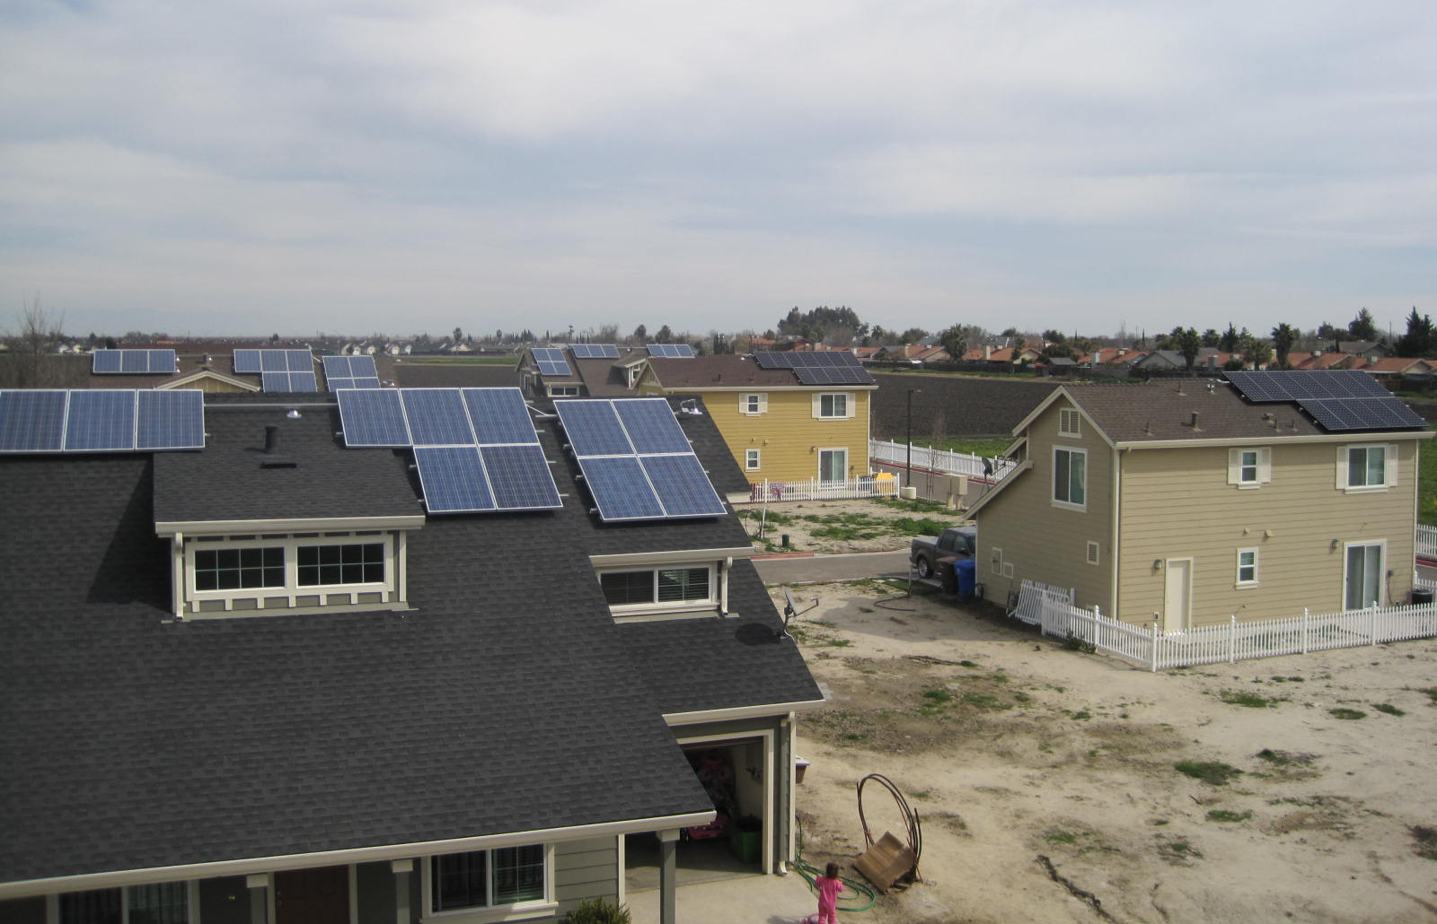
Planet
Preventing 406,000 tons of GHGs
growing 9.5 million trees
Taking 77,500 cars off the road/year

Slide 9
Case study: Templeton

Slide 10
Employment

Slide 11
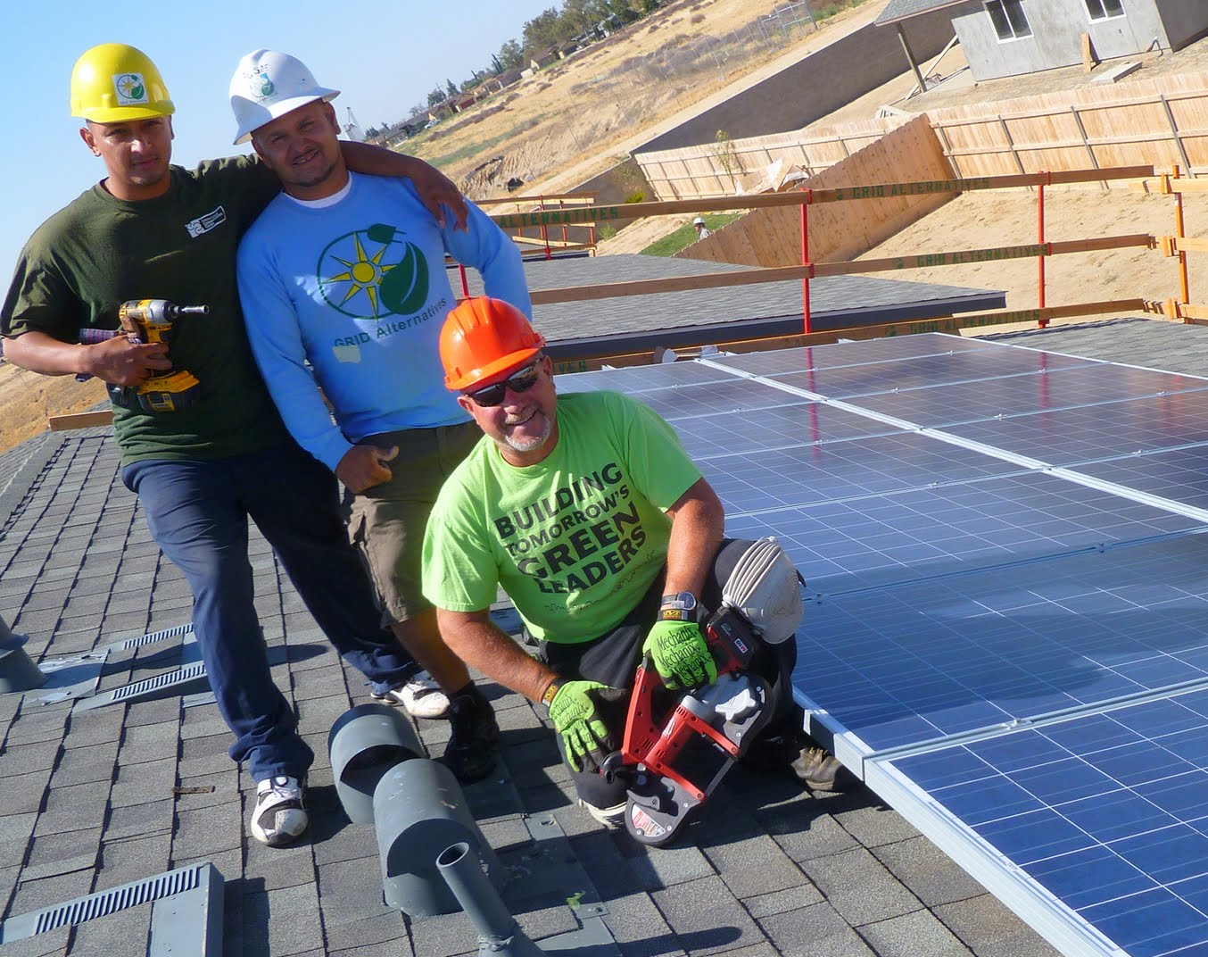
The solar industry
One of the fastest growing industries in U.S:
Adding jobs at a rate 20x the national average
86% growth over last 5 years (80,000 living wage jobs)
36,000 new jobs in 2015
86% of employers reported having a difficult or very difficult time hiring qualified employees
Source- 2014 National Solar Jobs Census

Slide 12
❖ Community college & job training partners  Affordable housing providers  Local governments  Energy efficiency/ weatherization partnerships  Industry partnerships
National Partnership Network

Slide 13
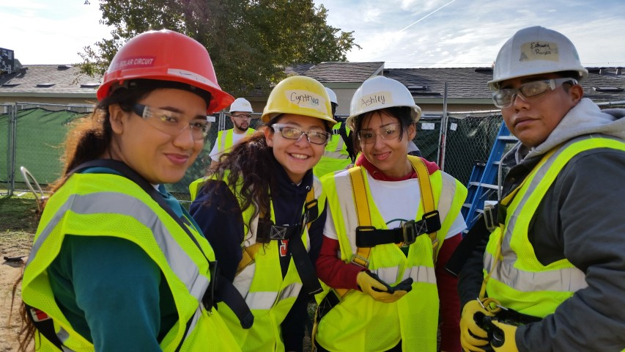
Workforce Development
RISE Initiative
Connecting communities that need good jobs with and industry that needs good people
Focused on recruiting and training more people of color and those who qualify as low-income
Women in Solar
Women’s Leadership Builds
Webinar series and mentorship program

Slide 14
Three Tiers of Training
Basic Training: Introductory workshop + hands-on rooftop training on a GRID installation
Team-leader Program: 160 hours + professional exam (NABCEP) prep
Paid Apprenticeships: Year-long position with GRID leading volunteer teams and installing solar

Slide 15
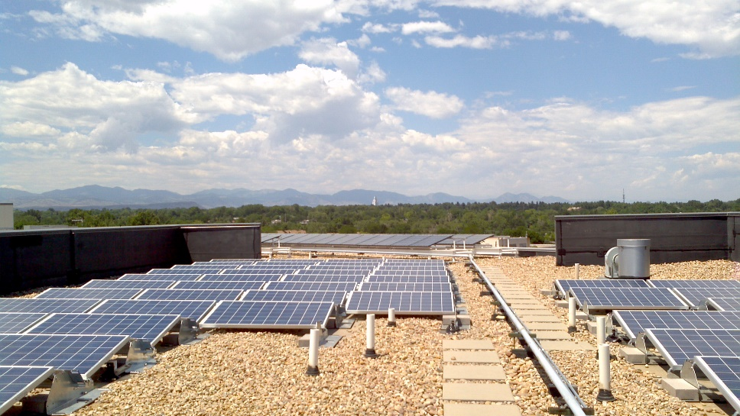
Solar Affordable Housing
Residential Rooftop:
Homeowners who qualify at 80% or below AMI
Community Solar:
Brings benefits to renters, home owner and affordable housing residents and developers
Multi-family Affordable Housing:
Advising HUD on President’s call for 100 MW of solar on federally assisted housing
Commercial scale installations

Slide 16
Why Solar?
Significant long-term Savings
Not subject to rising energy costs
Cost of solar declined by over 65% since 2010
Numerous financial & Tax Credit Incentives
Renewable Energy Credits (RECs)
30% Solar Investment Tax Credit
5-year accelerated depreciation
HUD’s Rate Reduction Incentive
Points for Enterprise Green Communities
Reductions in Green House Gas emissions
Resident Engagement & Training

Slide 17
Who Benefits?
Developers, Owners or Operators who:
Pay utility bill for residents
Have utility bills paid for by HUD
Have residents who are individual metered and receive HUD reimbursement
HUD Rate Reduction Incentive & Energy Performance Contracting
Residents
Who pay their own utility bills
Who are looking for good paying jobs

Slide 18
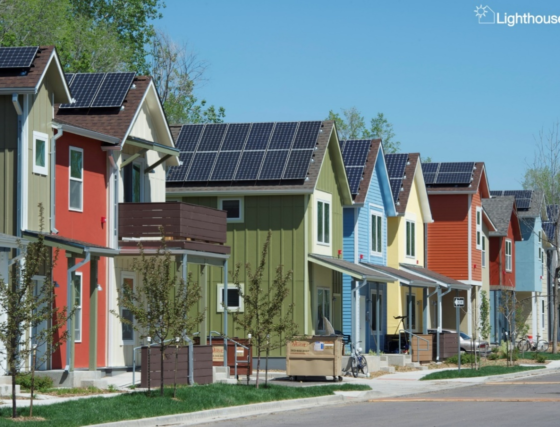
How we Help
Technical Assistance:
Feasibility analysis of properties
ROI analysis and financing options
Installation services:
Savings from Solar = more services & housing
Resident Engagement:
Workforce training
Employment opportunities
Energy efficiency education
Boulder Housing Partners

Slide 19
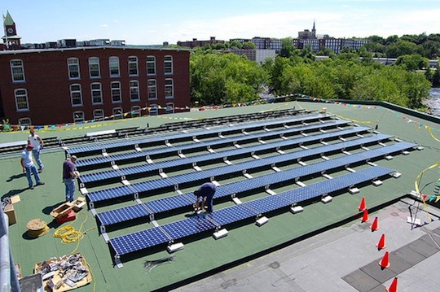
When to Incorporate Solar?
New Construction, Rehab, Refinance:
Easiest time to add solar to financing package & take advantage of 30% Solar Tax Credit
Many funders encourage on-site renewable energy generation and energy efficiency education
Retrofits:
Use GRID Alternatives to help bring in financial solutions
Power Purchase Agreements

Slide 20
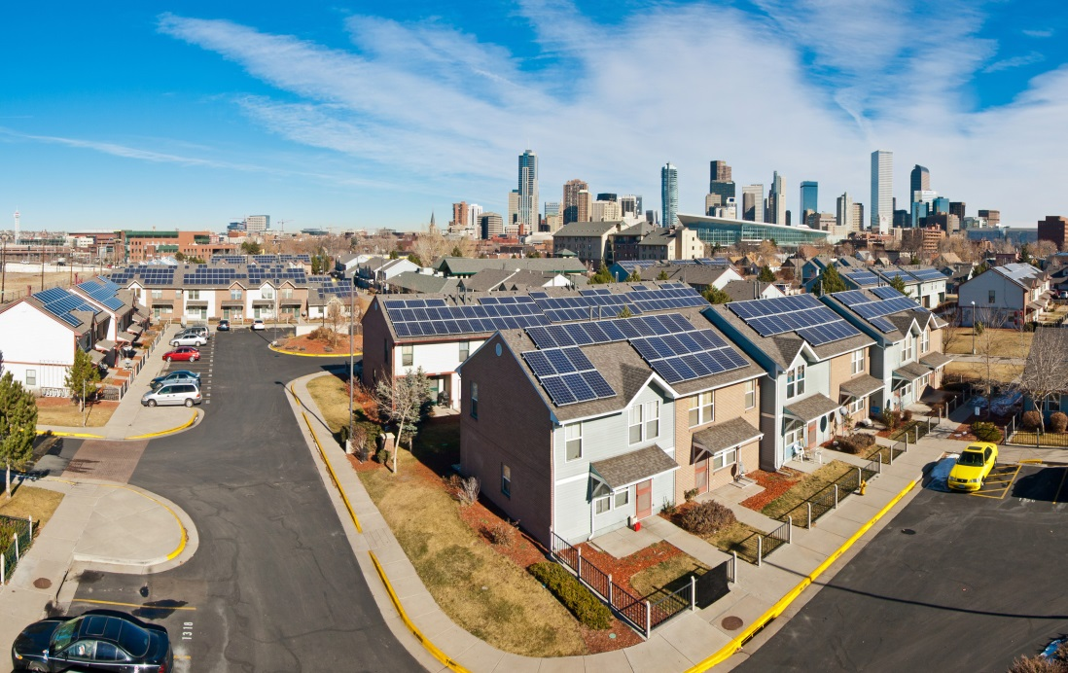
Case Studies
Denver Housing Authority (DHA)
Over 2.5MW of solar installed
Metro West Housing Solutions (MWHS)
50% of energy used from Solar
CRHDC
Saving $12,000/year on project in Delta, CO
Boulder Housing Partners
50% of properties have solar
918kW
Denver Housing Authority

Slide 21
Case Study: CRHDC
Farm worker housing in Delta, CO
42 units built in 2012
70kW system
Financed through 30% tax credit

Slide 22
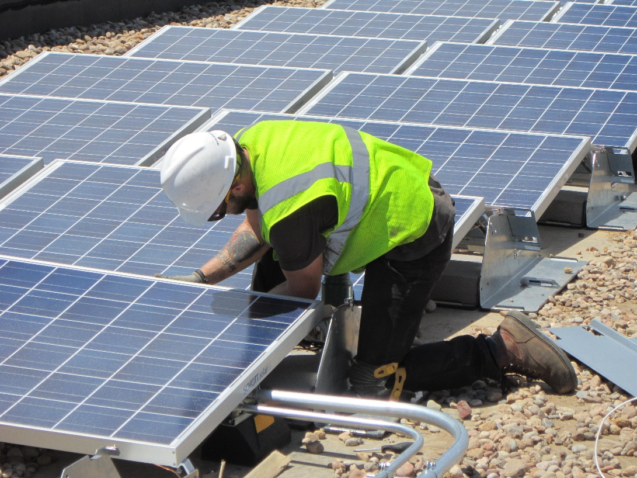
Case Study: CRHDC
Benefits of 70kW Solar Array:
Offsets about 30% of electricity needs
Saves about $12,000 annually
Payback in 10 years
System warrantied for 25 years (will likely last 35+)

Slide 23
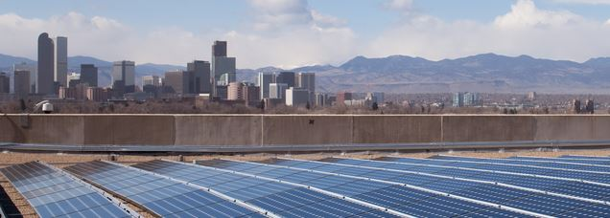
Takeaways & Next Steps?
Solar can save you lots of $.
5-8 year payback is realistic and systems can last 35+ years
GRID Offers free Technical Assistance
Contact Jake- jbobrow@gridalternatives.org
GRID is a licensed contractor & experienced Installer that also provides:
Resident engagement opportunities and energy efficiency education
Comprehensive job training & workforce development program

Slide 24
Thank you!
Questions & Discussion

