Slide 1
Demystifying the Assessment of Fair Housing (AFH)
May 25, 2017
Mollie Fitzpatrick, bbc research & consulting
Crystal latier, el paso county, co

Slide 2
Fair Housing Overview
Fair Housing Act (FHA):
Title VIII of the Civil Rights Act of 1968, prohibits discrimination in the sale, rental and financing of dwellings based on race, color, religion, sex and national origin.
Amended in 1988 to prohibit discrimination on the basis of disability or familial status and to require accessible units as part of multifamily units built after 1991.
Affirmatively Furthering Fair Housing(AFFH):
AFFH provision enacted with the Fair Housing Act (FHA of 1968) and executive orders
The AFFH obligation extends to all federal agencies that administer housing and urban development programs.

Slide 3
Fair Housing Overview
HUD’s AFFH Rule:
Adopted on July 16, 2015, applies to “program participants”—recipients of the CDBG, HOME, ESG, HOPWA—as well as PHAs.
Purpose of rule: “Provide HUD program participants with an approach to more effectively and efficiently incorporate into their planning processes the duty to affirmatively further the purposes and policies of the Fair Housing Act.”
“Refinement” of the Analysis of Impediments to Fair Housing Choice (AI) needed because of lawsuits (Westchester County) and General Accounting Office (GAO) audit
Assessment of Fair Housing (AFH):
Replaces the AI as the HUD mandated review of fair housing
Broader assessment of access to opportunity and housing choice
Additional direction and HUD-provided data through the online AFFH Tool (maps and tables)

Slide 4
the AI becomes the AFH
July 2013
December
31, 2015
HUD issues proposed rule to clarify and strengthen AIs
September 26 – November 24
2014
July 16 – August 15
2015
Happy New Year!
Final AFH released
60-day public
comment
30-day public comment
Final Rule is published
(Supreme Court ruling)
HUD releases a draft assessment tool, called the Assessment of Fair Housing
September 2014
July 16 2015

Slide 5
So… what is the AFH?
The AFH is:
A data- and community-driven approach to assessing segregation and expanding opportunity, among other fair housing issues
Designed to aid local leaders and community stakeholders in developing fair housing priorities and goals that will ultimately increase fair housing choice, build opportunity for all residents, and strengthen communities.
The purpose of the AFFH rule is to set up a framework for taking meaningful actions, to affirmatively further fair housing.
The AFH is that framework.

Slide 6
Primary AFH Topics
Analysis of Fair Housing Issues:
Demographic Summary
Segregation/Integration
R/ECAPs
Disparities in Access to Opportunity
Disproportionate Housing Needs
Publicly Supported Housing Analysis
Disability and Access Analysis
Fair Housing Enforcement, Outreach Capacity, and Resources Analysis
Goals and Priorities

Slide 7
AFH Requires Community Input
AFH Community Participation Requirements
Update Citizen Participation Plan to include AFH.
Make AFH data available to the community and provide opportunities for meaningful participation
Provide opportunities for the public to be involved in developing the AFH and setting goals and priorities
Ask, “who is missing from the process?” and seek them out
Summarize all comments obtained in the community participation process. Include a summary of any comments or views not accepted and the reasons why. Similar to Con Plan requirements.
Hold at least one public hearing before draft AFH released
Minimum 30 day public comment period

Slide 8
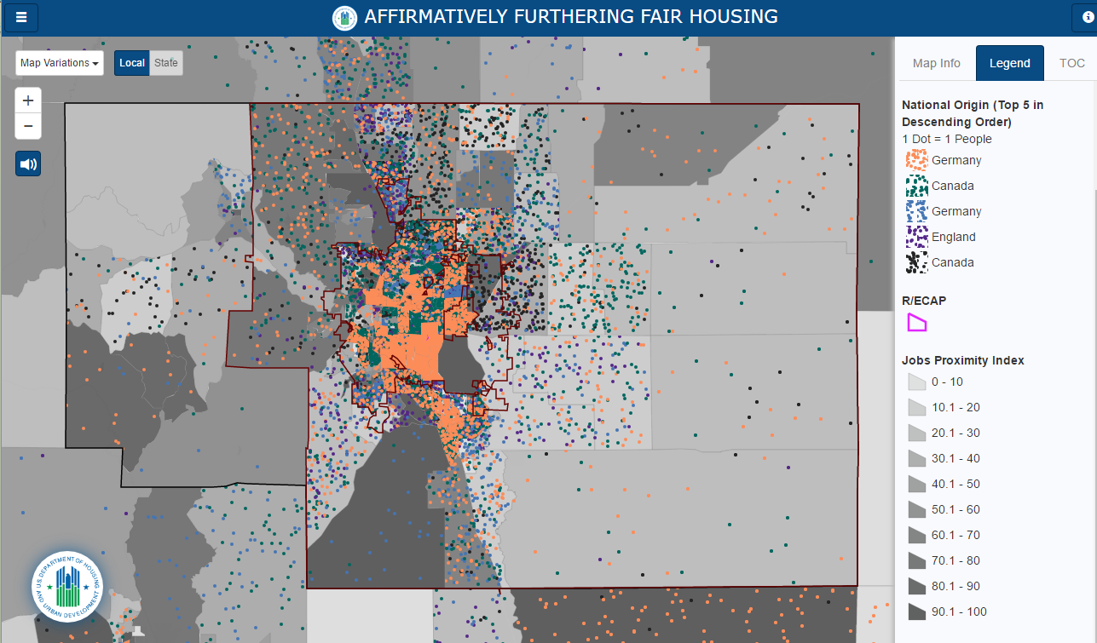
AFFH Data Mapping Tool
Notes:
17 maps and 16 tables

Slide 9
Opportunities for Collaboration
Regional: when two or more entitlements collaborate on an AFH
Joint: when an entitlement and a PHA collaborate on an AFH
Individual: when and entitlement or a PHA submit their own AFH

Slide 10
AFH Implementation
Things we like about the AFH
The AFH is a well thought out, research-based approach to improving the lives of everyone in a community.
A primary purpose of the AFH is building a foundation for long-term economic returns.
The AFH tool/guidance can help determine where communities can best intervene to affect positive change.
The AFH tool, being more prescriptive than the AI, offers communities assurance that they are meeting HUD’s expectations.

Slide 11
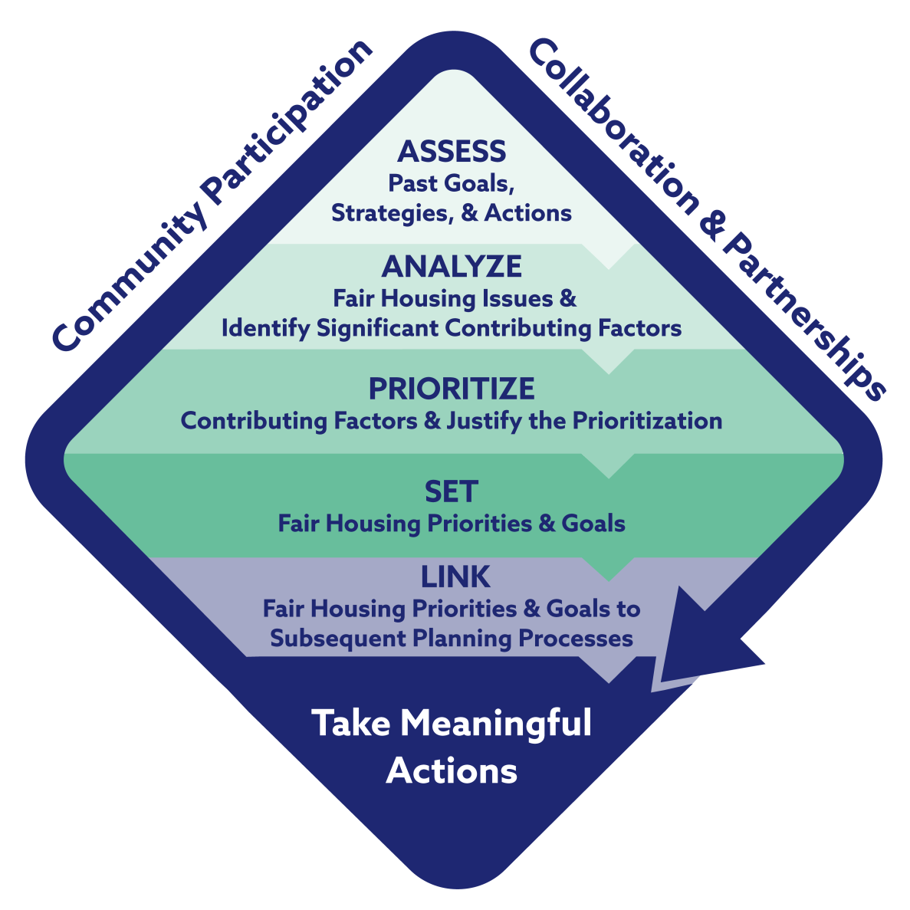
AFH Process

Slide 12
AFH Tool Background
The requirement to complete the Assessment of Fair Housing (AFH) Tool came out of the recent AFFH Rule
AFH replaces the Analysis of Impediments (AI)
HUD FHEO is now providing a template for the plan and nationally uniformed data
Goal of the Tool is to help communities “take meaningful actions, in addition to combating discrimination, that overcome patterns of segregation and foster inclusive communities free from barriers that restrict access to opportunity based on protected characteristics”
AFH Tool priorities, goals and actions must now be incorporated in Consolidated and Annual Action Plans

Slide 13
El Paso County, Colorado - Background
Population: 622,263 (of which 416,427 reside in the city of Colorado Springs)
Over 2,000 sq. miles
8 municipalities (Colorado Springs, Calhan, Fountain, Green Mountain Falls, Palmer Lake, Ramah, Manitou Springs and Monument) and large unincorporated area/population
Diverse areas including rural farming land, populated urban areas and less dense mountainous areas
Known for conservative politics

Slide 14
El Paso County, Colorado - Entitlement Community and PHAs
Designated an Urban County Entitlement Community in 2009
El Paso County’s 2016 CDBG allocation is $938,995
Serve low- to moderate-income residents throughout the county (unincorporated plus seven participating municipalities, excluding the City of Colorado Springs (Colorado Springs is an entitlement and has been receiving HUD funds since the 1970s)
Two Public Housing Authorities – Fountain Housing Authority and Colorado Springs Regional Housing Authority

Slide 15
El Paso County, Colorado - AFH Details
El Paso County was the first and only Region VIII submitter in the 2016
The El Paso County AFH was due to HUD on October 4, 2016
El Paso County has had two meetings and two conference calls with our Region VIII FHEO Office
El Paso County has no HUD-reported R/E CAPs
The El Paso County AFH was accepted by HUD on December 1, 2016

Slide 16
El Paso County, CO - Implementation Schedule
February 2016 | March 2016 | April 2016 | May 2016 | June and July 2016 | August 2016 | September 2016 | October 2016
Create Public Survey and First Public Meeting Materials | Have Regional FHEO Office Review Survey and First Public Meeting Materials | Hold First Public Meetings at a variety of locations and times Release Surveys | Consults – Various with a special focus on agencies that serve the disabled and Hispanic populations and PHAs | Use all data collected: HUD Mapping & Tables; Surveys; Meetings; Consults; Local Data to work on template | 30-day Public Comment Period (required by AFH Tool) | Finalize Document Final Public Meeting | Submit AFH Tool to HUD HUD has 60 days to approve and request additional information

Slide 17
El Paso County, CO Early Challenges of AFH Implementation
Public/Political Perception of the AFFH Rule and AFH Tool
HUD’s Involvement & HUD HQ’s encouragement to complete regional plans
Resources Needed for Completion: HUD is estimating 200 hours of staff time with no additional planning and administration funding
Guidance with Supplied/Needed Resources: Mapping/Data tool, Secured Systems Interface, AFFH Rule Guidebook (219 pages), AFH Tool Template, Access to Local Data
Guidance on Public Participation/Community Involvement: The AFH Tool requires robust public participation/community involvement. How will that look for our community?
Effective and Realistic Ways to Turn Fair Housing Goals and Priorities into Meaningful Actions: This is a strong theme throughout both the AFFH Rule and AFH Tool and we will be discussing both internally and with our regional HUD office the best way to approach this

Slide 18
HUD Involvement
HUD HQ started off with monthly national conference calls, then it transformed into communities working with their regional FHEO Office
El Paso County has had two meetings and two conference calls with our Region VIII FHEO Office
HUD FHEO Office staff offered to meet with elected officials and/or attend public meetings
HUD FHEO made a few minor comments regarding the AFH draft

Slide 19
Public/Political Perception of the AFFH Rule and AFH Tool
The Final Rule on Affirmatively Furthering Fair Housing was published On July 16, 2015.
Fair Housing Law has not changed
Concern over federal overreach- particularly local planning and zoning codes
Westchester Case and Supreme Court’s Disparate Impact Case
Several discussions were had with elected officials about the AFFH Rule/ AFH Tool

Slide 20
AFH Tool Resources to Consider
HUD Resources: AFFH Rule, AFH Tool Template, AFFH Rule Guidebook, AFFH Data Mapping Tool, HUD YouTube Trainings
https://www.huduser.gov/portal/affht_pt.html#affh
Secure Systems Log-in (to complete the AFH Tool Template):
https://hudapps.hud.gov/login/login_wass_external.fcc?TYPE=33554433&REALMOID=06-baab0df5-575f-1022-a49b-83d8f1ba0cb3&GUID=&SMAUTHREASON=0&METHOD=GET&SMAGENTNAME=-SM-VhDCnCGdwu3fOh0Zpa2OlI%2bk4WtkkqqpBZaCBHIijqHeFEsXqHx2gwUKFRpMjSQF&TARGET=-SM-https%3a%2f%2fhudapps.hud.gov%2fHUD_Systems%2f
Local Data*
Regional FHEO Office

Slide 21
Public Participation
Consultations/ Outreach
Public Meetings
Public Surveys
Comment Period

Slide 22
Primary and Secondary Data Sources
HUD’s Affirmatively Furthering Fair Housing Data and Mapping Tool.
Regional Affordable Housing Needs Assessment
Affordable and Accessible Housing Needs and Barriers
Census Data - multiple year census and ACS data retrieved from census.gov.
El Paso County sponsored Public Meetings and Consults
El Paso County Assessment of Fair Housing Survey
Pikes Peak Area of Council of Governments (PPACG)- FY 2017-2021 Transportation Improvement Program Plan
Colorado Springs Metro Transit Map & Data
Fountain Municipal Transit Map & Data
El Paso County School Districts Map & Data
Colorado Department of Public Health and Environment (CDPHE) PFC Report & Maps
Fort Carson 25-Year Sustainability Goal Plan & other related news articles
Colorado Housing and Finance Authority - Low Income Housing Tax Credit Map & Data.
Department of Regulatory Agencies/Colorado Civil Rights Division
U.S. Department of Housing and Urban Development/Fair Housing and Equal Opportunity

Slide 23
Evaluating R/E CAPs
This is a very important aspect of the AFH Tool
El Paso County does not have any R/E CAPs
If you have R/E CAPs I would strongly encourage you framing goals around addressing them

Slide 24
Goals
AFH Goal #1: Improve access to transportation services and infrastructure, remove impediments to mobility and increase access to opportunities
AFH Goal #2: Assist in the development of additional publicly- supported affordable housing units in areas of opportunity
AFH Goal #3: Rehabilitation of pre-existing housing inventory to increase affordable, accessible housing choices
AFH Goal #4: Increase fair housing education, outreach and enforcement
Carefully examine: metrics, milestones, and timeframe for achievement

Slide 25
AFH Process
Assessment: assessing past goals, strategies and actions relating to the El Paso County Analysis of Impediments which was adopted in 2010.
Analyzing: collecting data (through reliable and credible federal, state and local sources) and public input (through the community efforts and local agency collaboration and partnerships) to analyze fair housing issues and identify significant contributing factors
Prioritizing: review and prioritization of present statistically significant contributing factors which affect fair housing in the region
Goal setting: El Paso County set housing priorities and goals to address current statistically significant present fair housing issues and contributing factors
Coordination: El Paso County plans to coordinate and incorporate the priorities and goals into strategies and actions included in the 2017-2021 Consolidated Plan and subsequent Annual Action Plans

Slide 26
HUD Response
El Paso County’s Assessment of Fair Housing (AFH) was approved on December 1, 2016
Analyzing Segregation Data & Maps
Racially or Ethnically Concentrated Areas of Poverty (R/E CAPs)
Access to Opportunity
Disability and Access
Fair Housing Goals and Priorities

Slide 27
Final Lessons Learned
Political Affects
Robust Community Participation/Outreach
Resources Needed
Goals
Long Term Program Administration Effects

