Slide 1
INTRODUCTION
TO
MINDFULNESS

Slide 2
Have you ever been in a mental state that was not effective for the situation?
When did you notice, if at all?
Would the situation have been different if you caught it earlier?

Slide 3
Define mindfulness
Learn the science
Two areas for practice
Attention
Awareness

Slide 4
The awareness that arises from paying attention
On purpose
In the present moment
Without judgement

Slide 5
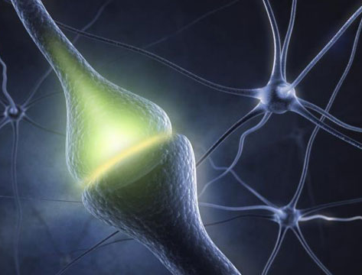

Slide 6
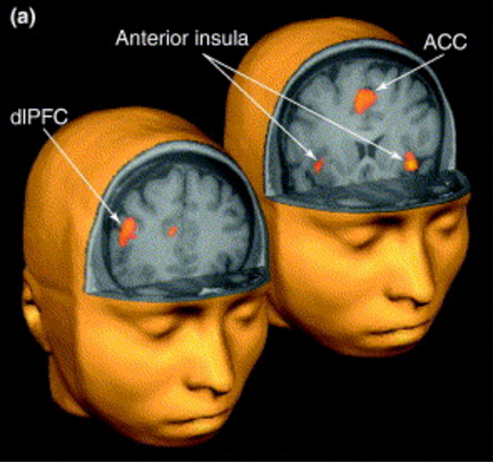
Meditation ↑ Cortical Thickness

Slide 7
Corporate programs shown to improve productivity, performance, and resilience
Aetna
Increase in productivity: Gain of 62 minutes per week in productivity, valued at $3,000 per employee
Reduction in stress: 36% decrease in perceived stress and improvements in heart rate measurements, suggesting bodies were better equipped to manage stress
Improved physical health: 7% lower health care costs
Source: American Psychological Association
Service industry
For employees working in emotionally demanding jobs, mindfulness
promotes job satisfaction
helps prevent burnout in terms of emotional exhaustion
Source: Hülsheger et al, 2012
Office based middle managers
Improvements in
work related stress
job satisfaction
psychological distress
employer related job performance
Source: Shonin et al, 2014

Slide 8
ATTENTION

Slide 9
Notice breath
Mind wanders
Notice mind wanders
Return attention to breath

Slide 10
How was this exercise?
What did you notice?
How can it help?

Slide 11
BREAK

Slide 12
AWARENESS

Slide 13
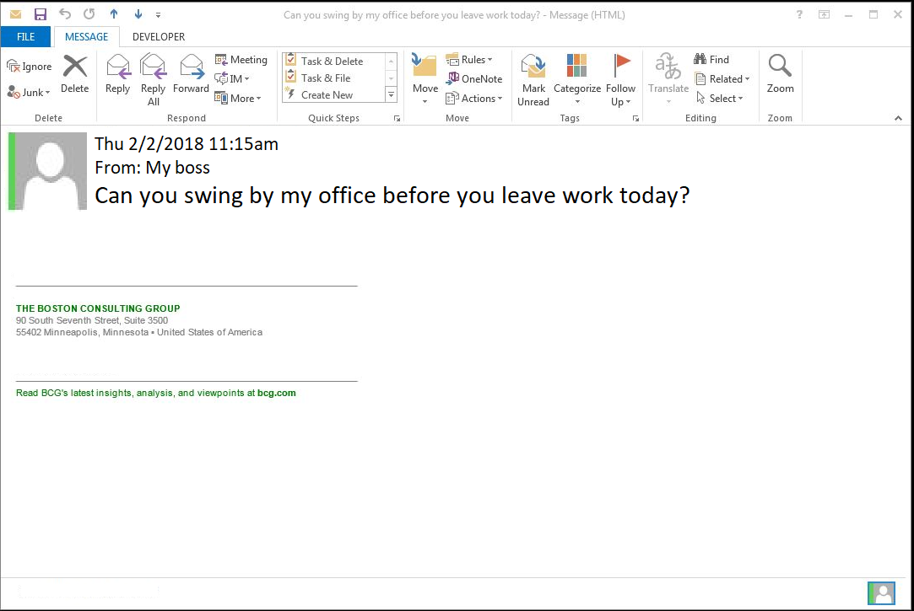

Slide 14
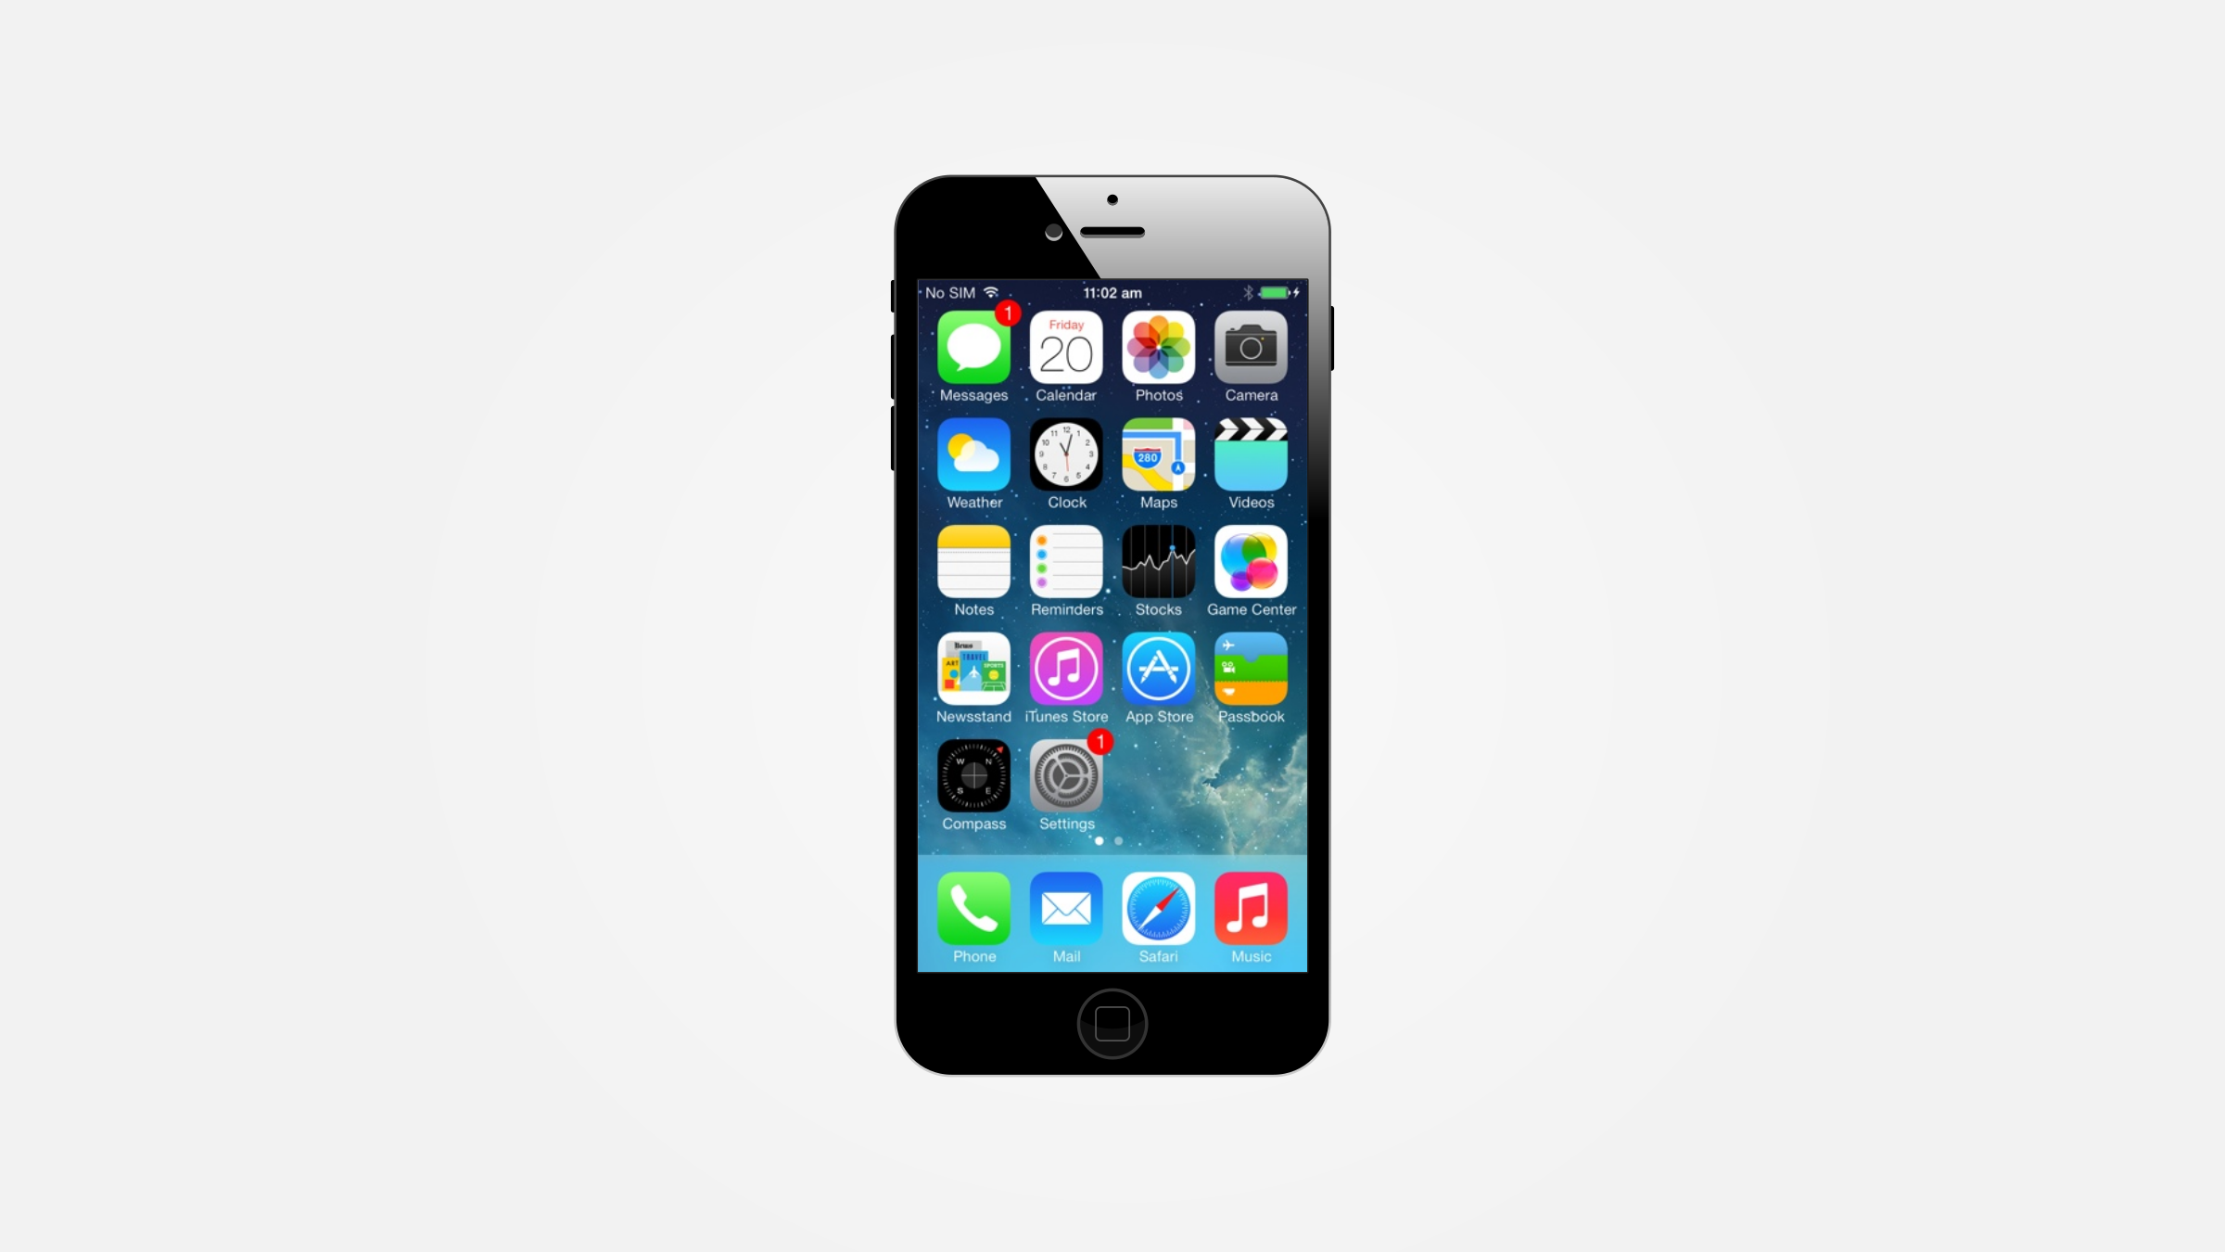

Slide 15
Biologically based reactions that organize an individual’s response to important events and are composed of a…
Physiological response
Subjective experience
Expressive behavior

Slide 16
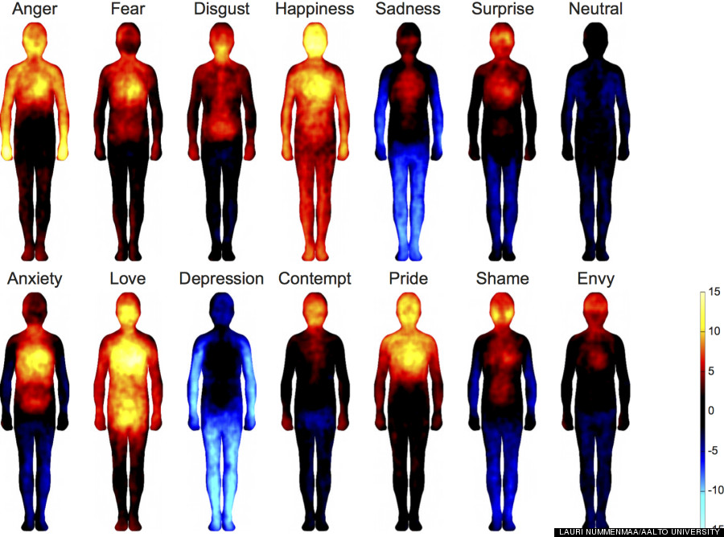

Slide 17
S top
T ake a breath
O bserve
P roceed

Slide 18
How was this exercise?
How can it help?
When would you use it?

Slide 19
RECAP

Slide 20
WHAT NOW?
Pick one:
Focused attention training, 1 min daily
Mindful email every time you check your email
STOP, at least once daily
One breath, at least once daily

Slide 21
What is one thing I learned?
What is one thing I am inspired to do now?

