Slide 1
Urban Peak
Colorado Springs
Audrey Field, Deputy Director/Director of Programs
Audrey.Field@urbanpeak.org
719-630-3223 Ext 2826

Slide 2
URBAN PEAK IGNITES THE POTENTIAL IN YOUTH TO EXIT HOMELESSNESS AND CREATE SELF-DETERMINED, FULFILLED LIVES.

Slide 3
Urban Peak Colorado Springs helps youth ages 15 through 24 become self-sufficient by providing a convergence of services including:
Street Outreach
Education & Employment
Health Services Coordination
Shelter
Housing
Development

Slide 4
PROGRAM RESULTS
Total Unduplicated Youth Served by Program
 | FY 2015 | FY 2016 | FY 2017 | % Change
Education & Employment | 102 | 115 | 133 | 15%
Shelter | 143 | 146 | 170 | 16%
Housing | 41 | 49 | 51 | 4%
Outreach & Drop In | 445 | 468 | 569 | 22%
Health Services | 155 | 194 | 183 | 6%
Total Unduplicated Youth | 528 | 557 | 653 | 17%

Slide 5
Demographics

Slide 6
Demographics
55% of youth served – Disabling Condition
40% identified having a mental health concern
32 individual youth turned away from shelter – 40 total turn aways
Notes:
Age breakdown is (Outreach, Shelter and Housing youth combined) – see how our age ranges have shifted from FY 16 – 17 with the 18-20 and 21-24 age ranges evening out more. Most commonly served client in shelter and outreach is 20 years old, and in housing it’s age 22
55% of youth self-identified having a disabling condition (mental health, substance abuse, chronic illness, developmental disability, etc.)
40% of those identified as having a mental health concern –
Youth turned away from the shelter was down significantly this year – only 32 youth turned away vs 120 in FY 16 – we saw a lot more vacancies in the shelter this year

Slide 7
Housing Overview
Permanent Supportive Housing (PSH)
Youth with documented disabilities & chronically homeless youth
Ages 18 - 24
15 apartments with Greccio Housing & Private landlords
Length of stay = typically 2-3 years
Rapid Re-Housing
Homeless youth & young families
Ages 18 – 24
Length of stay = up to 24 months
Savings program
Served 20 youth in FY17
UPCS served 26 new youth in the Rapid Re-Housing Program in FY 17
CoC RRH & ESG RRH grants
2 – CoC PSH grants
PT Case Manager
Homeless Prevention
Youth and young families at imminent risk of becoming homeless
Rental assistance to prevent them from becoming homeless
UPCS served 5 youth in the Homeless Prevention Program
Quarter time Case Manager
ESH Prevention grant
Transitional Living Program
Homeless youth & pregnant or parenting youth
Ages 16 – 21
Length of stay = up to 18 months
8 Units – provided by Partners In Housing
2 full time Case Managers & 1 Direct Care staff
HHS – Transitional Living Program grant
Notes:
UPCS Housing Programs:
Rapid Re-Housing – This program provides rent and utilities assistance, and a moderate level of case management support to youth for up to a 24-month timeframe but typically for 12 months or less. Services are tiered in a manner to support youth steadily gaining independence and self-sufficiency to be on their own. Youth must be already working or currently employable.
Homeless Prevention Funds – A program that helps youth avert homelessness if they hit a stumbling block such as a job loss or big car repair bill. This funding is typically for 3 months or less of rent assistance and utility bill payments.
Permanent Supportive Housing – This housing program includes rent, utility payments, counseling and other intensive case management support focused on youth with the highest needs. UPCS has 8 dedicated housing units for youth with a diagnosed disability and this year received 7 dedicated units for chronically homeless youth. Some youth may gain jobs or attend school, but it is not required. We partner with Greccio Housing for some of these apartment units.
Chronically homeless: Definition of Chronically Homeless: Being homeless more than 4 times in 3 years for a total of a year

Slide 8
Housing Overview
CoC Permanent Supportive Housing Vouchers
Documented disabilities, chronically homeless youth and young families
Ages 18-24
10 Vouchers
FT Case Manager
CoC PSH grant – partnership with DOH
Will start July 2018
All open housing resources are filled through community coordinated entry process
Notes:
UPCS Housing Programs:
Rapid Re-Housing – This program provides rent and utilities assistance, and a moderate level of case management support to youth for up to a 24-month timeframe but typically for 12 months or less. Services are tiered in a manner to support youth steadily gaining independence and self-sufficiency to be on their own. Youth must be already working or currently employable.
Homeless Prevention Funds – A program that helps youth avert homelessness if they hit a stumbling block such as a job loss or big car repair bill. This funding is typically for 3 months or less of rent assistance and utility bill payments.
Permanent Supportive Housing – This housing program includes rent, utility payments, counseling and other intensive case management support focused on youth with the highest needs. UPCS has 8 dedicated housing units for youth with a diagnosed disability and this year received 7 dedicated units for chronically homeless youth. Some youth may gain jobs or attend school, but it is not required. We partner with Greccio Housing for some of these apartment units.
Chronically homeless: Definition of Chronically Homeless: Being homeless more than 4 times in 3 years for a total of a year

Slide 9
The Year In Review
Goal: 75% of youth who exit an Urban Peak Housing Program will exit to a safe and stable environment.
Result: 86% of youth who have exited an Urban Peak Housing Program exited to a safe and stable environment
Notes:
Why people do not exit safely – landlords vs. Urban Peak
Savings when they exit and while they are in the program – how does this work?

Slide 10
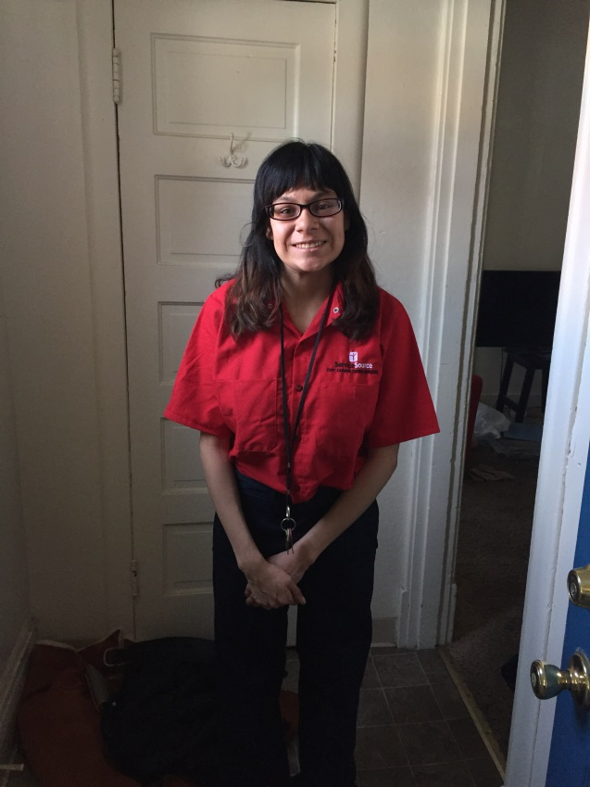
Youth Story
Kimberly
Came to Urban Peak from a Residential Treatment Center
Lived at Urban Peak’s shelter for 5 months and transitioned into Urban Peak’s Permanent Supportive Housing Program
While in PSH, case manager assisted her with obtaining Supplemental Security Income
Obtained employment at Service Source and has maintained this job for a year
After 3 years in PSH, Kim was connected with The Resource Exchange by her case manager to provide ongoing services
Between her SSI and stable employment, Kim qualified for Greccio Housing and moved into her own apartment with her own lease
Notes:
Residential Treatment Center
Urban Peak Shelter
Permanent Supportive Housing
Supplemental Security Income
Service Source
The Resource Exchange
Greccio Housing

Slide 11
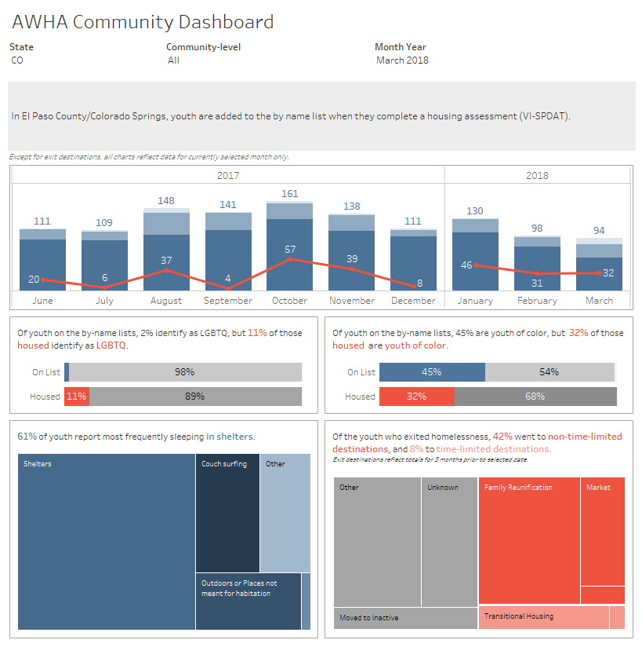
A Way Home America Dashboard
Notes:
July 2017 – joined community dashboard
1 of 13 communities across the country participating
Updated monthly and puts our community in a National spotlight
Helped to move our CoC data tracking forward – pushing for better and more complete information

