Slide 1
Finding Alternative Responses to Conflict
Belinda Waldron, M.Div.

Slide 2
agenda
Introductions
Intentions
Sculpting Activity
Debrief
Takeaways
Evaluations

Slide 3
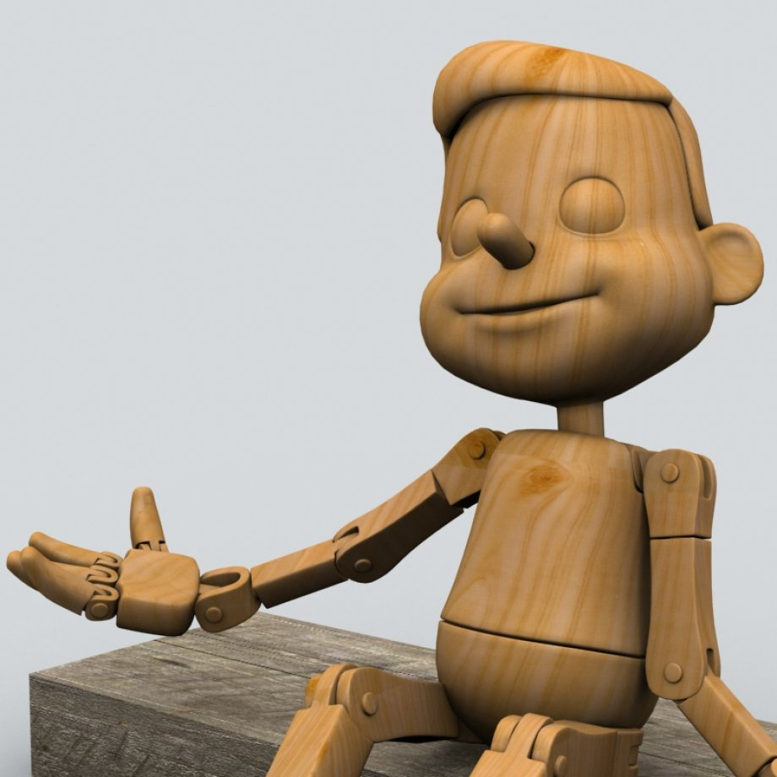
Sculpting: debrief questions
What did it feel like to play that character?
How did you feel when you heard…?
Could you identify with your character?
What did you learn about conflict?
What did you see about what builds or limits positive relationships?
Group members, what were your impressions?
After debriefing, begin a new scenario and change roles.

Slide 4
Sculpting: debrief questions
Lenses
Power
Assertiveness
Principles/beliefs/values
Taking a stand
Caring for self & others
What did it feel like to play that character?
How did you feel when you heard…?
Could you identify with your character?
What did you learn about conflict?
What did you see about what builds or limits positive relationships?
Group members, what were your impressions?
After debriefing, begin a new scenario and change roles.

Slide 5
agenda
Introductions
Intentions
Sculpting Activity
Debrief
Takeaways
Evaluations
Thank you for contributing your insights today!

